Slide 1

UNIT 17:STORIES FOR CHILDREN
LESSON 1 (4, 5, 6)
Notes:
MADE BY FACEBOOK :TRAN THI THANH TAM

Slide 2
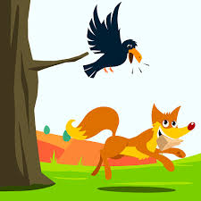
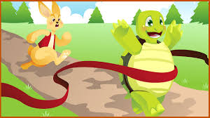
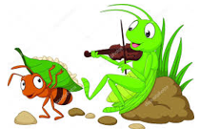
LET’S PLAY: KIM’S GAME
0:0
0:3
0:2
0:5
0:4
0:1
Start
The fox and the crow
The hare and the tortoise
The ant and the grasshopper

Slide 3
Look and check
The fox and the crow
The hare and the tortoise
The ant and the grasshopper

Slide 4

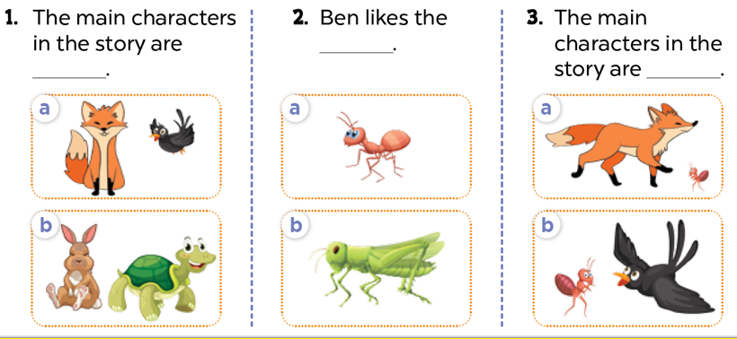
4. Listen and circle
Notes:
MADE BY FACEBOOK :TRAN THI THANH TAM

Slide 5
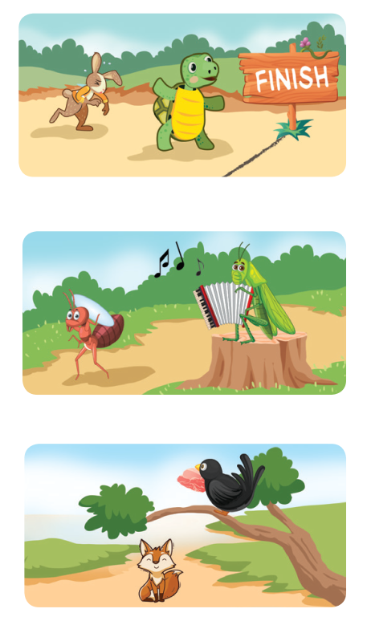
5. Read and complete
2. A: Are the hare and the ___________ the main
characters in this story?
B: Yes, they are.
3. A: Are the ___________ and the grasshopper
the main characters in this story?
B: Yes, they are.
A: Which ___________ do you prefer?
B: I prefer the ant.
4. A: What story are you ___________?
B: I’m reading The Fox and the Crow.
A: Do you like the ___________ or the crow?
B: I like the fox.
Snow White
ant
characters
reading
fox
Notes:
MADE BY FACEBOOK :TRAN THI THANH TAM

Slide 6
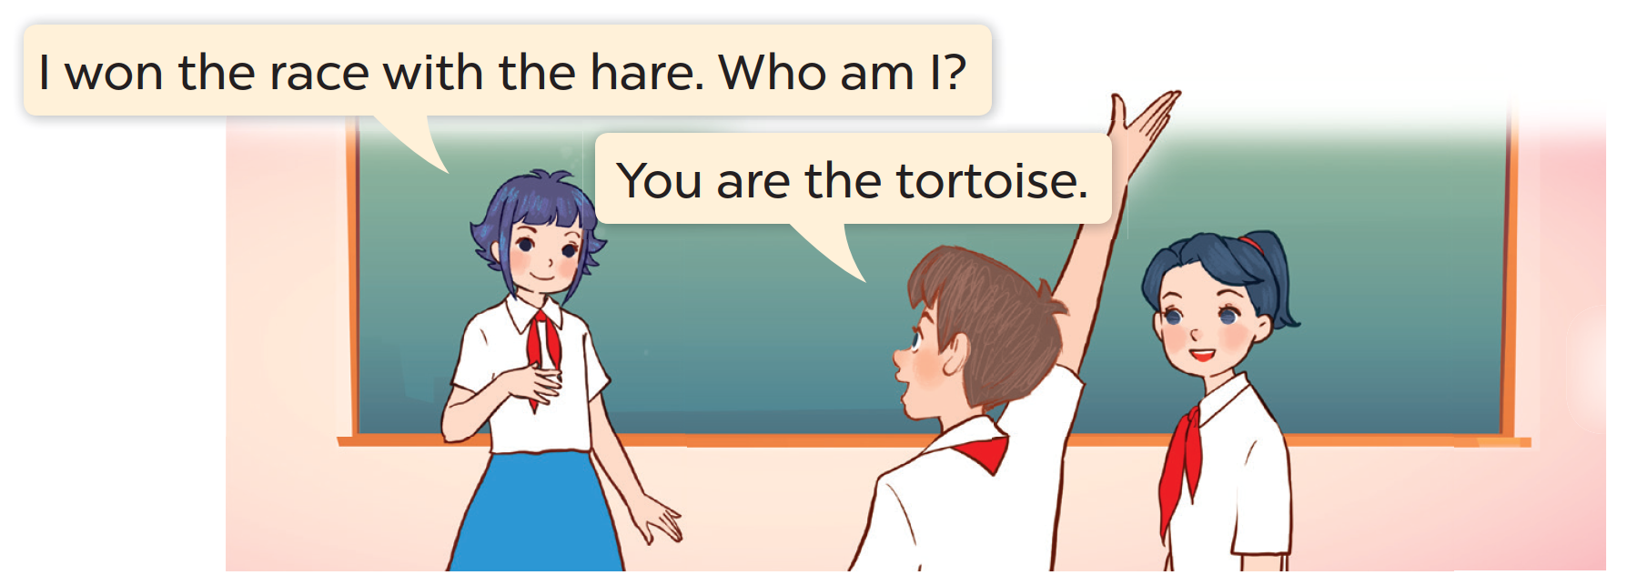
6. Let’s play
Notes:
MADE BY FACEBOOK :TRAN THI THANH TAM

