Slide 1

UNIT 17: STORIES FOR CHILDREN
LESSON 2 ( 1, 2, 3)
Notes:
MADE BY FACEBOOK :TRAN THI THANH TAM

Slide 2

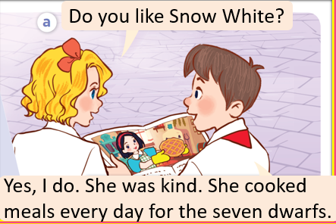
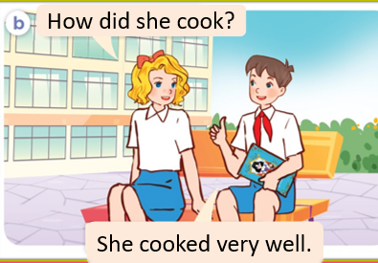
1.Look, listen and repeat
Notes:
MADE BY FACEBOOK :TRAN THI THANH TAM

Slide 3
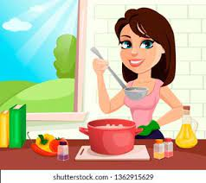
cook well /kʊk wel/ nấu ăn giỏi
Notes:
MADE BY FACEBOOK :TRAN THI THANH TAM

Slide 4
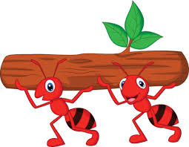
work hard /wɜːk hɑːd/: làm việc chăm chỉ
Notes:
MADE BY FACEBOOK :TRAN THI THANH TAM

Slide 5
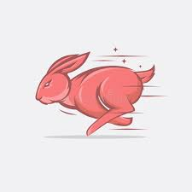
run fast /rʌn fɑːst/: chạy nhanh
Notes:
MADE BY FACEBOOK :TRAN THI THANH TAM

Slide 6

sing beautifully /sɪŋ ˈbjuːtɪfli/
: hót (hát) hay
Notes:
MADE BY FACEBOOK :TRAN THI THANH TAM

Slide 7

VOCABULARY
Cook well: nấu ăn ngon
Work hard: làm việc chăm chỉ
Run fast: chạy nhanh
Sing beautifully: hát ( hót) hay

Slide 8
Guessing
Guessing?
Run fast
Notes:
MADE BY FACEBOOK :TRAN THI THANH TAM

Slide 9
Guessing
Guessing?
Cook well
Notes:
MADE BY FACEBOOK :TRAN THI THANH TAM

Slide 10
Guessing
Guessing?
Sing beautifully
Notes:
MADE BY FACEBOOK :TRAN THI THANH TAM

Slide 11
Guessing
Guessing?
Work hard
Notes:
MADE BY FACEBOOK :TRAN THI THANH TAM

Slide 12
Hỏi và trả lời xem ai đó làm việc gì thế nào
How did she cook?
( Cô ấy nấu ăn thế nào? )
She cooked well.
(Cô ấy nấu ăn ngon.)
Notes:
MADE BY FACEBOOK :TRAN THI THANH TAM

Slide 13
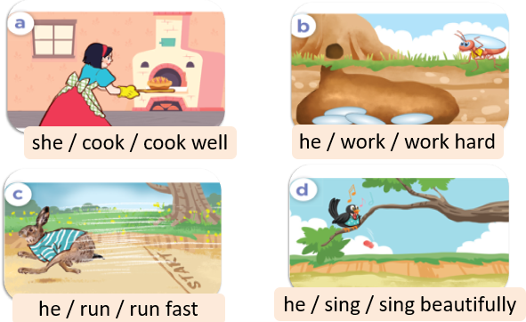
2.Listen, point and say
she cook
cooked well
How did ..................?
She…..................
Notes:
MADE BY FACEBOOK :TRAN THI THANH TAM

Slide 14
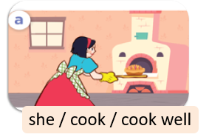
she cook
How did ..................?
cooked well
She…..................
Notes:
MADE BY FACEBOOK :TRAN THI THANH TAM

Slide 15
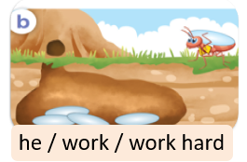
he work
How did ..................?
worked hard
He..…..................
Notes:
MADE BY FACEBOOK :TRAN THI THANH TAM

Slide 16
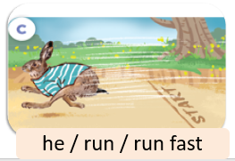
he run
How did ..................?
ran fast
He….................
Notes:
MADE BY FACEBOOK :TRAN THI THANH TAM

Slide 17

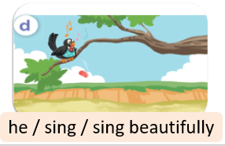
he sing
How did ..................?
sang beautifully
He.......…..................
Notes:
MADE BY FACEBOOK :TRAN THI THANH TAM

Slide 18
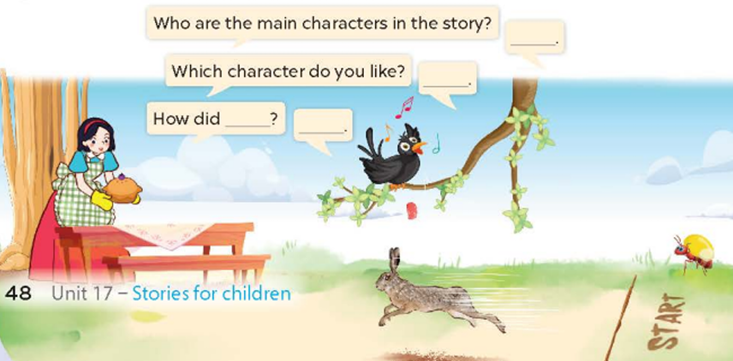
3. Let’s talk
Notes:
MADE BY FACEBOOK :TRAN THI THANH TAM

Slide 19

LUCKY CHICKENS
Notes:
MADE BY FACEBOOK :TRAN THI THANH TAM

Slide 20

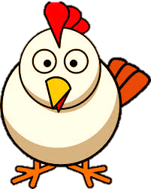
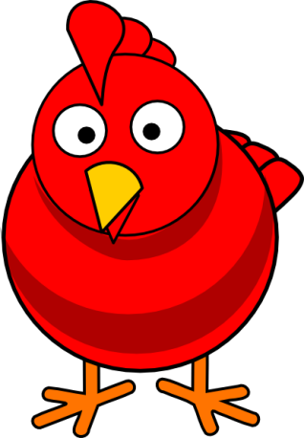
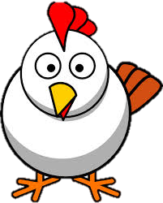
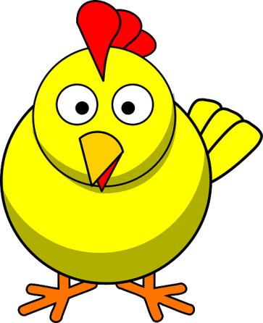
LUCKY CHICKENS
Next Activity
Notes:
Students choose one chicken and answer the question. Answer correctly, get 1 point.
There are three lucky chickens. Choose the lucky chicken, immediately get 5 points.

Slide 21
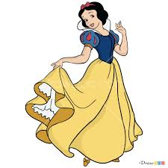
Which character do you like?-> I like.......
Snow White

Slide 22
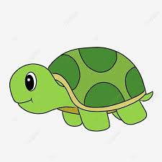
Which character do you like?-> I like.......
the tortoise

Slide 23
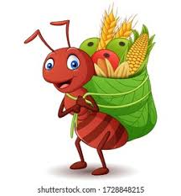
Which character do you like?-> I like.......
the ant

Slide 24
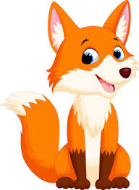
Which character do you like?-> I like.......
the fox

