Slide 1
UNIT 17: STORIES FOR CHILDREN
LESSON 2 ( 4, 5, 6)
Notes:
MADE BY FACEBOOK :TRAN THI THANH TAM

Slide 2

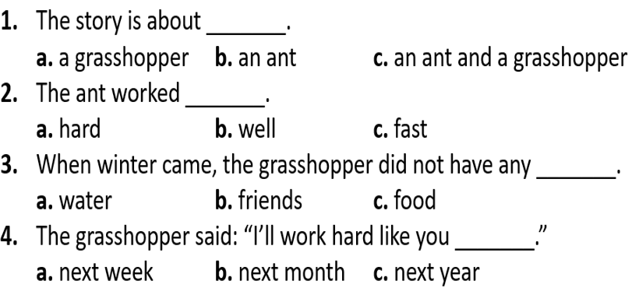

4. Listen and circle
Notes:
MADE BY FACEBOOK :TRAN THI THANH TAM

Slide 3
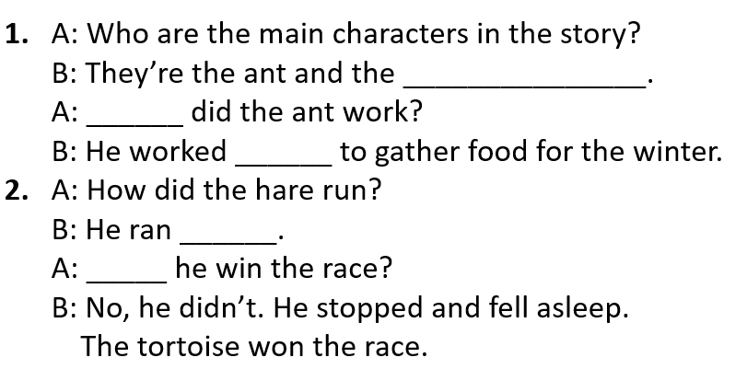
5. Read and complete
grasshopper
How
hard
fast
Did
Notes:
MADE BY FACEBOOK :TRAN THI THANH TAM

Slide 4
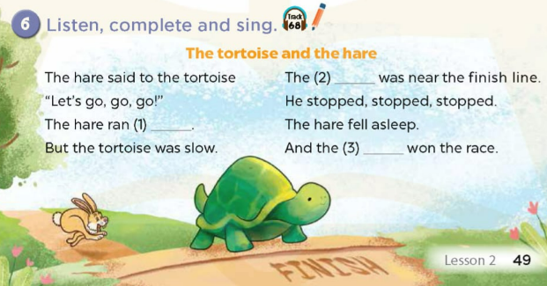
hare
fast
tortoise won the race.
Notes:
MADE BY FACEBOOK :TRAN THI THANH TAM

