Slide 1

UNIT 17: STORIES FOR CHILDREN
LESSON 3 (1, 2, 3)
Notes:
MADE BY FACEBOOK :TRAN THI THANH TAM

Slide 2
BRAINSTORMING

Slide 3
Let’s tell about characters that you have learnt

Slide 4
?
?
?
Characters
?
?
?
?

Slide 5
fox
tortoise
crow
Characters
ant
hare
grasshopper
Snow White
Seven dwarfs

Slide 6

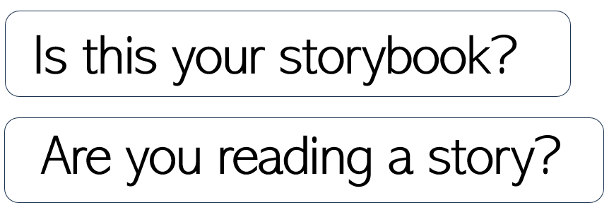
1.Listen and repeat
Notes:
MADE BY FACEBOOK :TRAN THI THANH TAM

Slide 7
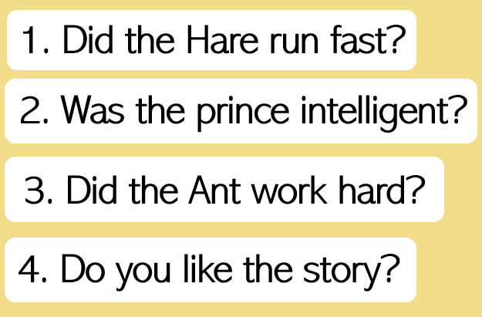
2. Listen and repeat. Pay attention to the intonation.
Notes:
MADE BY FACEBOOK :TRAN THI THANH TAM

Slide 8
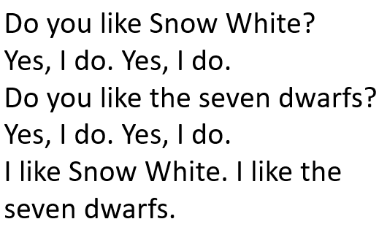
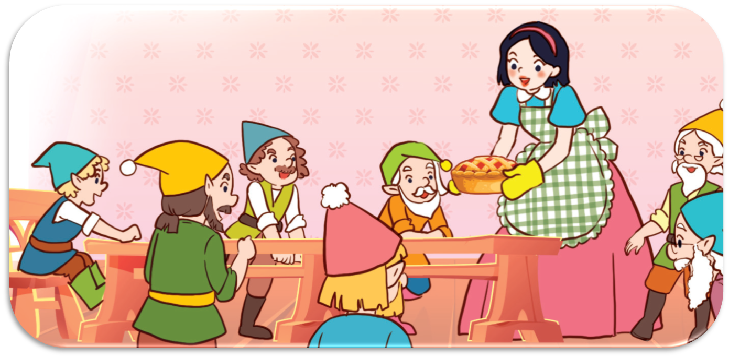
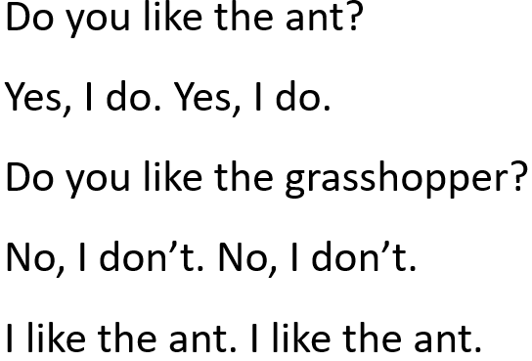
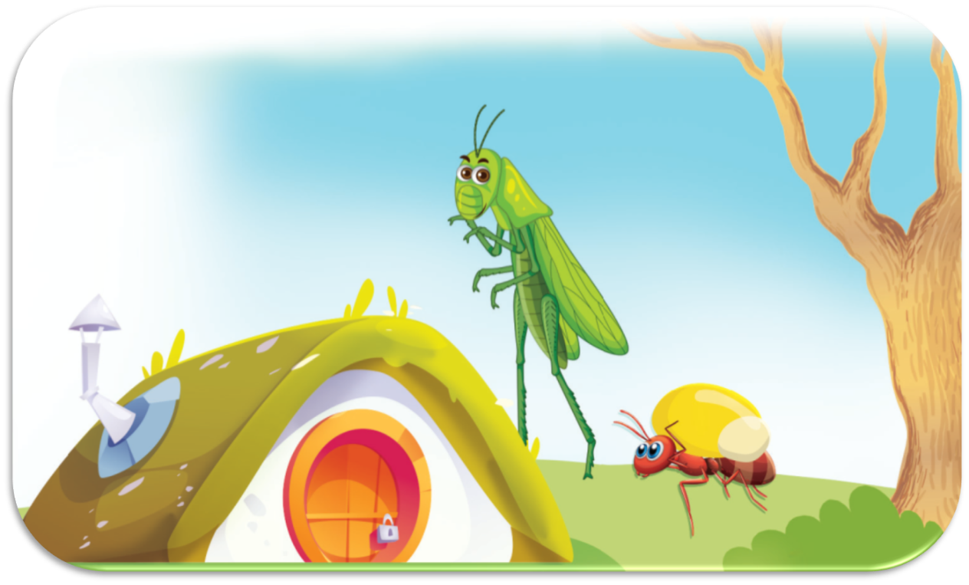
3. Let’s chant
Notes:
MADE BY FACEBOOK :TRAN THI THANH TAM

Slide 9
LET’S PLAY
TRUE OR FALSE GAME

Slide 10


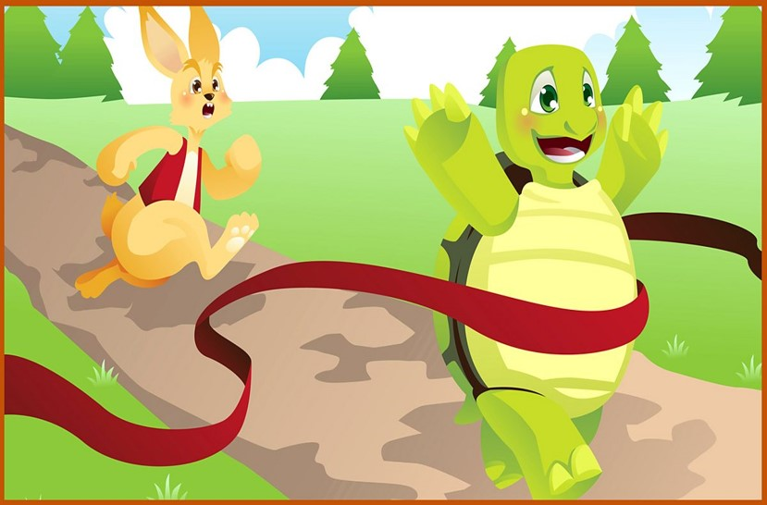
The main characters are the hare and the tortoise.
TRUE
FALSE

Slide 11
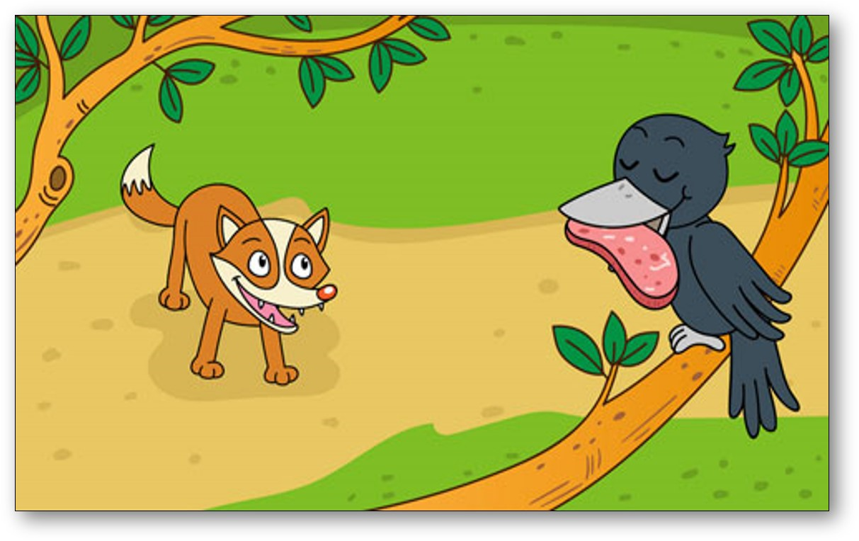
The main characters are fox and ant.
TRUE
FALSE

Slide 12

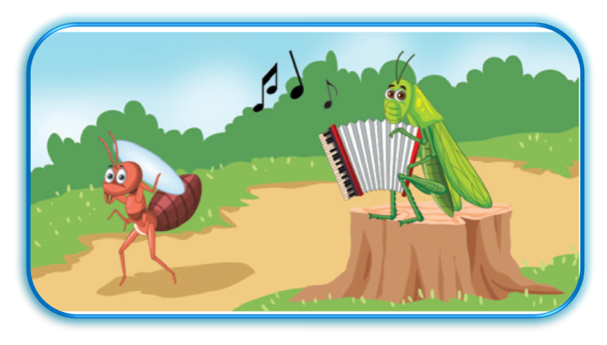
The main characters are the ant and the grasshopper.
TRUE
FALSE

Slide 13
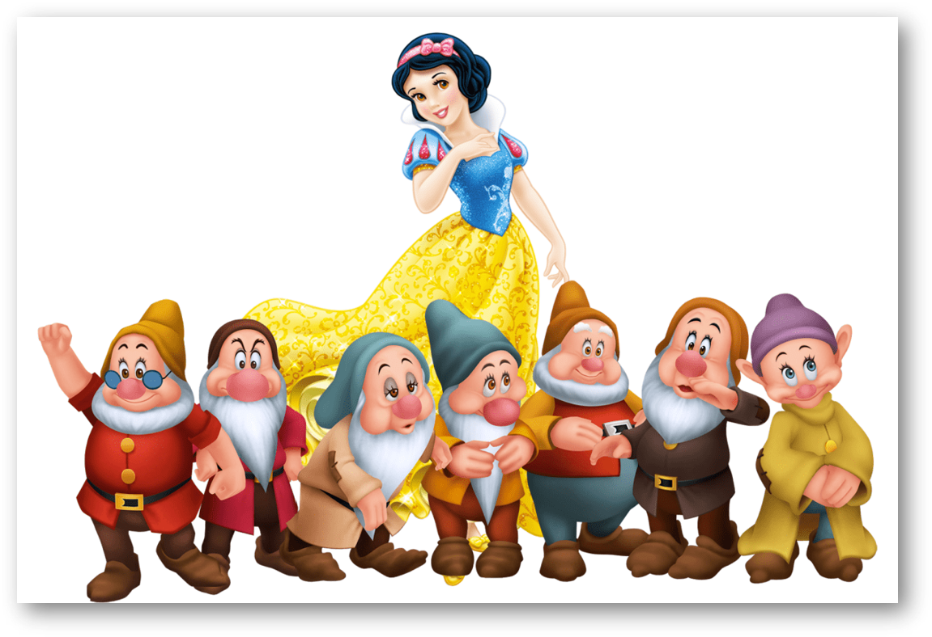
The main characters are Snow White and the six dwarfs.
TRUE
FALSE

