Slide 1


UNIT 17:STORIES FOR CHILDREN
LESSON 3 ( 4, 5, 6)

Slide 2
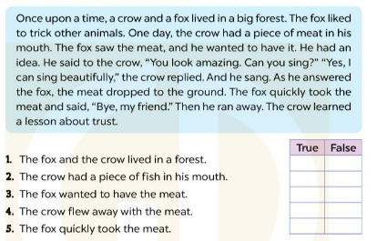





4. Read and tick true or false
Notes:
MADE BY FACEBOOK :TRAN THI THANH TAM

Slide 3
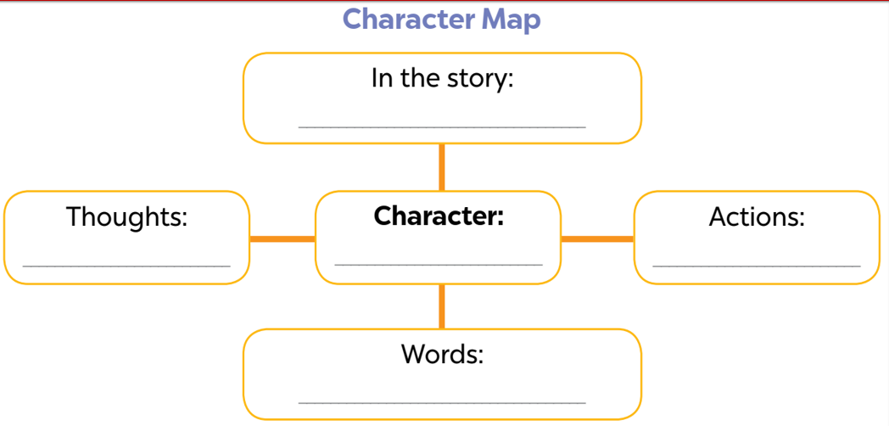
5. Let’s write
the Fox and the Crow
I want to have the meat.
the Fox
I take the meat from the Crow.
Can you sing? / Bye, my friend.
Notes:
MADE BY FACEBOOK :TRAN THI THANH TAM

Slide 4
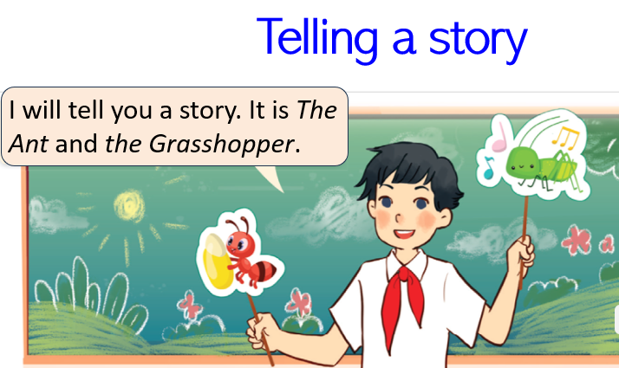
6. Project
Notes:
MADE BY FACEBOOK :TRAN THI THANH TAM

Slide 5
LET ’S PLAY
BINGO

Slide 6
BINGO GAME
grasshopper
crow
ant
hare
eighteen
meat
story
forest
sing
Draw the table and fill with your numbers. Then listen and circle the numbers you hear. Say bingo if you find the number first
Notes:
MADE BY FACEBOOK :TRAN THI THANH TAM

