Slide 1
Unit 14
DAILY ACTIVITIES

Slide 2

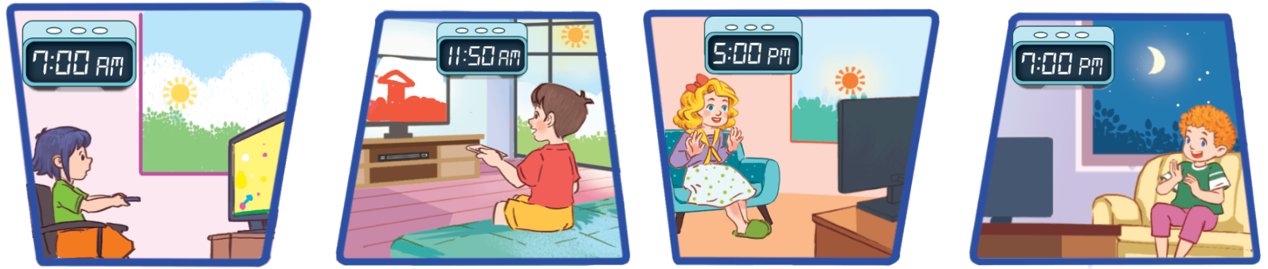
When do you watch TV?
I watch TV __________.
in the morning
at noon
in the afternoon
in the evening

Slide 3

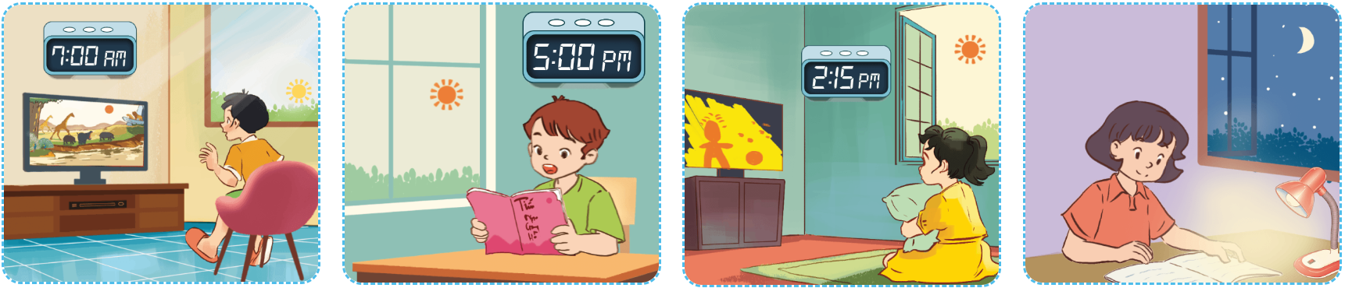
4
Listen and tick or cross.
✗
✓
✗
✗
1
2
3
4

Slide 4
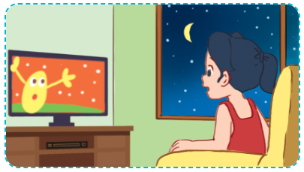
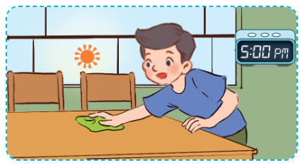
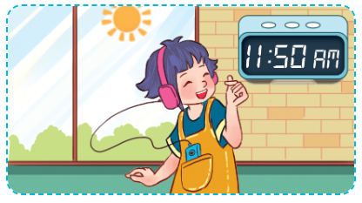
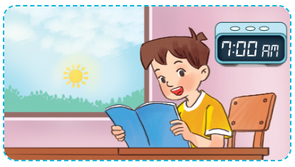
5
Look, complete and read.
1
2
A: When do you watch TV?
B: In the ___________.
A: When do you do housework?
B: In the ___________.
evening
afternoon
3
4
listen to music
When
A: When do you ____________?
B: At ___________.
A: ______ do you read books?
B: In the ___________.
noon
morning

Slide 5
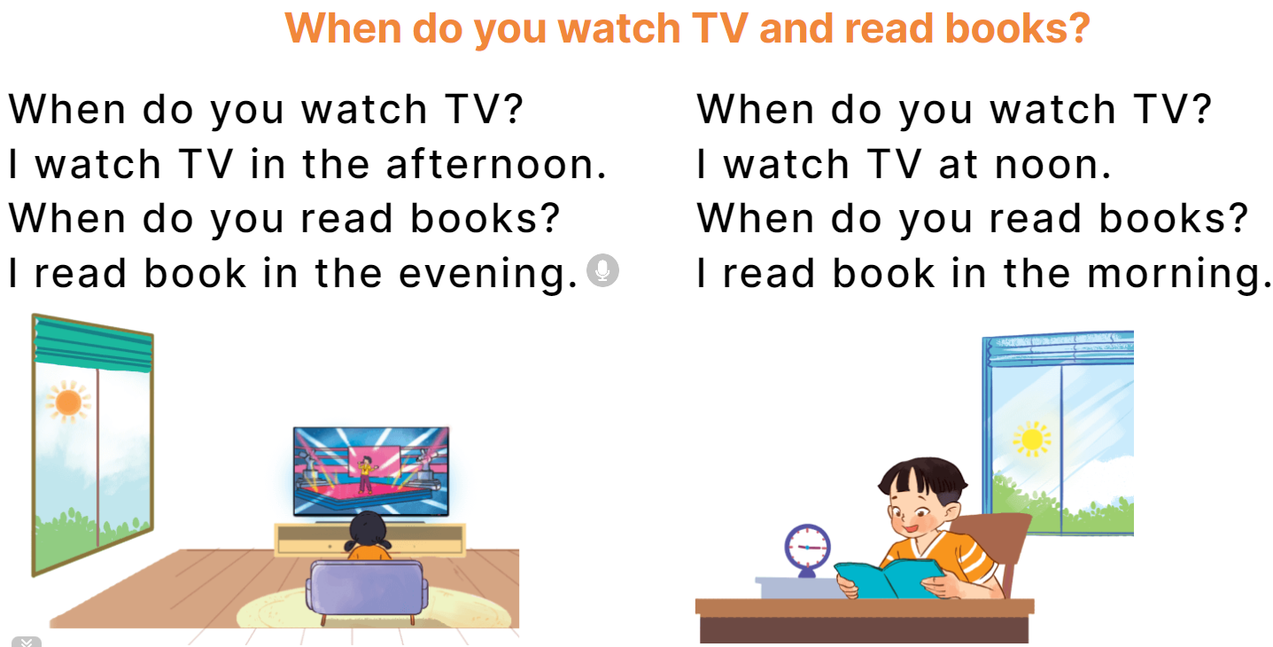
6
Let’s sing.

