Slide 1
Unit 14
DAILY ACTIVITIES
Lesson 2 - Period 2

Slide 2







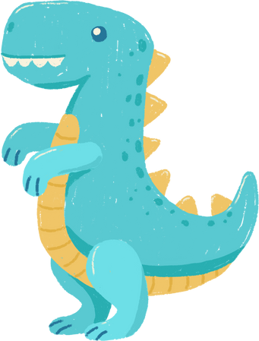



Review

Slide 3

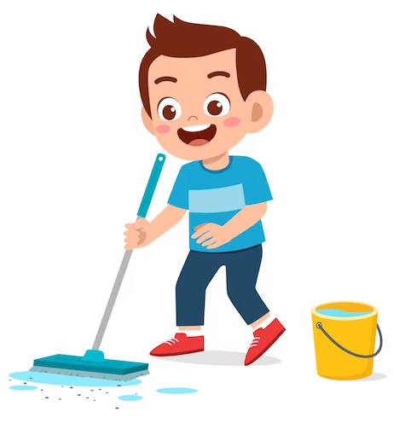
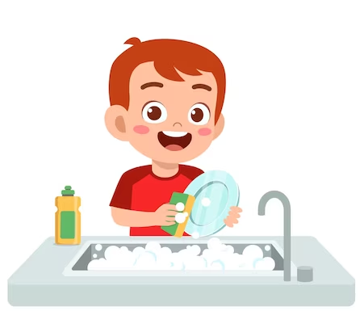
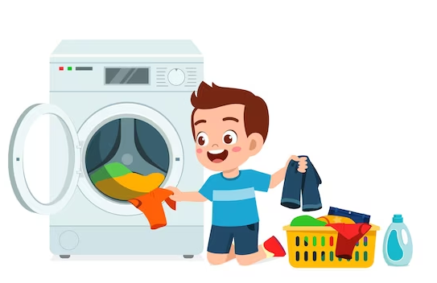
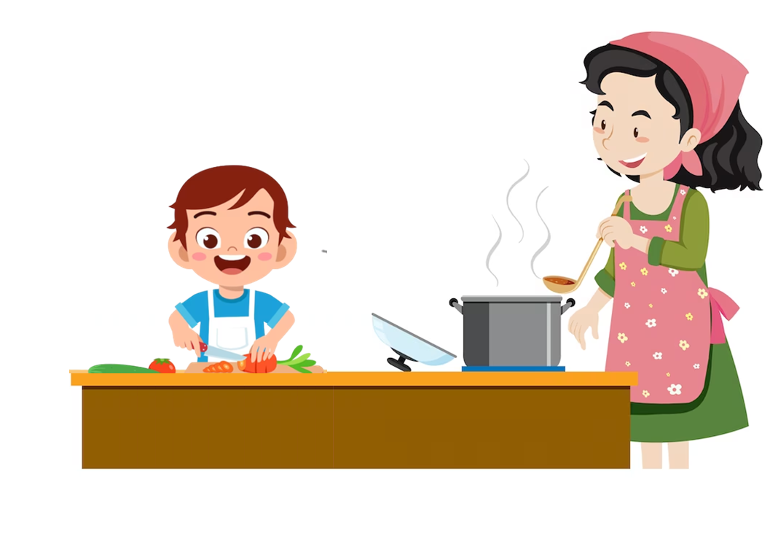
When do you do in the morning?
I _________________________.
help with cooking
wash the clothes
clean the floor
wash the dishes

Slide 4
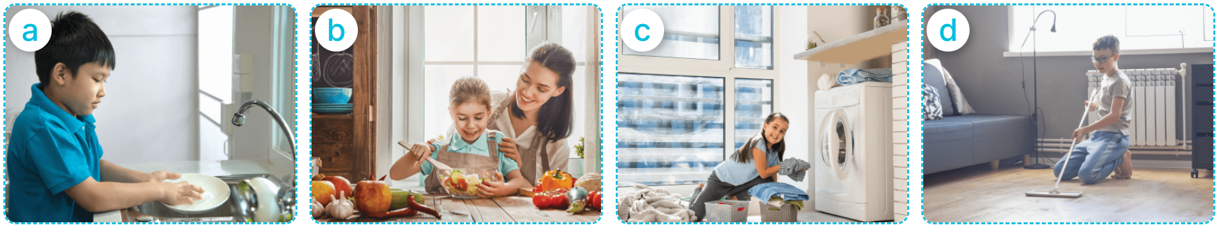

4
Listen and number.
a
b
c
d
1
2
3
4

Slide 5
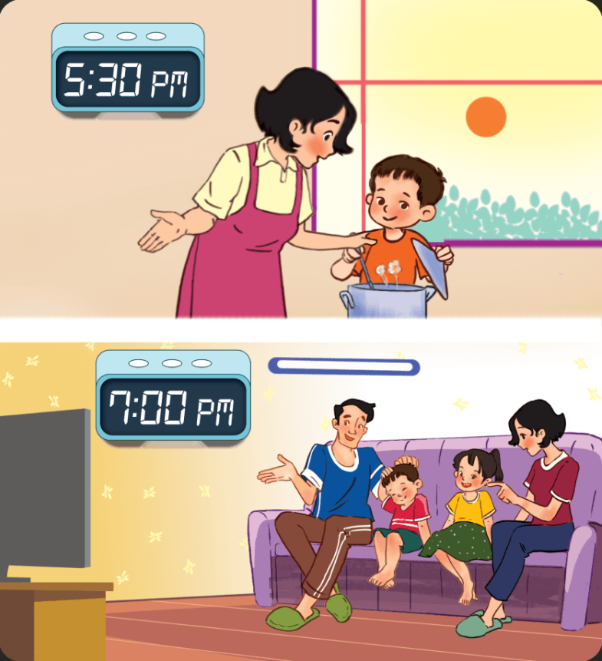
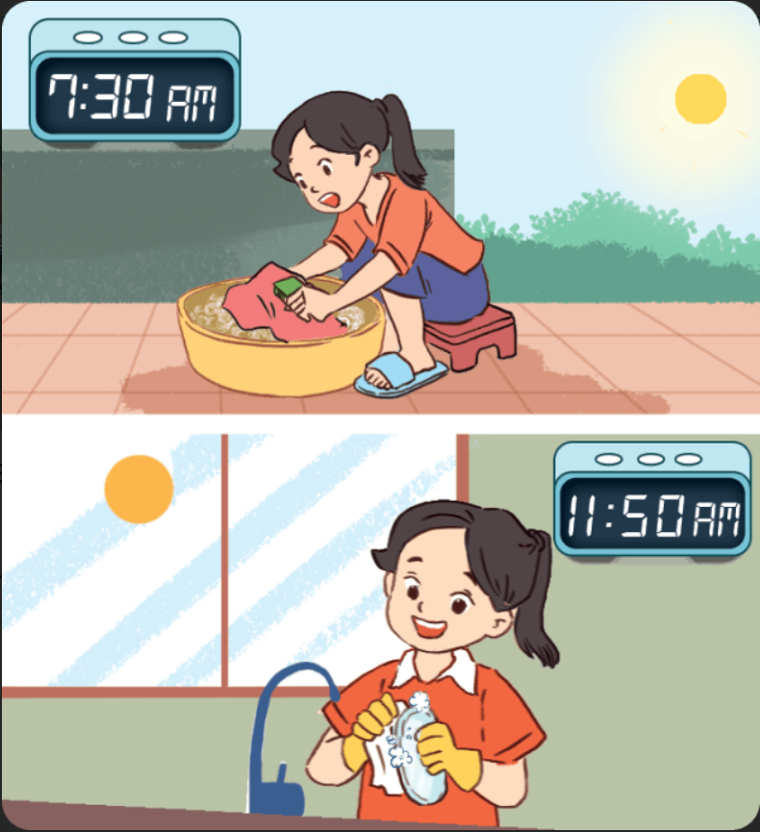
5
Look, complete and read.
1
2
A: What do you do in the morning?
B: I wash my ________.
A: ________ do you do in the morning?
B: I wash the dishes.
afternoon
A: What do you do in the _________?
B: I help my mum with the cooking.
A: And in the ________, what do you?
B: We watch ________ together.
clothes
What
evening
TV

Slide 6
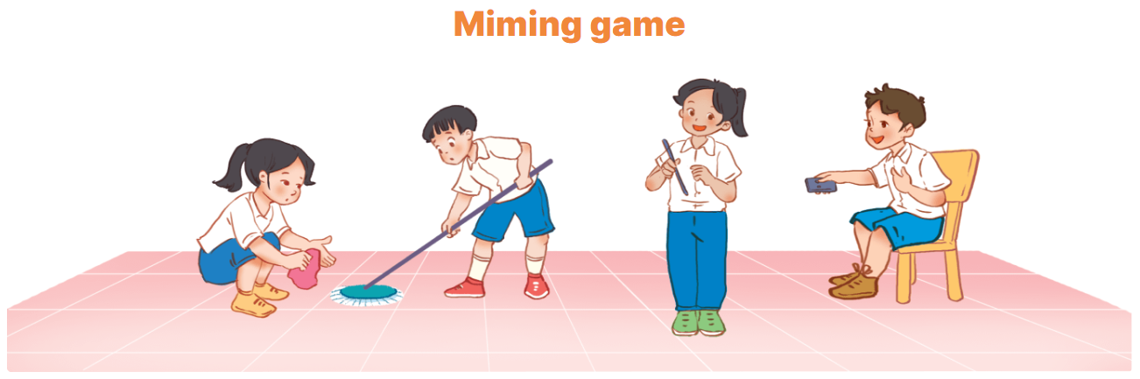
6
Let’s play.

