Slide 1
Unit 17
In the city
Lesson 1 – Period 1

Slide 2


stop
/stɒp/
Dừng lại

Slide 3

go straight
/ɡəʊ streɪt/
Đi thẳng

Slide 4

turn right
/tɜːn ˈraɪt/
Rẽ phải

Slide 5

turn left
/tɜːn ˈleft/
Rẽ trái

Slide 6

Vocabulary
stop
: Dừng lại
go straight
: Đi thẳng
turn right
: Rẽ phải
turn left
: Rẽ trái

Slide 7
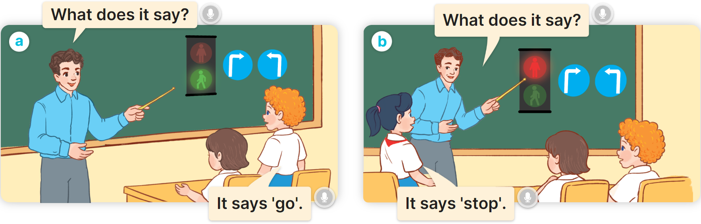
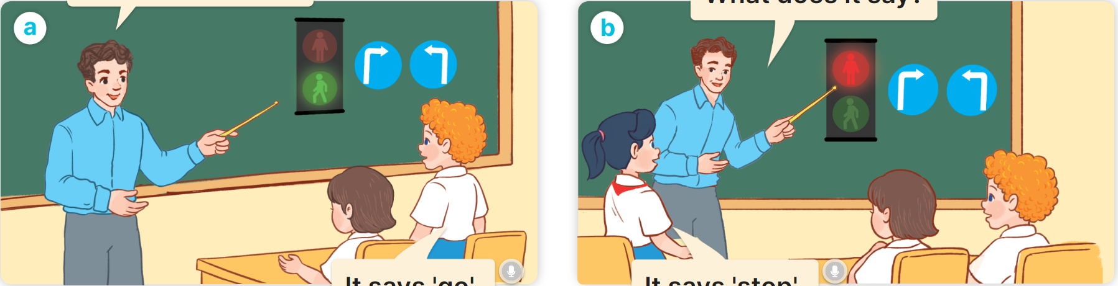

1
Look, listen and read.

Slide 8
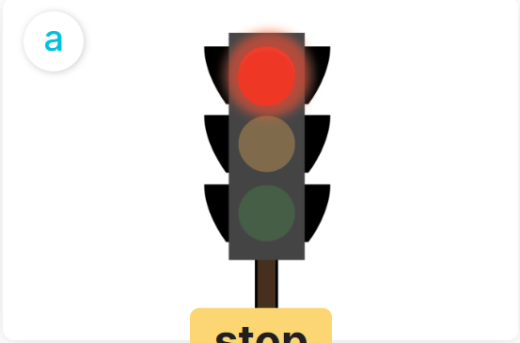
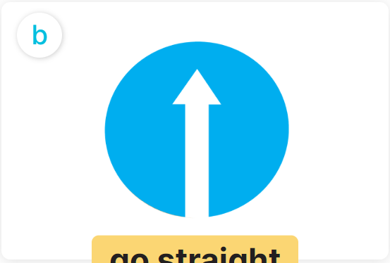
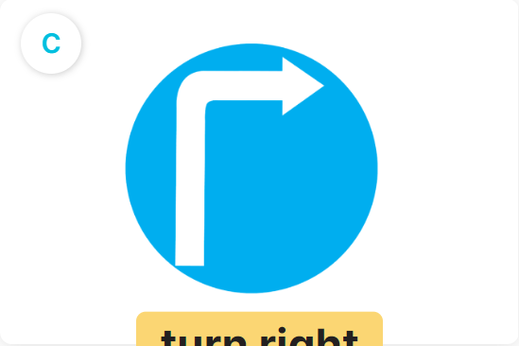
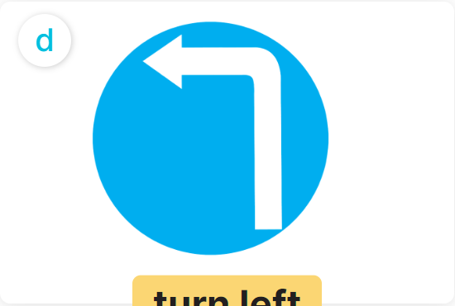
2
Listen, point and say.
What does it say?
a
b
It says: “__________”.
stop
go straight
c
d
turn right
turn left

Slide 9


2
Listen, point and say.
stop
What does it say?
It says: “stop”.

Slide 10
2
Listen, point and say.
go straight
What does it say?
It says: “go straight”.

Slide 11
2
Listen, point and say.
turn right
What does it say?
It says: “turn right”.

Slide 12
2
Listen, point and say.
turn left
What does it say?
It says: “turn left”.

Slide 13
2
Listen, point and say.
What does it say?
a
b
It says: “__________”.
stop
go straight
c
d
turn right
turn left

Slide 14
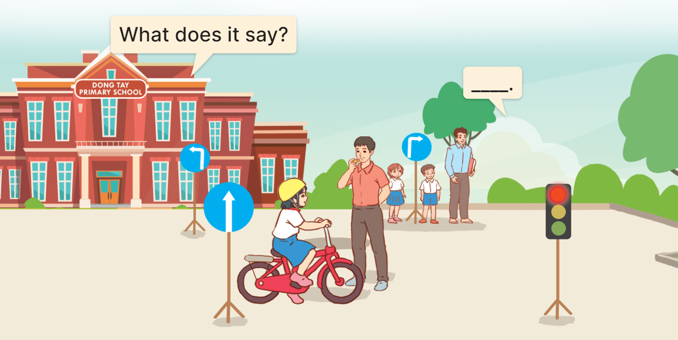

3
Let’s talk.
It says: “go straight”.

Slide 15


It says: “__________”.
MsPham
0936082789
What does it say?
MsPham
0936082789
Stop
Go straight
Turn left
Turn right

