Slide 1








Unit 17
In the city
Lesson 1 – Period 2

Slide 2






It says: “__________”.
MsPham
0936082789
What does it say?
MsPham
0936082789
Stop
Go straight
Turn left
Turn right

Slide 3
It says: “__________”.
MsPham
0936082789
What does it say?
MsPham
0936082789
Stop
Go straight
Turn left
Turn right

Slide 4

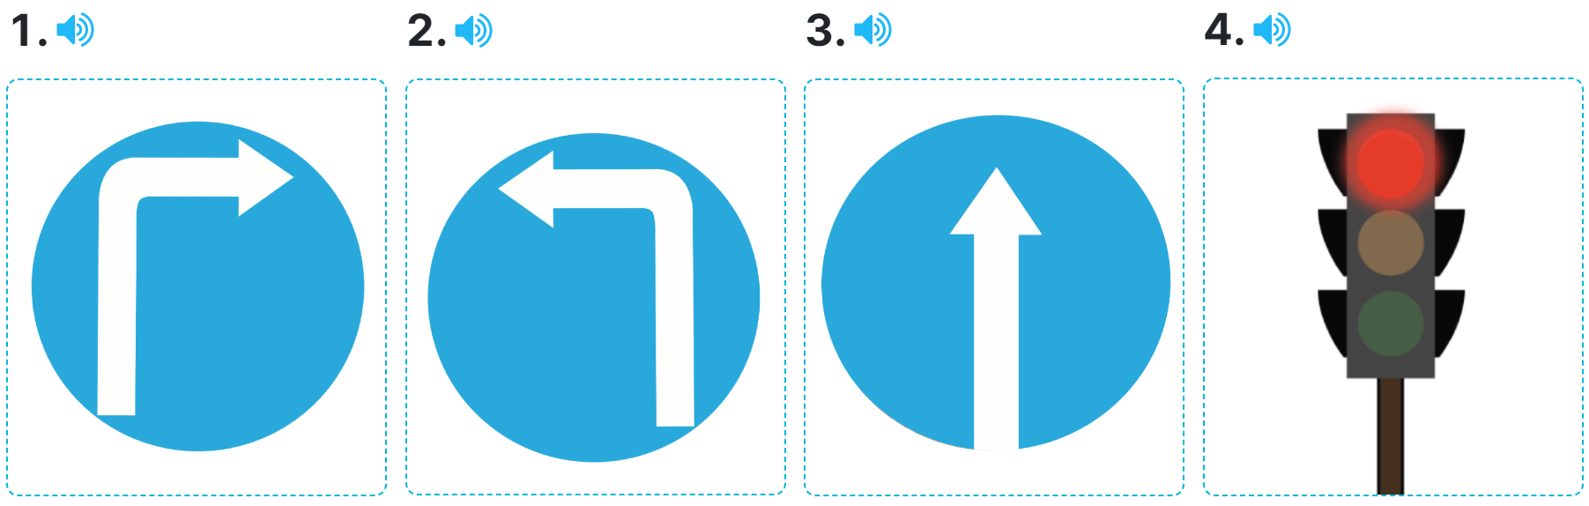
4
Listen and tick or cross.
✓
✗
✓
✗

Slide 5
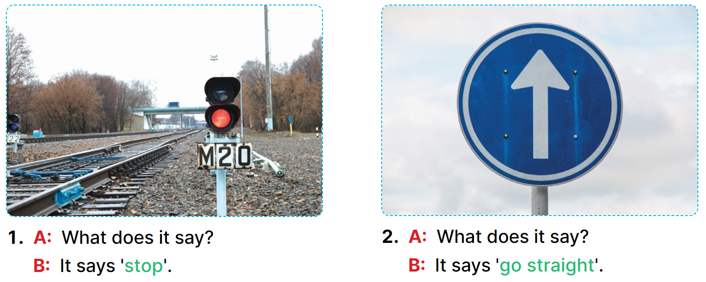
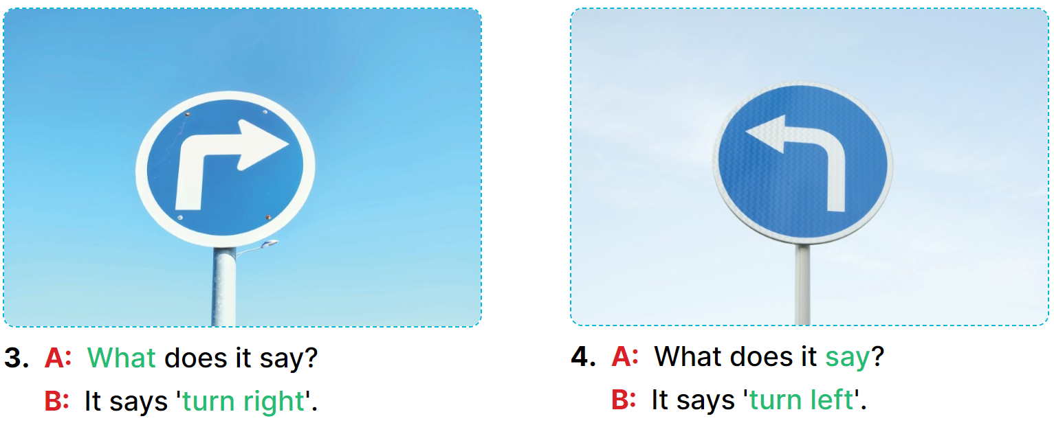
5
Look, complete and read.
_
_____
___
___?
____
_____

Slide 6
5
Look, complete and read.
MsPham
0936082789
____
____________

Slide 7
5
Look, complete and read.

Slide 8
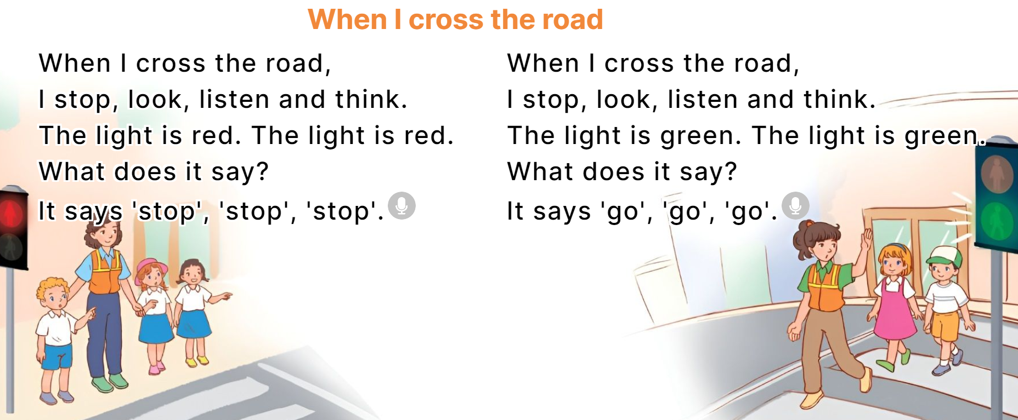
6
Let’s sing.

