Slide 1




Unit 17
In the city
Lesson 2 – Period 1

Slide 2
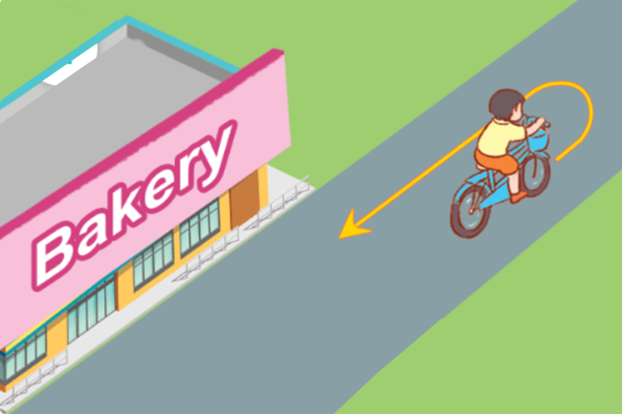
Vocabulary
turn round
/tɜːn ˈraʊnd/
Quay lại

Slide 3
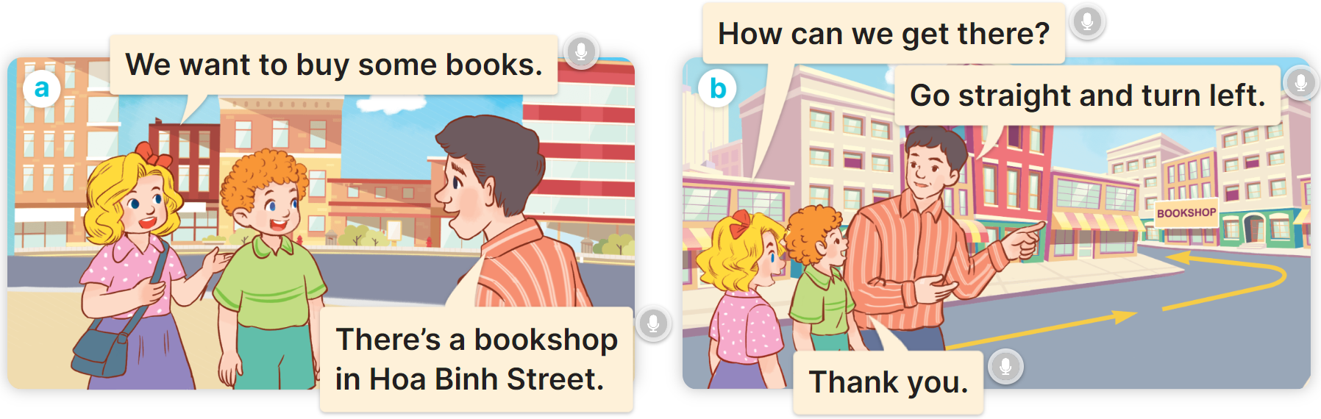

1
Look, listen and read.

Slide 4
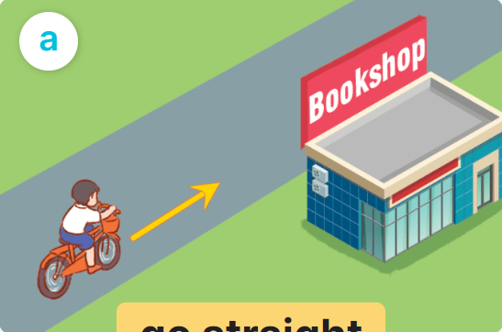
1
Cách hỏi đường:
How can I get to the _________?
________________.
(Tôi đến _______ như thế nào?)
(__________.)
Ex:
How can I get to the _________?
Go straight.

Slide 5
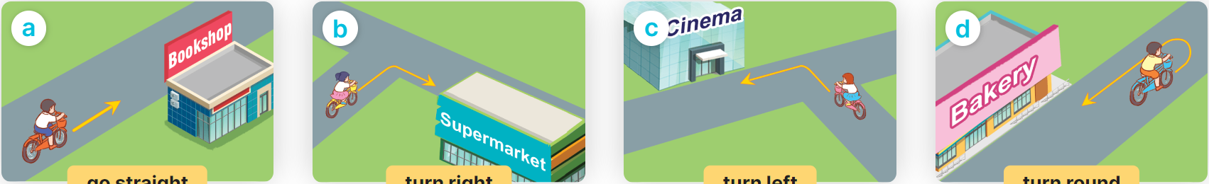
2
Listen, point and say.
How can I get to the ______?
________________.
go straight
turn right
turn left
turn round

Slide 6


2
Listen, point and say.
go straight
How can I get to the bookshop?
Go straight.

Slide 7


2
Listen, point and say.
turn right
How can I get to the supermarrket?
Turn right.

Slide 8
2
Listen, point and say.
turn left
How can I get to the cinema?
Turn left.

Slide 9
2
Listen, point and say.
turn round
How can I get to the bakery?
Turn round.

Slide 10



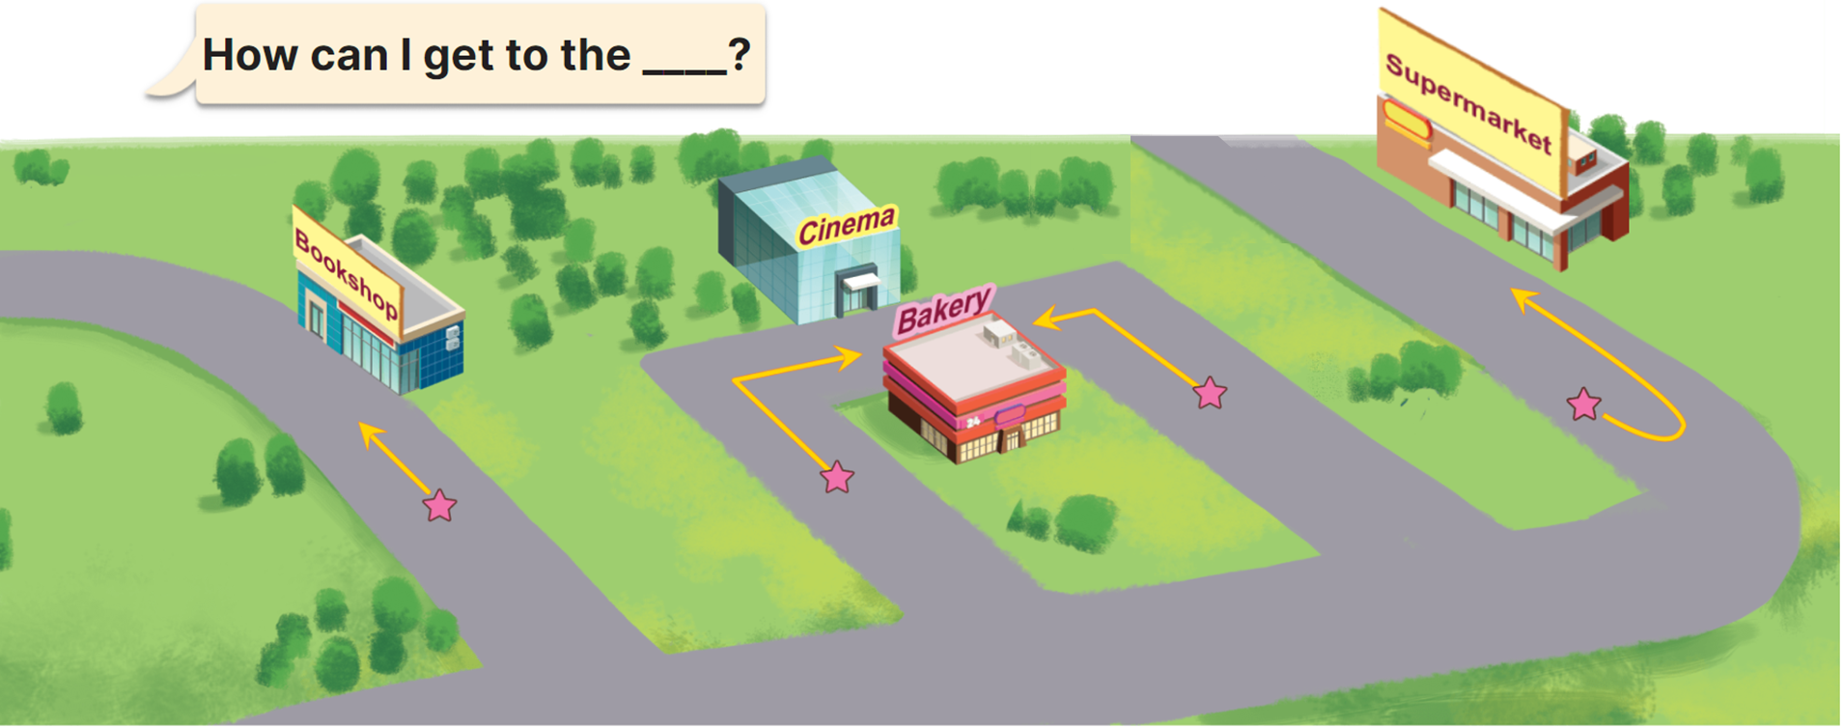

-1
Turn left
How can I get to the_______?
Turn right
+5
-1
Go straight
Notes:
Ms Huyền Phạm - 0936.082.789 – YOUTUBE: MsPham. Facebook: Dạy và học cùng công nghệ.

Slide 11
Go straight
+5
How can I get to the_______?
Turn round
-1
Turn left
-1
Notes:
Ms Huyền Phạm - 0936.082.789 – YOUTUBE: MsPham. Facebook: Dạy và học cùng công nghệ.

Slide 12
Turn round
-1
How can I get to the_______?
Turn right
-1
Turn left
+5
Notes:
Ms Huyền Phạm - 0936.082.789 – YOUTUBE: MsPham. Facebook: Dạy và học cùng công nghệ.

Slide 13
Turn round
+5
How can I get to the supermarket?
Turn left
-1
Turn right
-1
Notes:
Ms Huyền Phạm - 0936.082.789 – YOUTUBE: MsPham. Facebook: Dạy và học cùng công nghệ.

Slide 14
Where is the bookshop?
-1
_________?
Go straight!
How can I get to the bookshop?
+5
What can I get to the bookshop?
-1
Notes:
Ms Huyền Phạm - 0936.082.789 – YOUTUBE: MsPham. Facebook: Dạy và học cùng công nghệ.

