Slide 1










Unit 17
In the city
Lesson 2 – Period 2

Slide 2
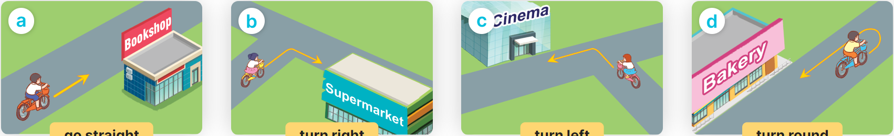

How can I get to the _____?
______________.
MsPham
0936082789
MsPham
0936082789
go straight
turn right
turn left
turn round

Slide 3

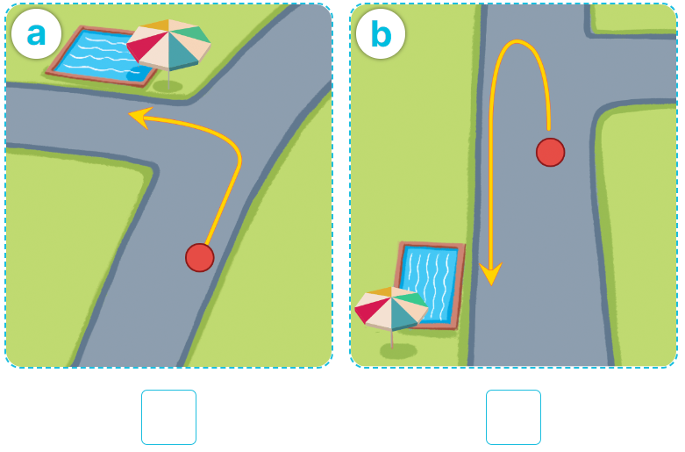
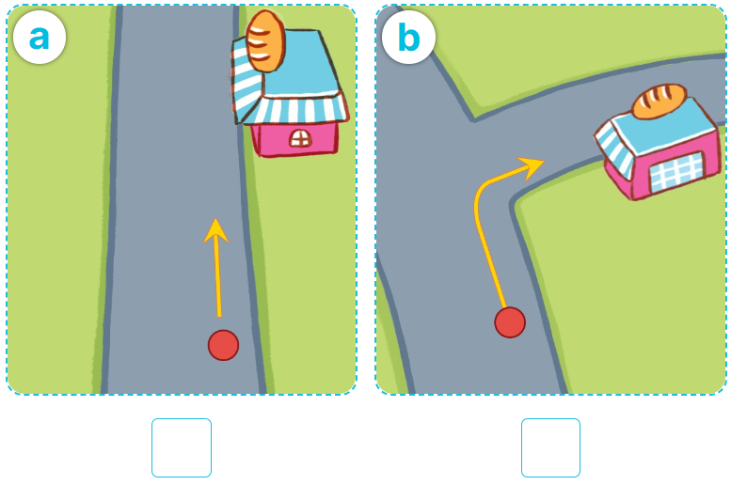
4
Listen and tick or cross.
1
2
✓
✓

Slide 4
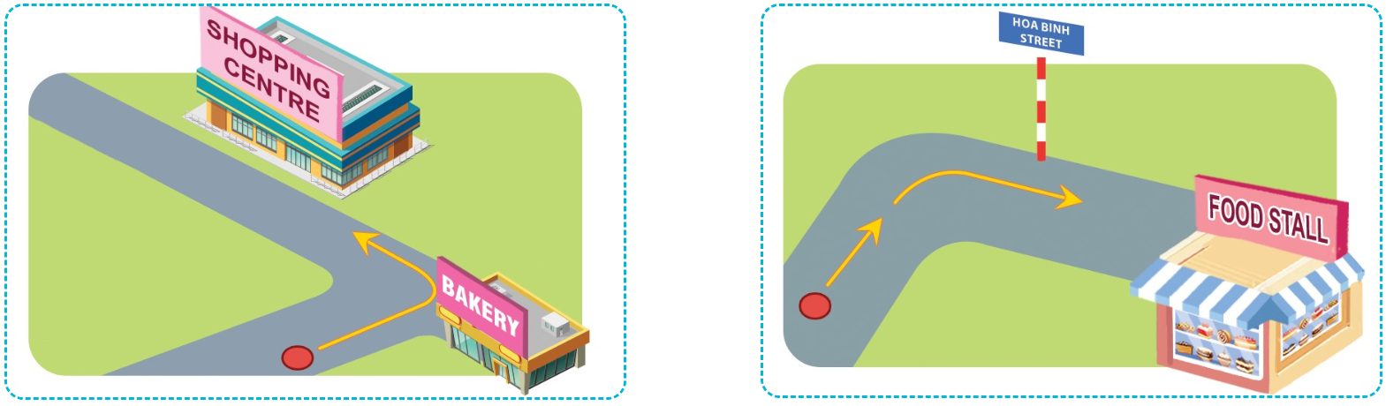
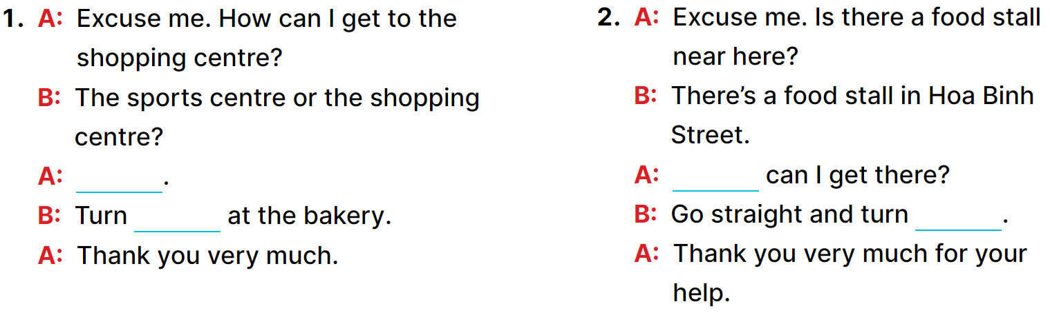
5
Look, complete and read.
The shopping centre.
How
left
right.

Slide 5
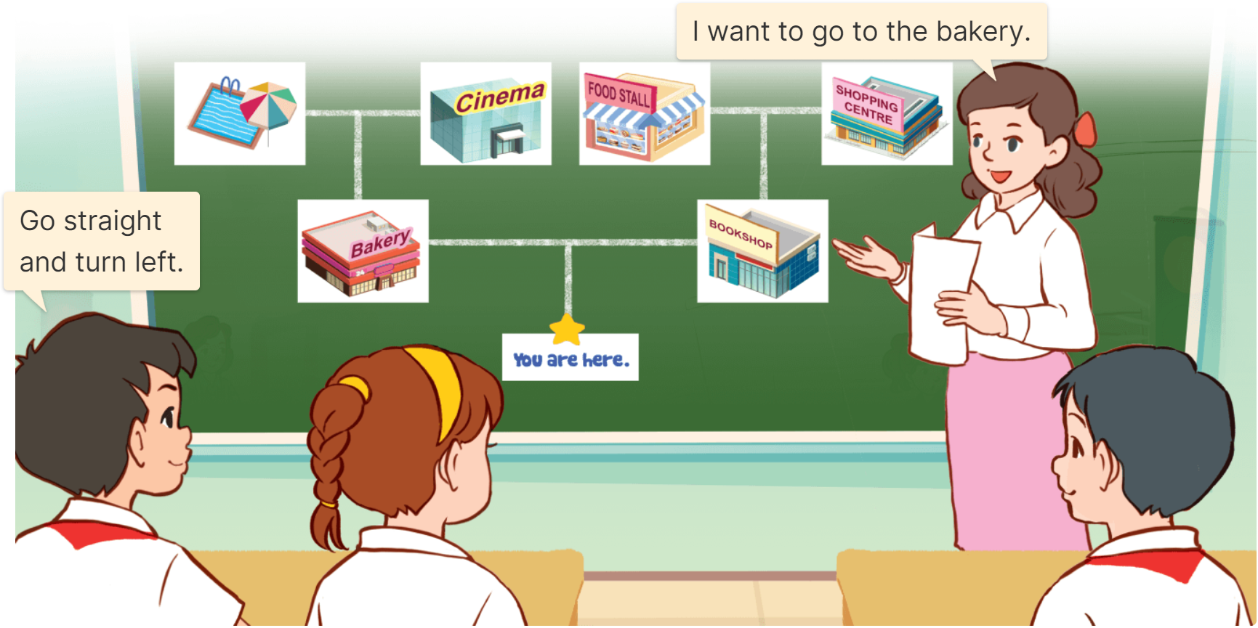
6
Let’s sing.
Show the way

Slide 6
______________.
MsPham
0936082789
How can I get to the _____?
MsPham
0936082789
go straight
turn right
turn left
turn round

