Slide 1











Unit 17
In the city
Lesson 3 – Period 1

Slide 2
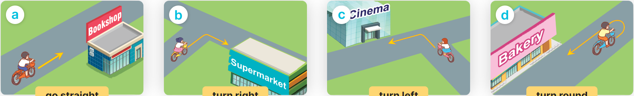

______________.
MsPham
0936082789
How can I get to the _____?
MsPham
0936082789
go straight
turn right
turn left
turn round

Slide 3

1
Listen and repeat.
'bookshop
How can I get to the 'bookshop?
'campsite
How can I get to the 'campsite?

Slide 4
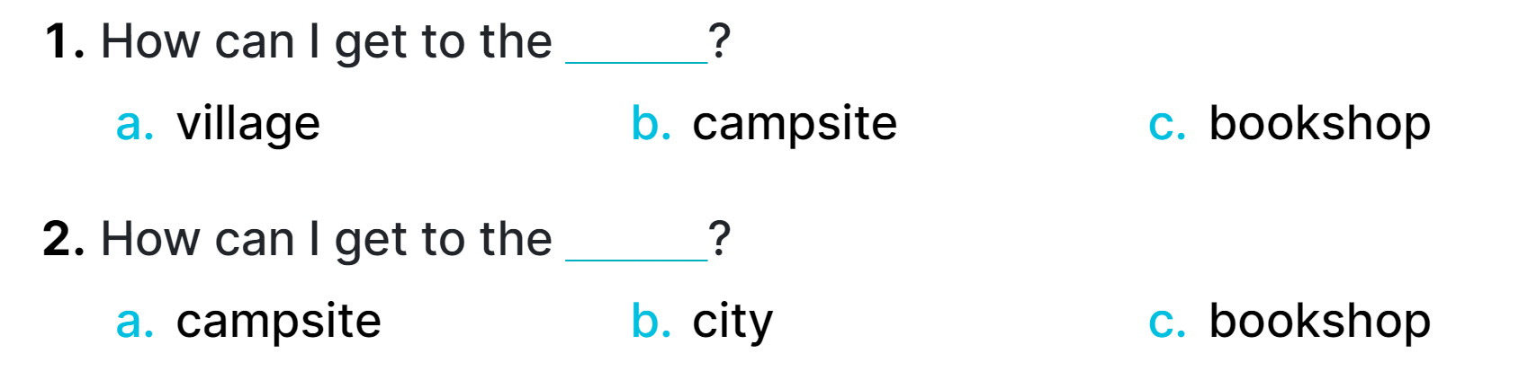
2
Listen and circle.

Slide 5
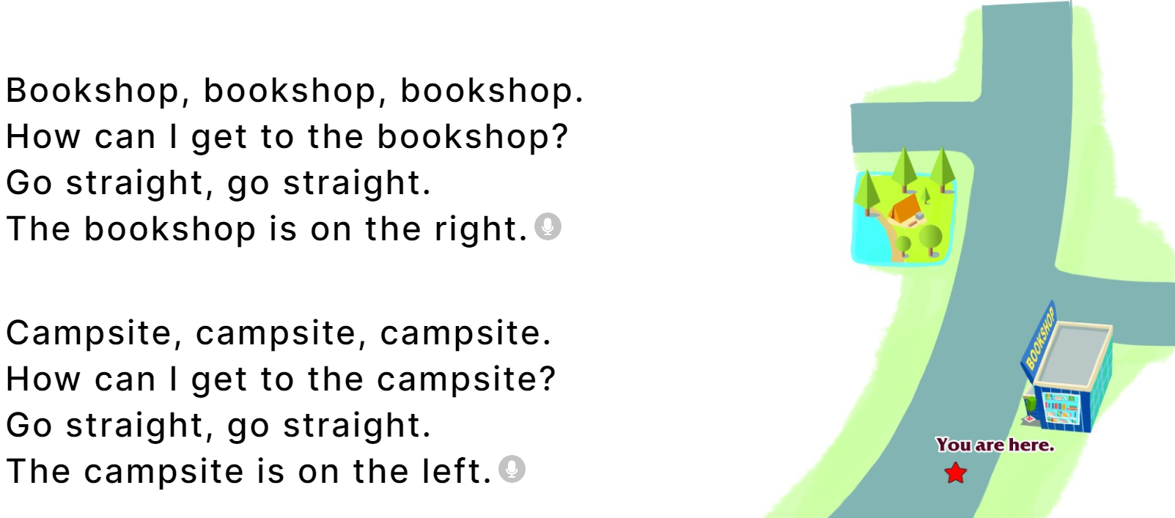
3
Let’s chant.

