Slide 1











Unit 17
In the city
Lesson 3 – Period 2

Slide 2






What does it say?
It says: “__________”.
MsPham
0936082789
MsPham
0936082789
Stop
Go straight
Turn left
Turn right

Slide 3
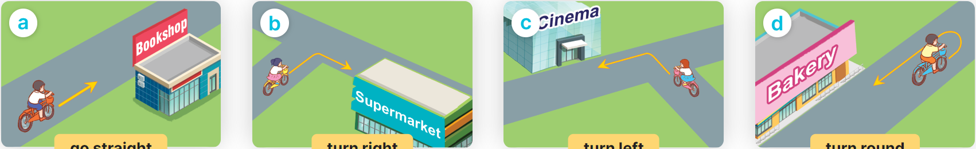
How can I get to the _____?
______________.
MsPham
0936082789
MsPham
0936082789
go straight
turn right
turn left
turn round

Slide 4
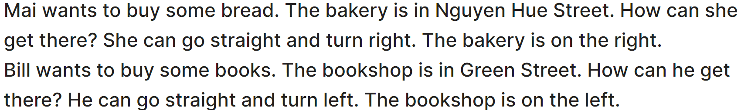
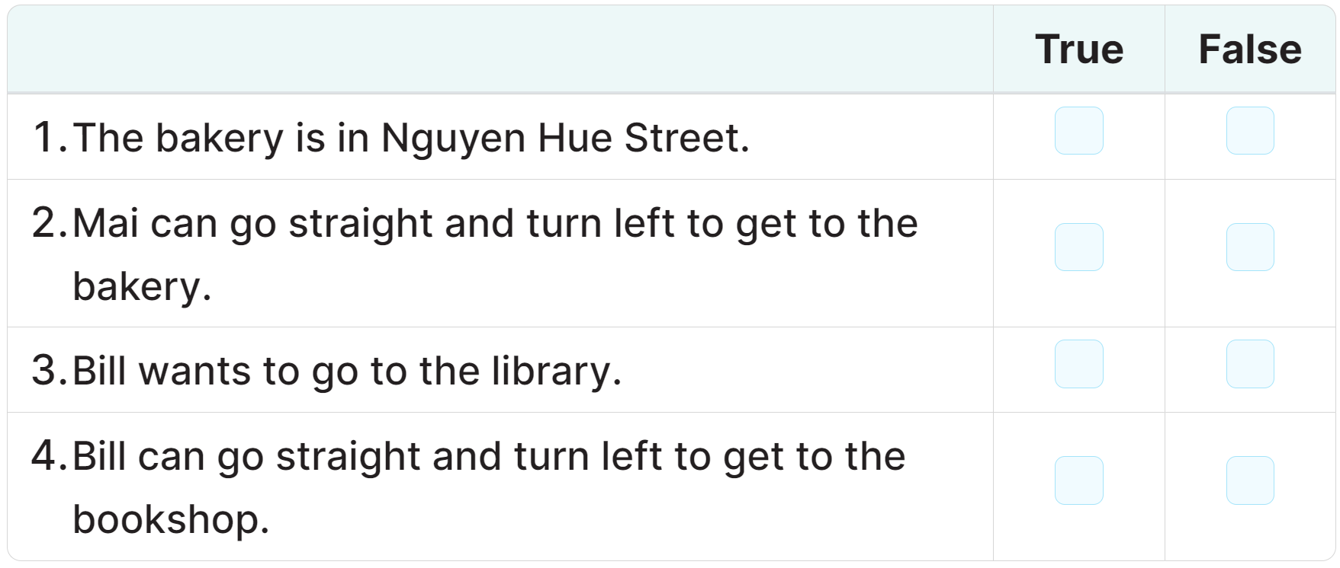
4
Read and tick True or False.
✓
✓
✓
✓

Slide 5
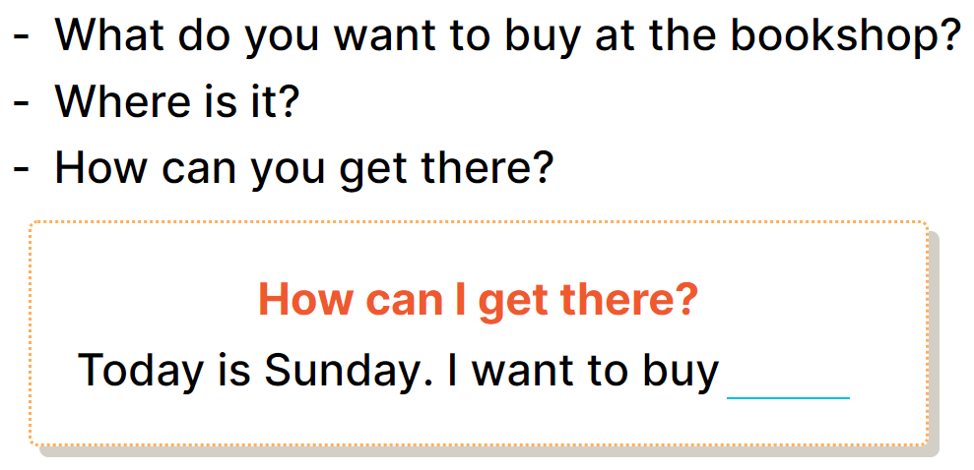
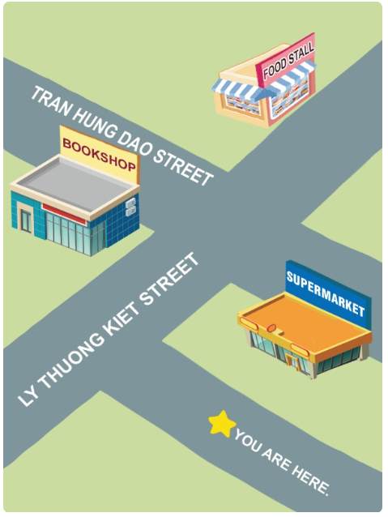
5
Let’s write.
some
school things. The bookshop is in
Tran Hung Dao Street. I can go straight and turn right, then turn left. It’s on the left.

Slide 6
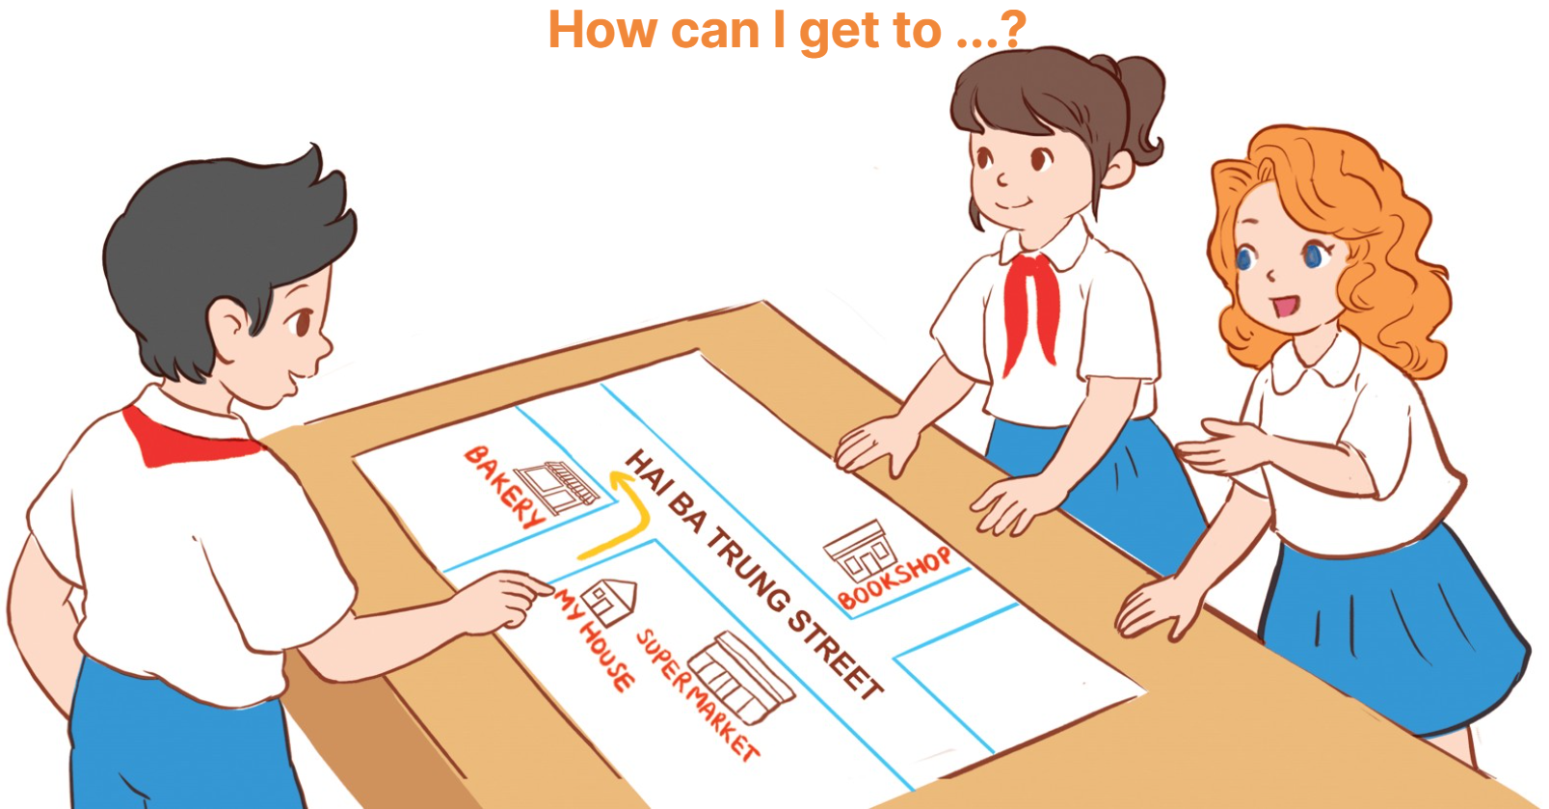
6
Project

