Slide 1





Unit 18
At the
shopping centre
Lesson 1 – Period 1

Slide 2
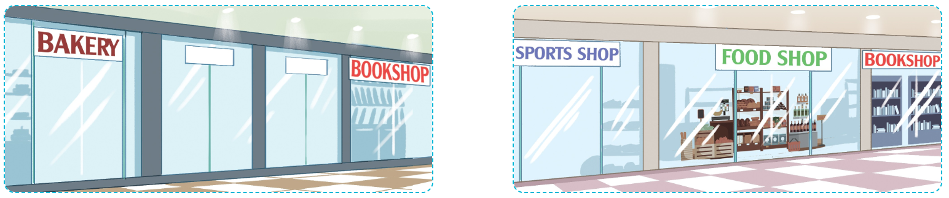
Vocabulary
near
Ở gần
/nɪə/

Slide 3
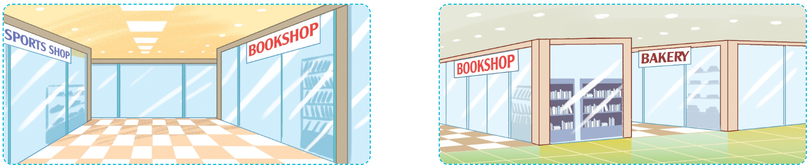
Vocabulary
opposite
Ở đối diện
/ˈɒpəzɪt/

Slide 4
Vocabulary
behind
Ở đằng sau
/bɪˈhaɪnd/

Slide 5
Vocabulary
between
Ở giữa
/bɪˈtwiːn/

Slide 6
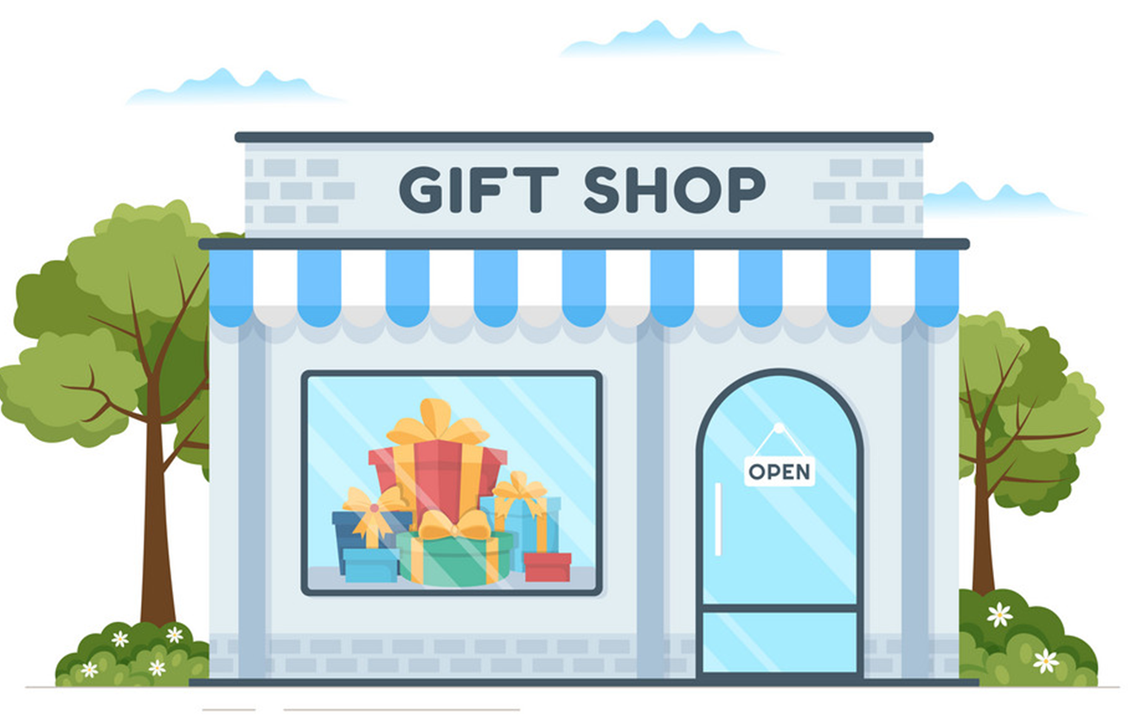
Vocabulary
gift shop
Cửa hàng quà tặng
/ˈɡɪft ʃɒp/

Slide 7
Vocabulary
gift shop
: Cửa hàng quà tặng
behind
: Ở đằng sau
near
: Ở gần
between
: Ở giữa
opposite
: Ở đối diện

Slide 8
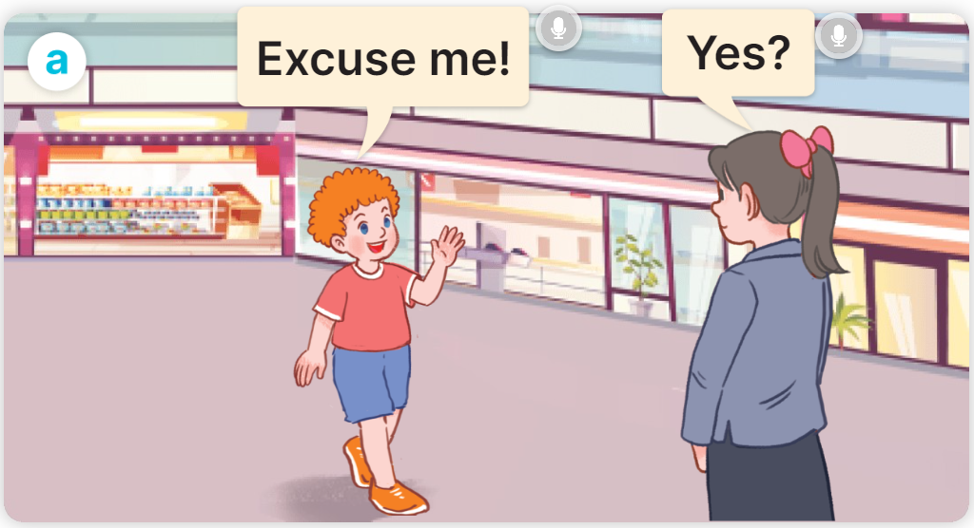
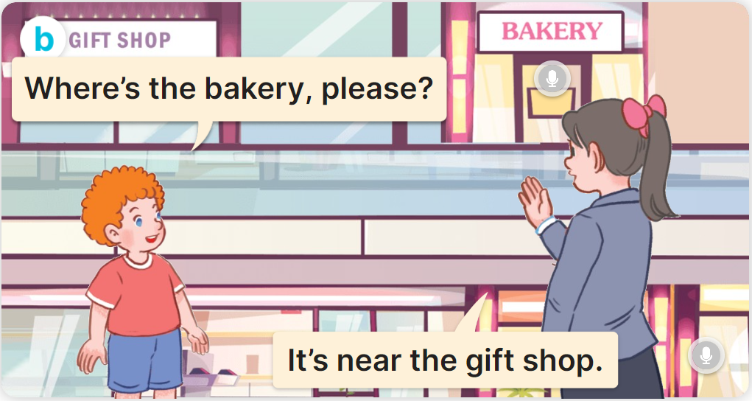
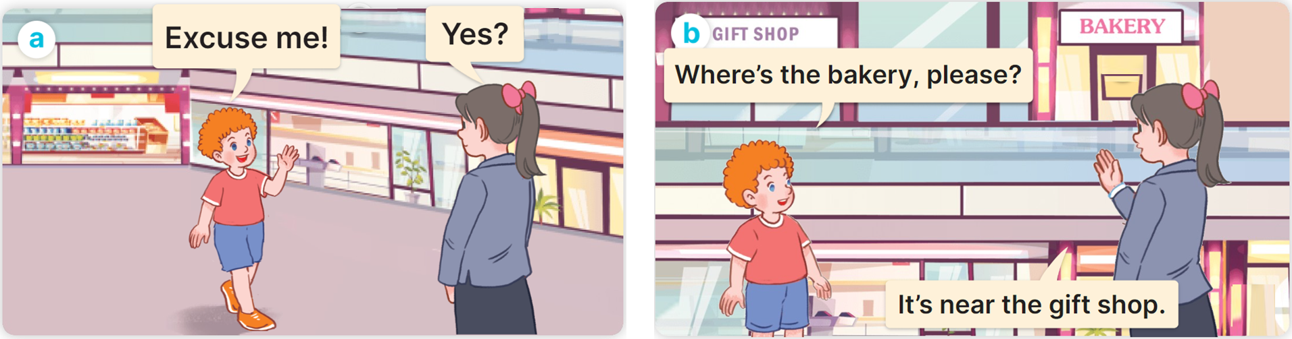

1
Look, listen and read.

Slide 9
Cách hỏi cái gì đó ở đâu:
Where’s the ___________?
(_______ ở đâu?)
It’s ______.
(Nó ở ________?)
Ex:

Slide 10
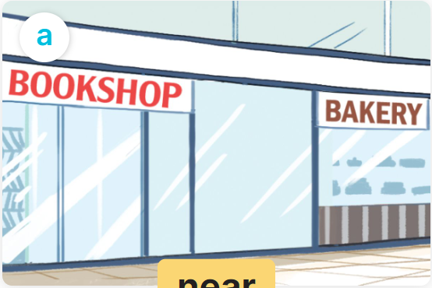
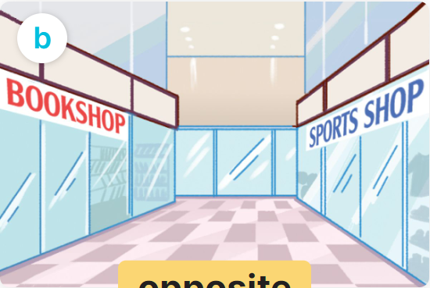
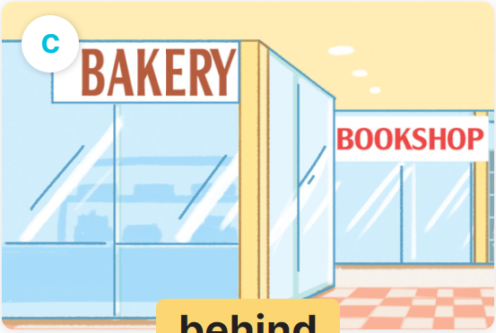
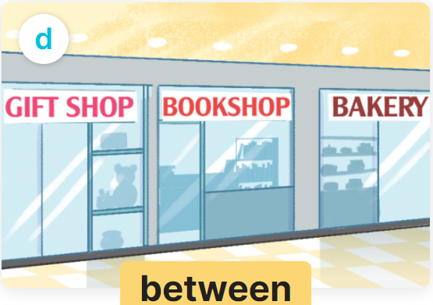
2
Listen, point and say.
Where’s the bookshop?
It’s ______ .
art
music
PE
IT

Slide 11


2
Listen, point and say.
MsPham
0936082789
near
Where’s the bookshop?
It’s near the bakery.

Slide 12
2
Listen, point and say.
opposite
Where’s the bookshop?
It’s opposite the sports shop.

Slide 13


2
Listen, point and say.
behind
Where’s the bookshop?
It’s behind the bakery.

Slide 14
2
Listen, point and say.
between
Where’s the bookshop?
It’s between the gift shop and the bakery.

Slide 15
2
Listen, point and say.
Where’s the bookshop?
It’s ______ .
opposite
near
behind
between

Slide 16
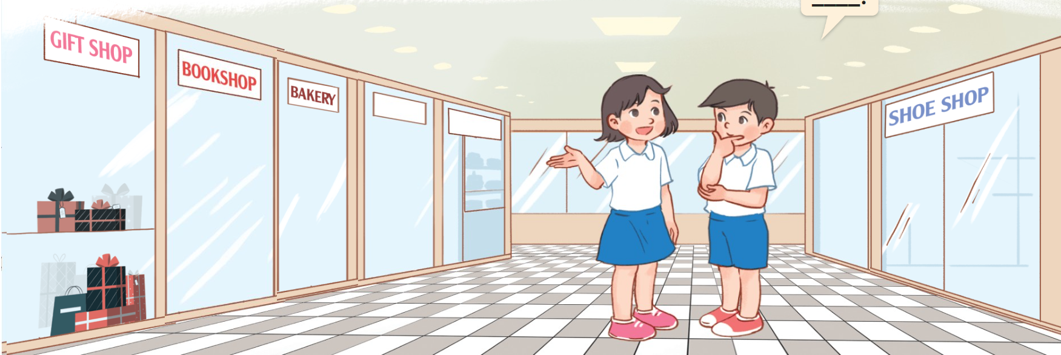
3
Let’s talk.
Where’s the ___________?
It’s _________.

