Slide 1





Unit 18
At the
shopping centre
Lesson 1 – Period 2

Slide 2
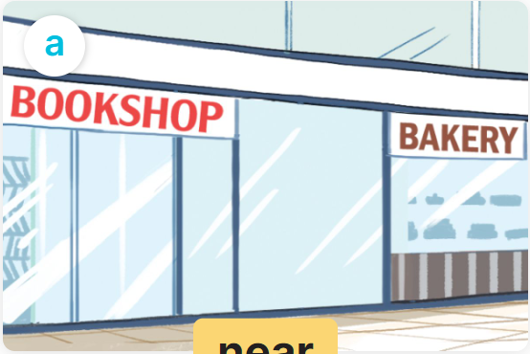
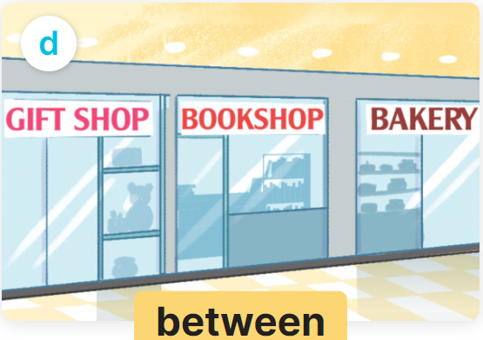
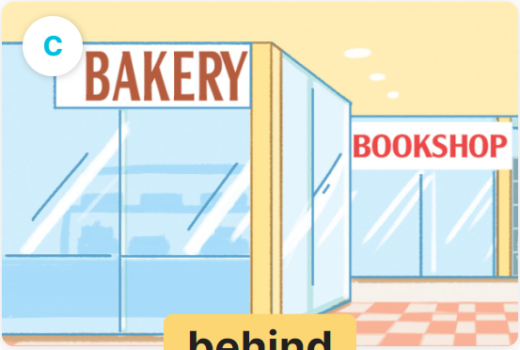
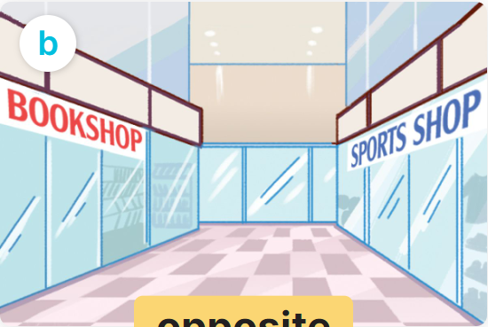
Where’s the bookshop?
It’s _________.
near
between
behind
opposite

Slide 3
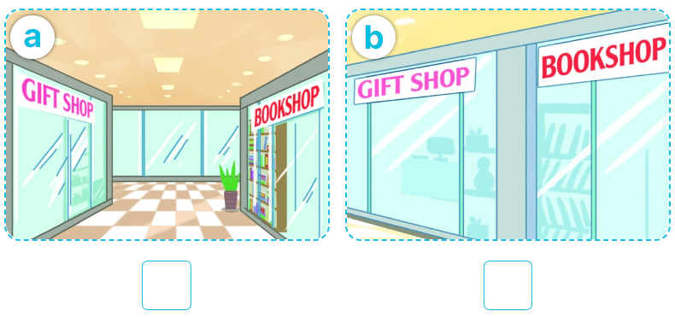

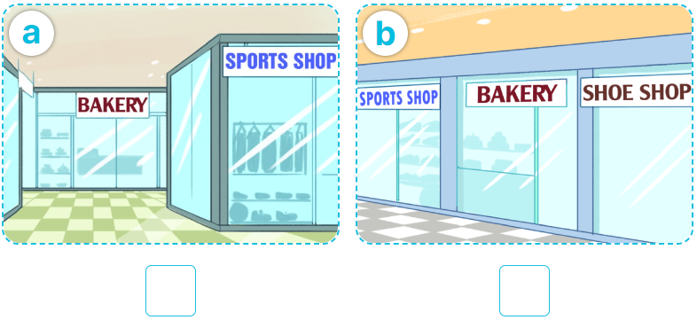
4
Listen and tick.
1
✓
2
✓

Slide 4


5
Look, complete and read.

Slide 5


5
Look, complete and read.
_____
________

Slide 6


5
Look, complete and read.
________
_______________
________
______

Slide 7

6
Let’s sing.

