Slide 1





Unit 18
At the
shopping centre
Lesson 2 – Period 1

Slide 2
10
20
30
40
50
ten
twenty
thirty
forty
fifty
60
70
80
90
100
sixty
seventy
eighty
ninety
one hundred

Slide 3

Vocabulary
skirt
/skɜːt/
Chân váy

Slide 4
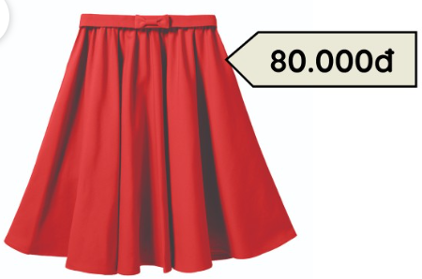
Vocabulary
dong
/dɒŋ/
đồng
(đơn vị tiền tệ của Việt Nam)

Slide 5
Vocabulary
thousand
/ˈθaʊznd/
Nghìn

Slide 6
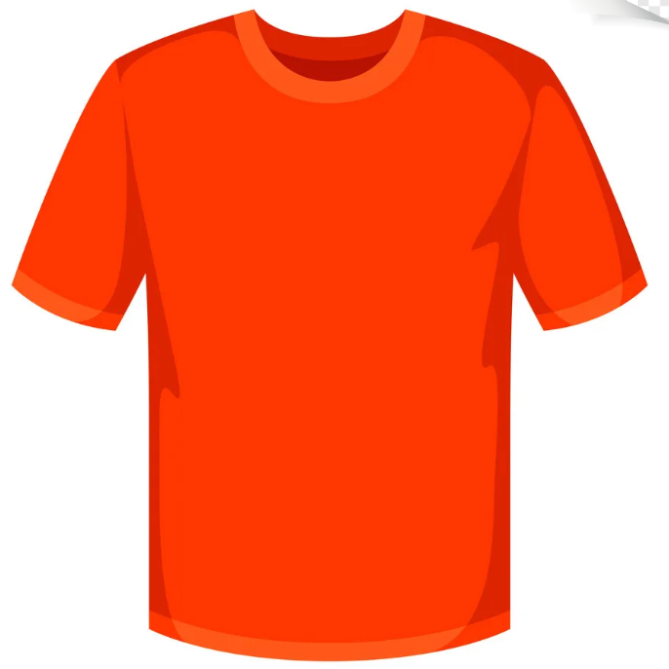
Vocabulary
T-shirt
/ˈtiː ʃɜːt/
áo thun

Slide 7
Vocabulary
skirt
: Chân váy
dong
: Đồng (đơn vị tiền tệ của Việt Nam)
thousand
: Nghìn
T-shirt
: Áo thun

Slide 8
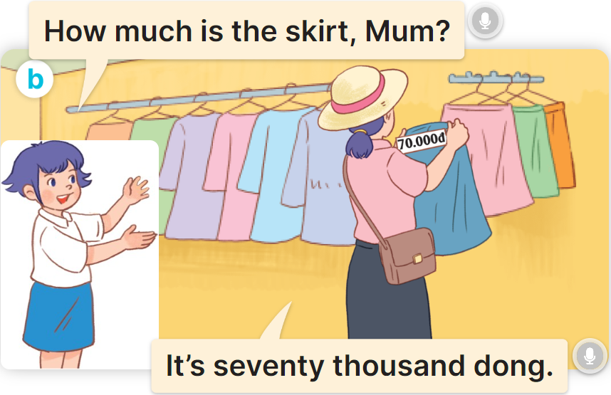
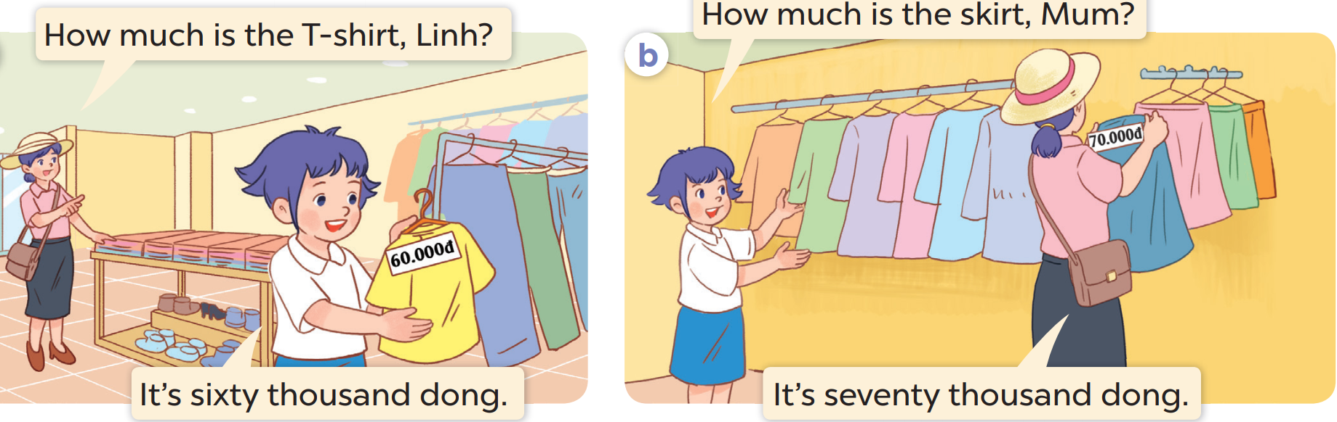
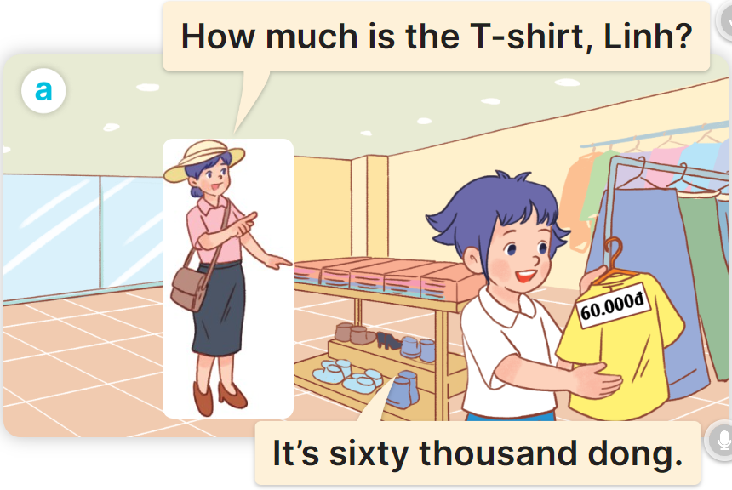

1
Look, listen and read.

Slide 9
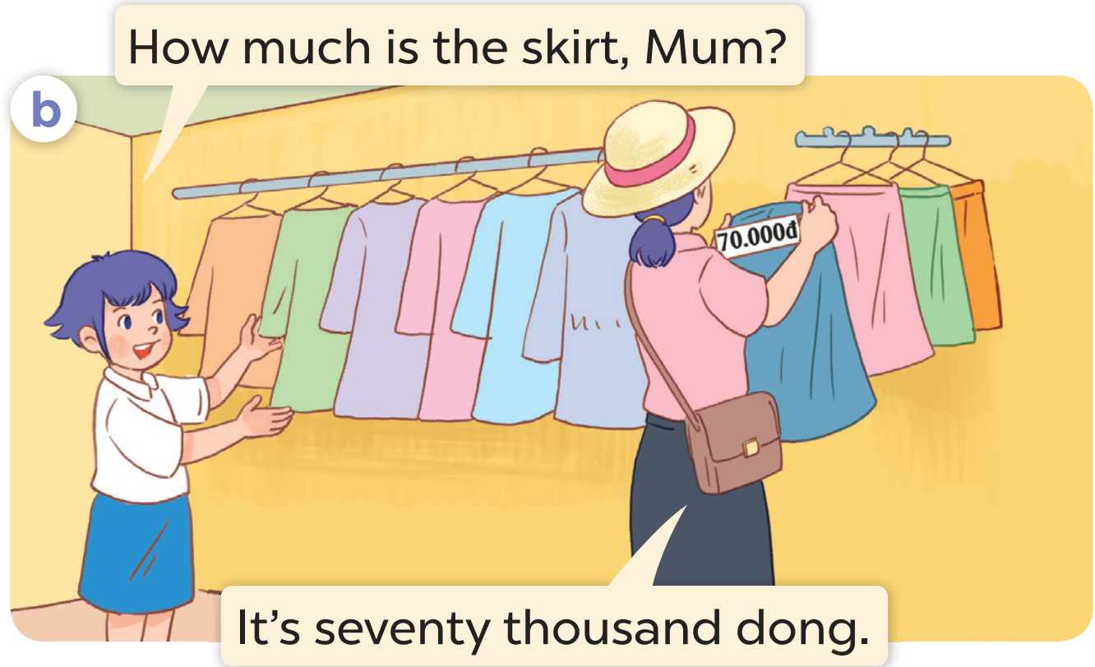
Cách hỏi giá cả:
How much is the _________?
(Cái ______ giá bao nhiêu?)
It’s ______ dong.
(Nó là ________ đồng?)
Ex:

Slide 10
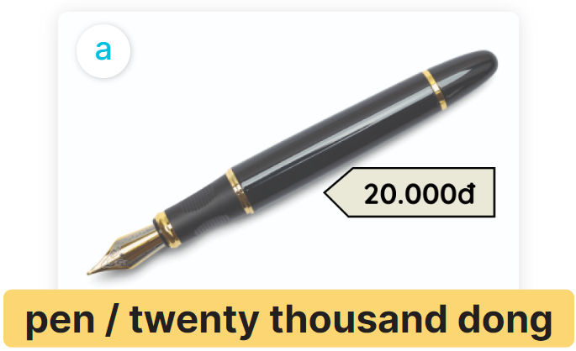
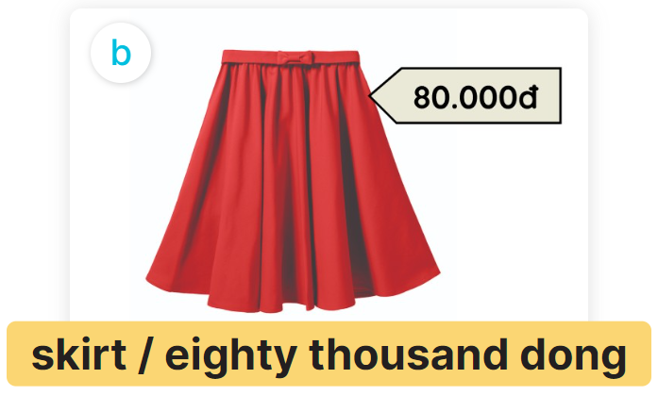
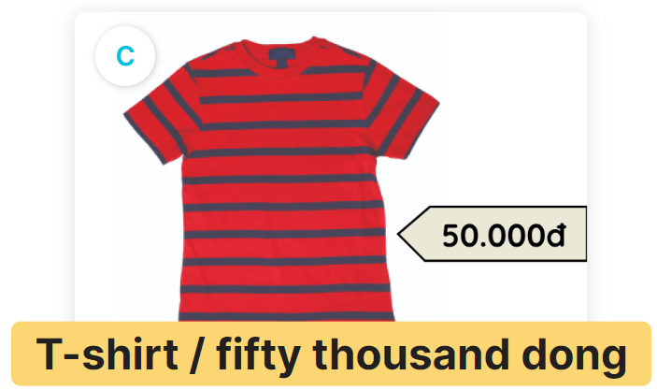
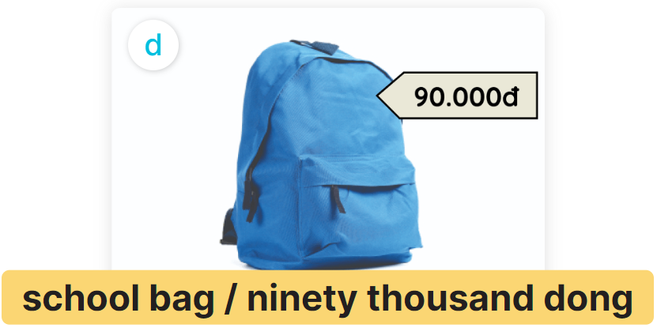
2
Listen, point and say.
How much is the _________?
It’s ____________.

Slide 11
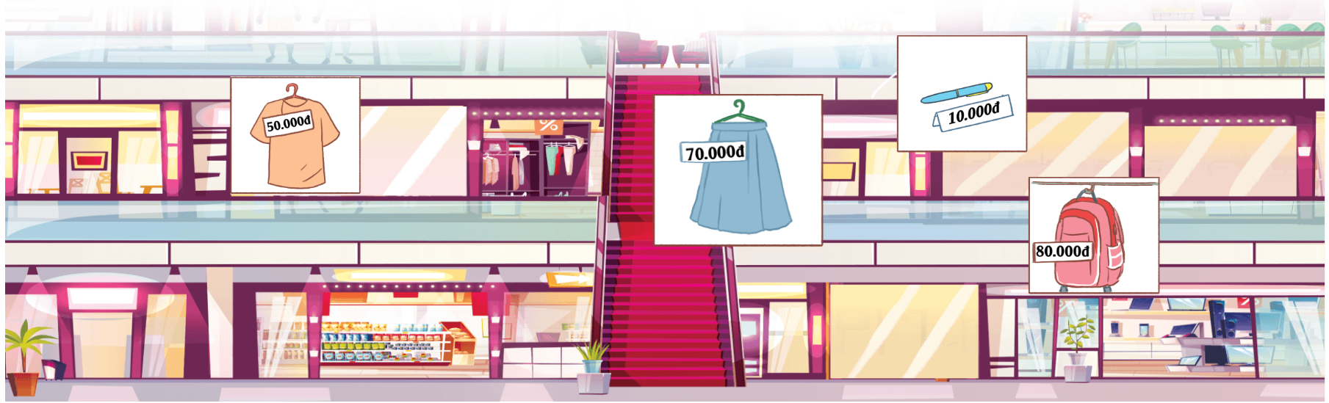
3
Let’s talk.
How much is the _____________?
skirt
It’s ____________ thousand dong.
seventy

