Slide 1





Unit 18
At the
shopping centre
Lesson 2 – Period 2

Slide 2


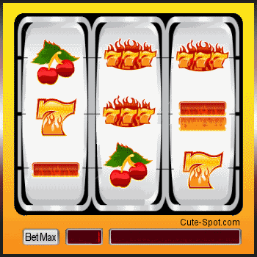
PLAY
READ THE NUMBER

Slide 3



NEXT
How much?
1/8
20
000
đ
TIME’S UP
TWENTY THOUSAND DONG
CHECK

Slide 4
NEXT
How much?
2/8
70
000
đ
TIME’S UP
SEVENTY THOUSAND DONG
CHECK

Slide 5
NEXT
How much?
3/8
50
000
đ
TIME’S UP
FIFTY THOUSAND DONG
CHECK

Slide 6
NEXT
How much?
4/8
40
000
đ
TIME’S UP
FORTY THOUSAND DONG
CHECK

Slide 7
NEXT
How much?
5/8
60
000
đ
TIME’S UP
SIXTY THOUSAND DONG
CHECK

Slide 8
NEXT
How much?
6/8
90
000
đ
TIME’S UP
NINETY THOUSAND DONG
CHECK

Slide 9
NEXT
How much?
7/8
80
000
đ
TIME’S UP
EIGHTY THOUSAND DONG
CHECK

Slide 10
NEXT
How much?
8/8
30
000
đ
TIME’S UP
THIRTY THOUSAND DONG
CHECK

Slide 11
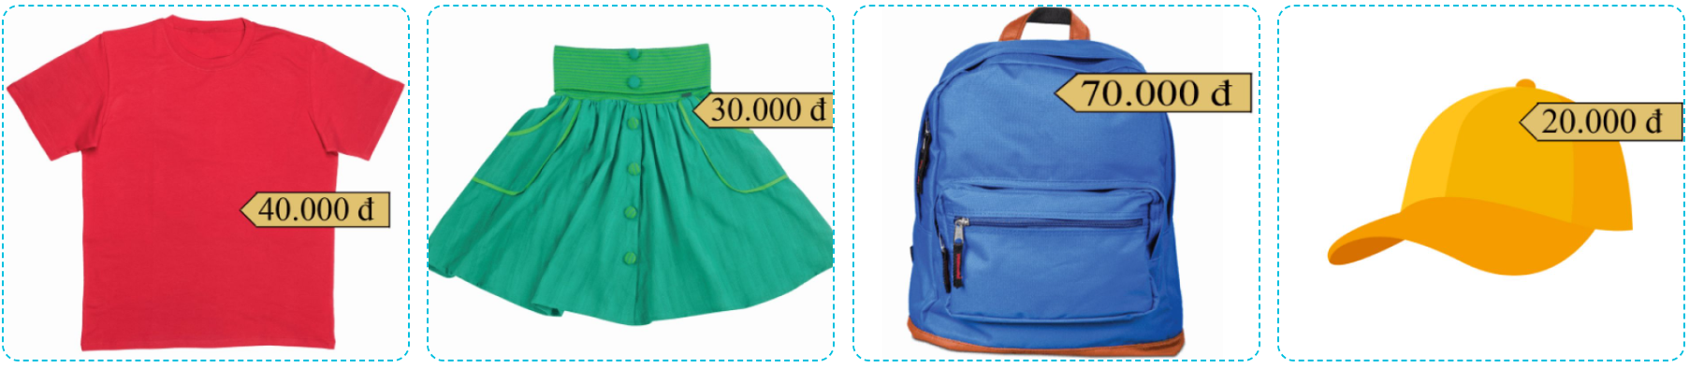

4
Listen and number.
2
4
1
3
1
2
3
4

Slide 12
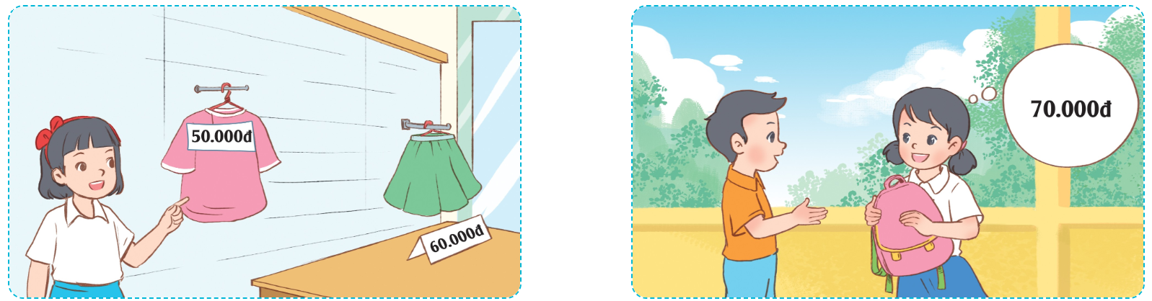
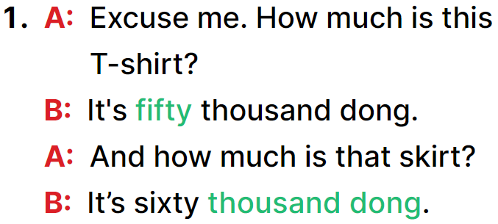
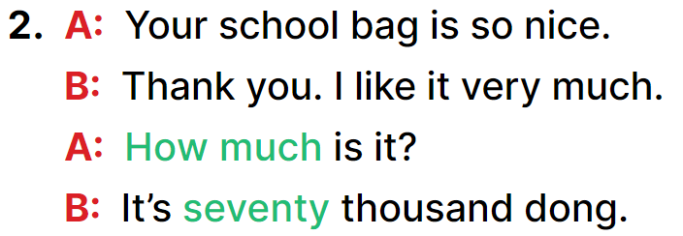
5
Look, complete and read.
________
________
_______
________.

