Slide 1


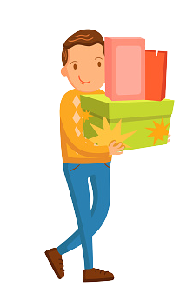


Unit 18
At the
shopping centre
Lesson 3 – Period 1

Slide 2

Listen and clap.
Which syllable is stressed?

Slide 3


campsite
‘campsite

Slide 4
shopping
‘shopping

Slide 5
‘bookshop
bookshop

Slide 6
centre
‘centre

Slide 7
be’hind
behind

Slide 8
between
be’tween

Slide 9
The stress is on the second syllable
be’hind
be’tween

Slide 10

1
Listen and repeat.
be'hind
The bakery is be'hind the bookshop.
be'tween
The bakery is be'tween the bookshop and the sports shop.

Slide 11
2
Listen and circle.
1. The gift shop is ______ the bookshop and the bakery.
a. behind b. between c. opposite
2. The gift shop is ______ the bookshop and the bakery.
a. between b. opposite c. behind

Slide 12
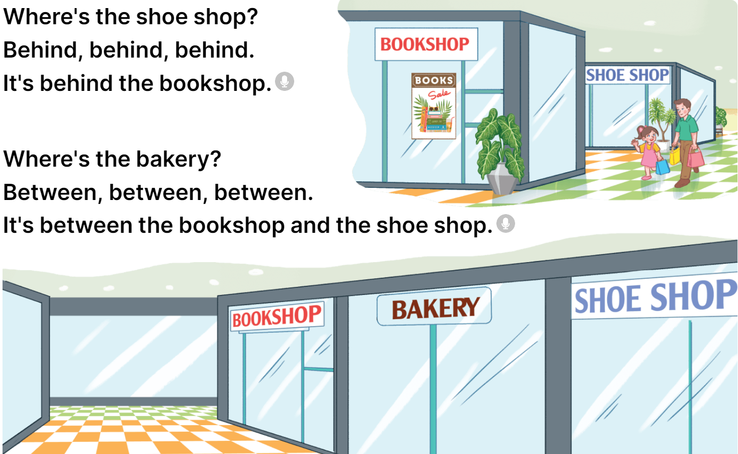
3
Let’s chant.

