Slide 1





Unit 18
At the
shopping centre
Lesson 3 – Period 2

Slide 2
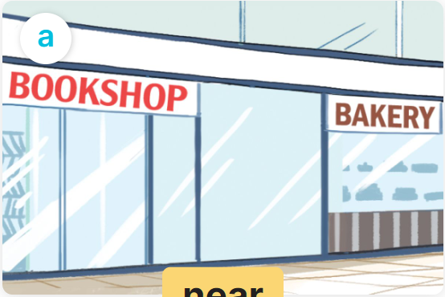
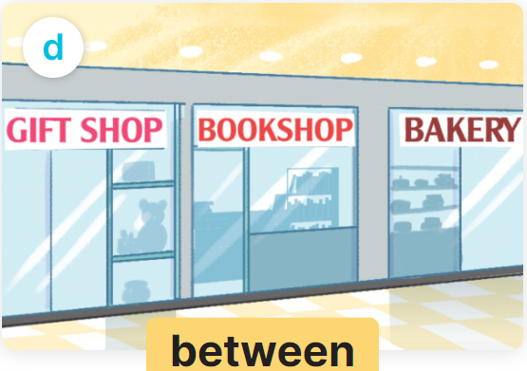

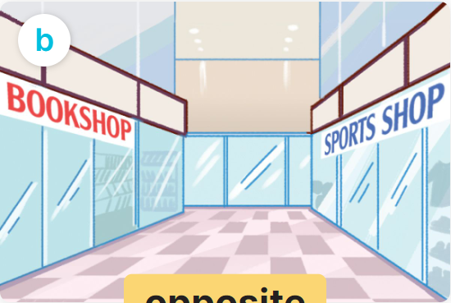
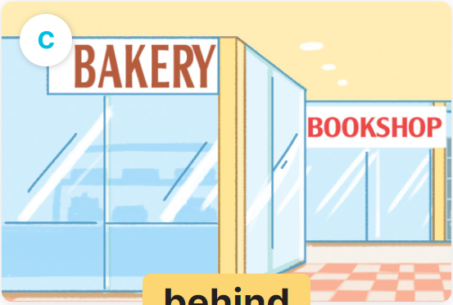
It’s _________.
Where’s the bookshop?
near
between
MsPham
0936082789
opposite
behind

Slide 3
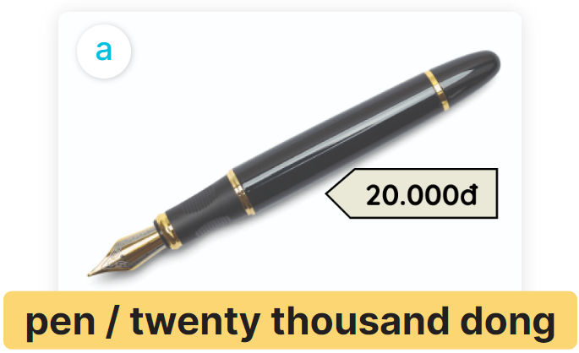
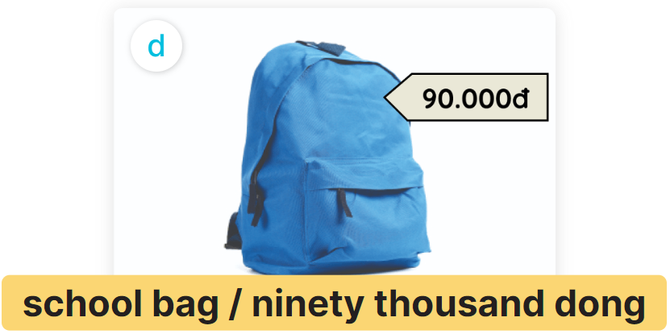
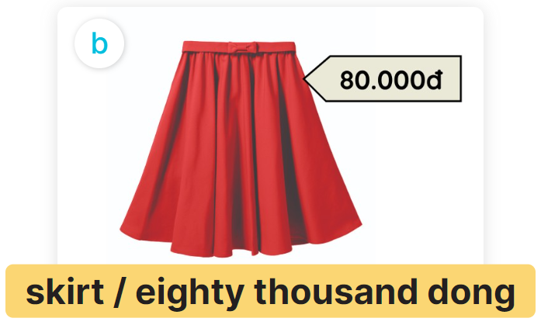
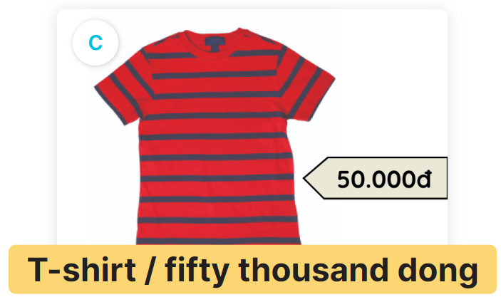
It’s ________thousand dong.
How much is the _________
MsPham
0936082789

Slide 4
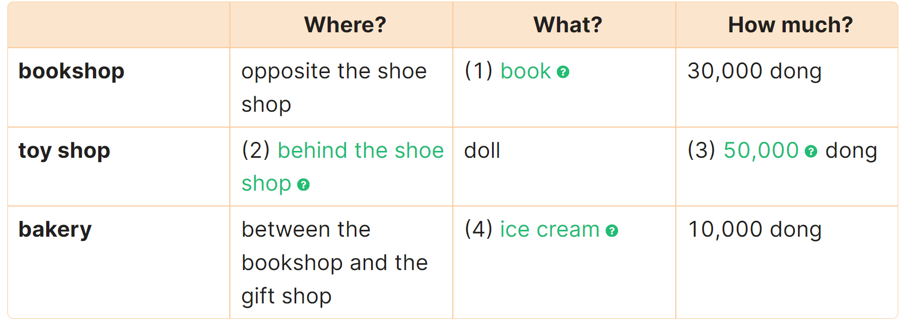
4
Read and complete.
We are at the shopping centre. We can see many shops. The bookshop is opposite the shoe shop. The toy shop is behind the shoe shop. The bakery is between the bookshop and the gift shop.
Mai wants to buy a book. It is 30,000 dong. Linh wants to buy a doll. It is 50,000 dong. I want to buy an ice cream. It is 10,000 dong.
__________
book
behind the
shoe shop
______
__________
50,000
__________
ice cream

Slide 5
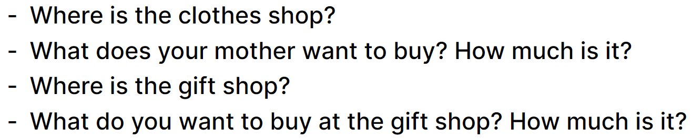
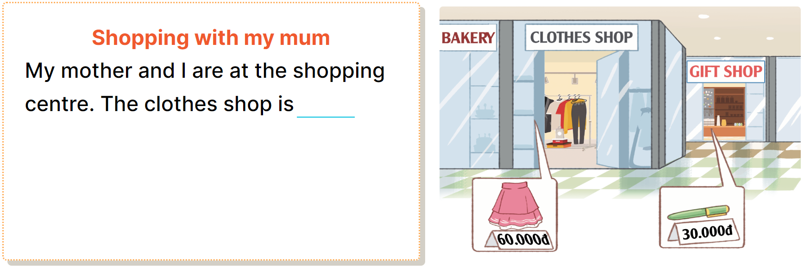
5
Let’s write.

Slide 6
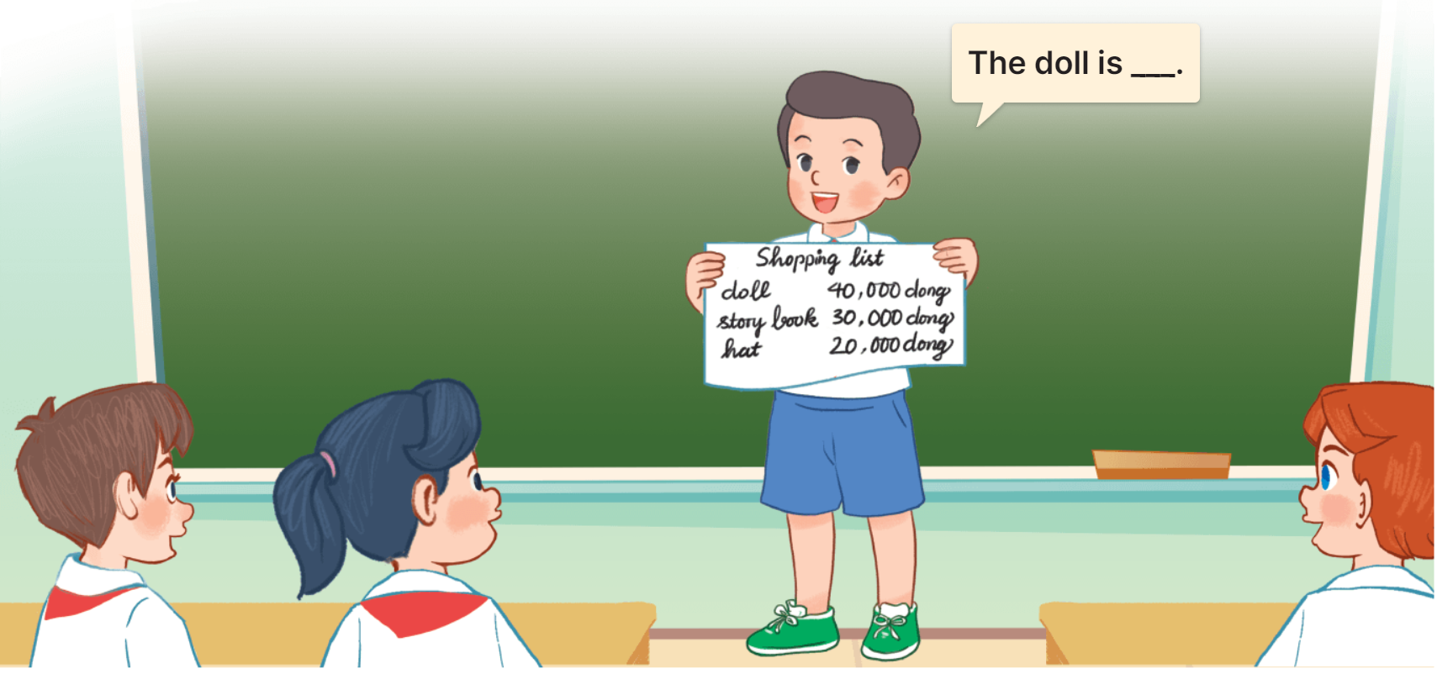
6
Project.
At the shopping centre

