Slide 1
Unit 16
weather
Lesson 1 – Period 2

Slide 2





What was the weather like last weekend?
It was _______.
rainy
windy
sunny
cloudy

Slide 3

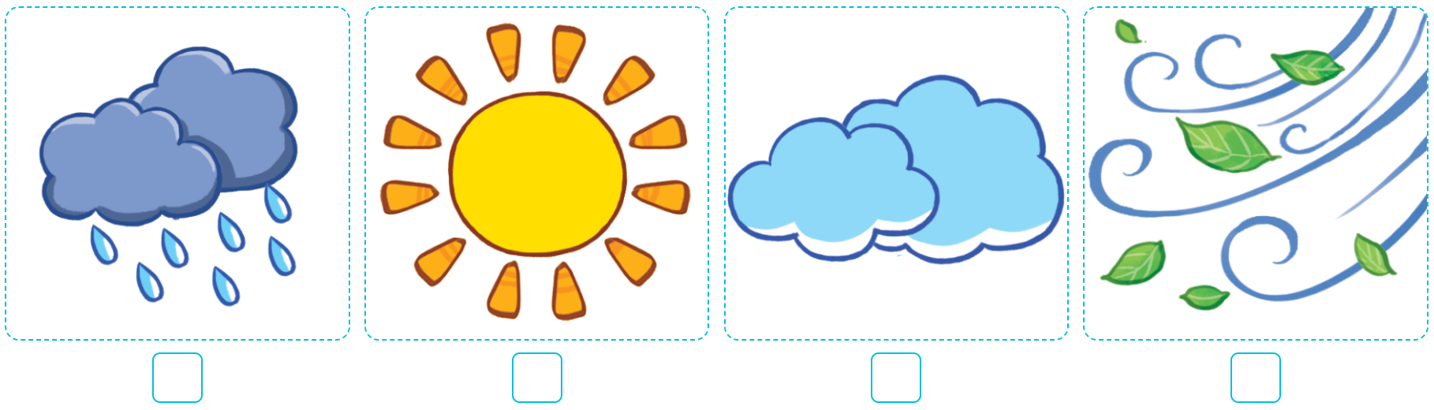

MsPham
0936082789
4
Listen and number.
2
4
3
1
1
2
3
4

Slide 4
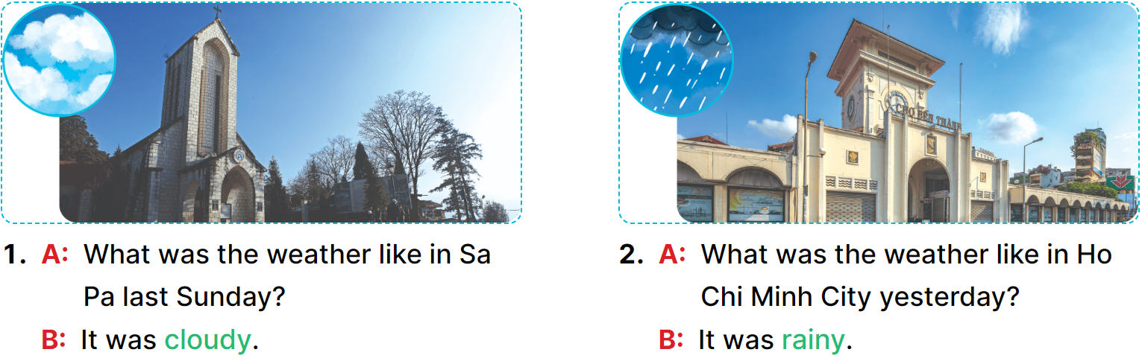
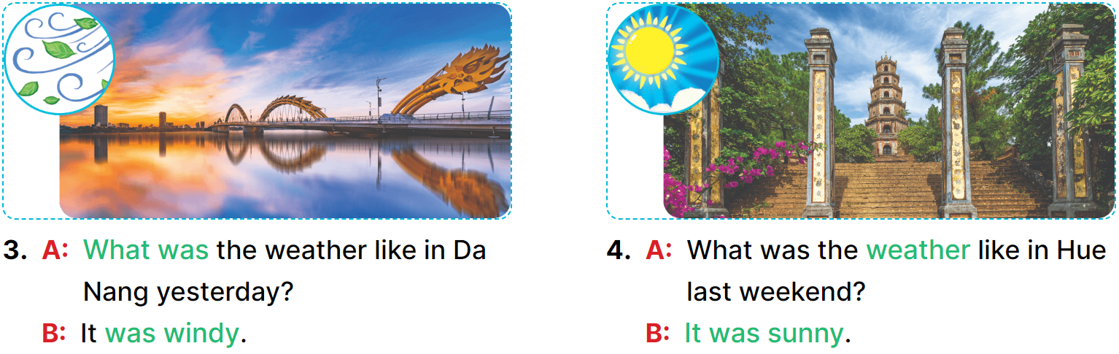
MsPham
0936082789
5
Look, complete and read.
__________.
__________.
_____
____
__________.
__________.

Slide 5
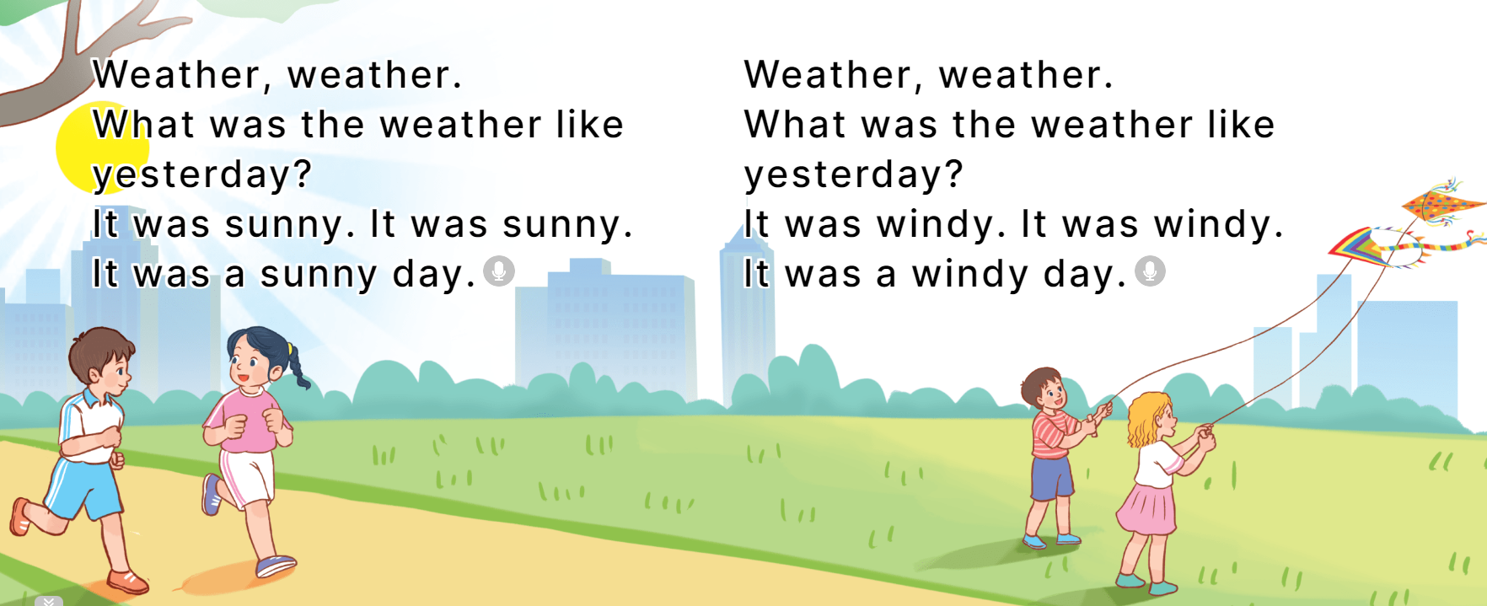
6
Let’s sing.

Slide 6
What was the weather like last weekend?
It was _______.
rainy
windy
sunny
cloudy

