Slide 1
Unit 16
weather
Lesson 2 – Period 1

Slide 2
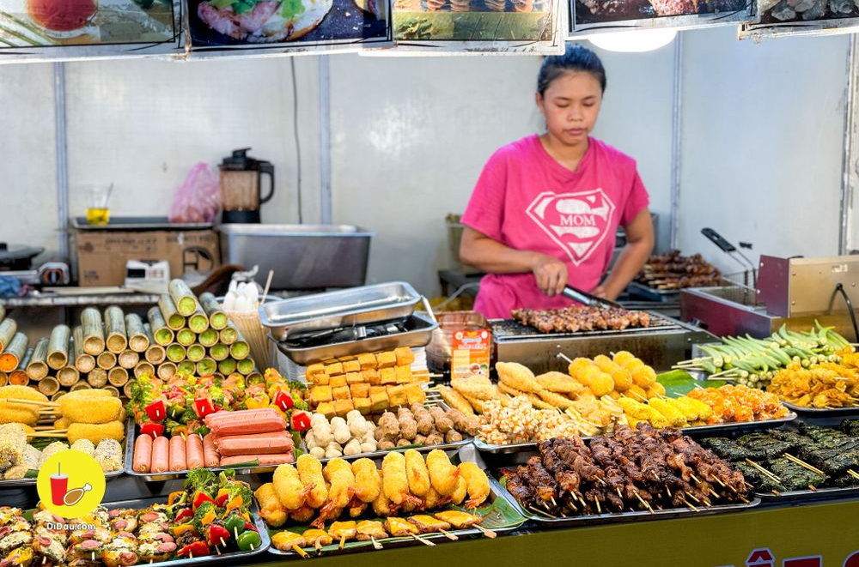
Vocabulary
food stall
/fuːd stɔːl/
Gian hàng thực phẩm
(Hàng ăn)

Slide 3
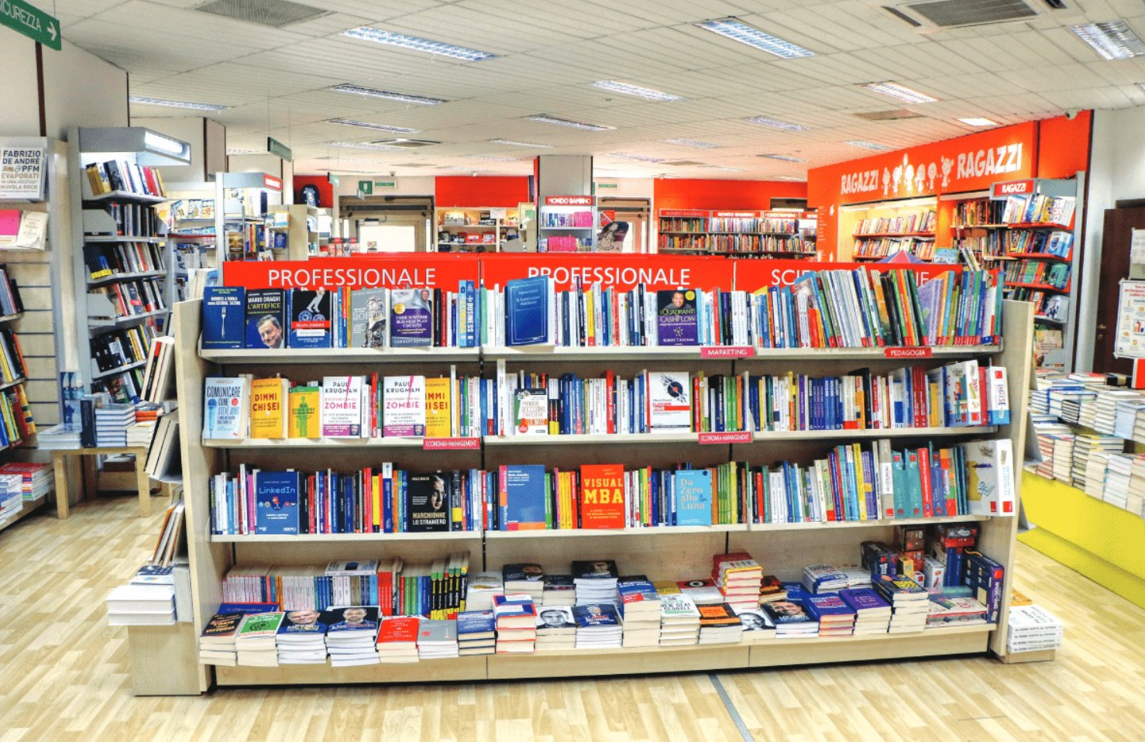
Vocabulary
bookshop
/ˈbʊkʃɒp/
Hiệu sách

Slide 4
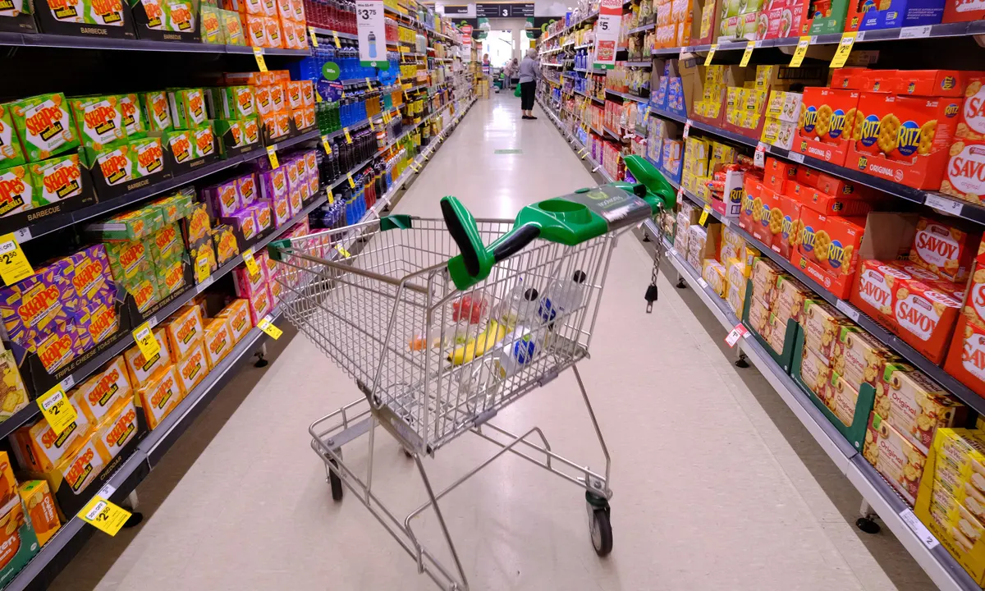
Vocabulary
supermarket
/ˈsuːpəmɑːkɪt/
Siêu thị

Slide 5
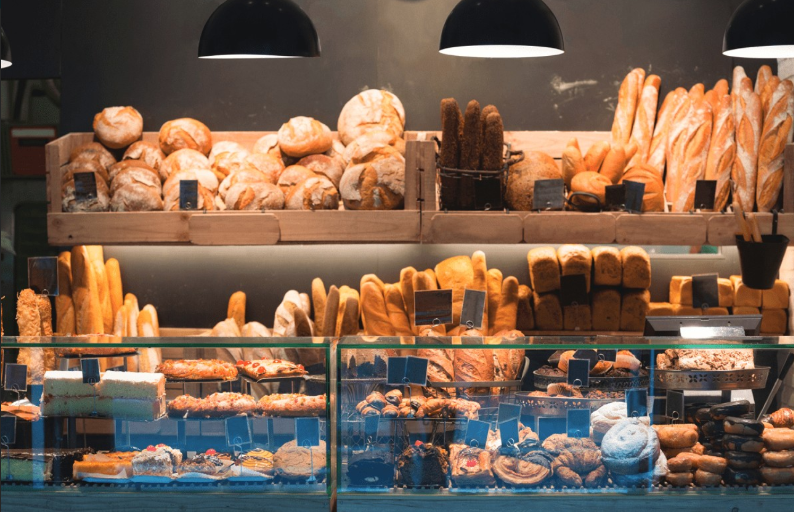
Vocabulary
bakery
/ˈbeɪkəri/
Hiệu bánh mì

Slide 6
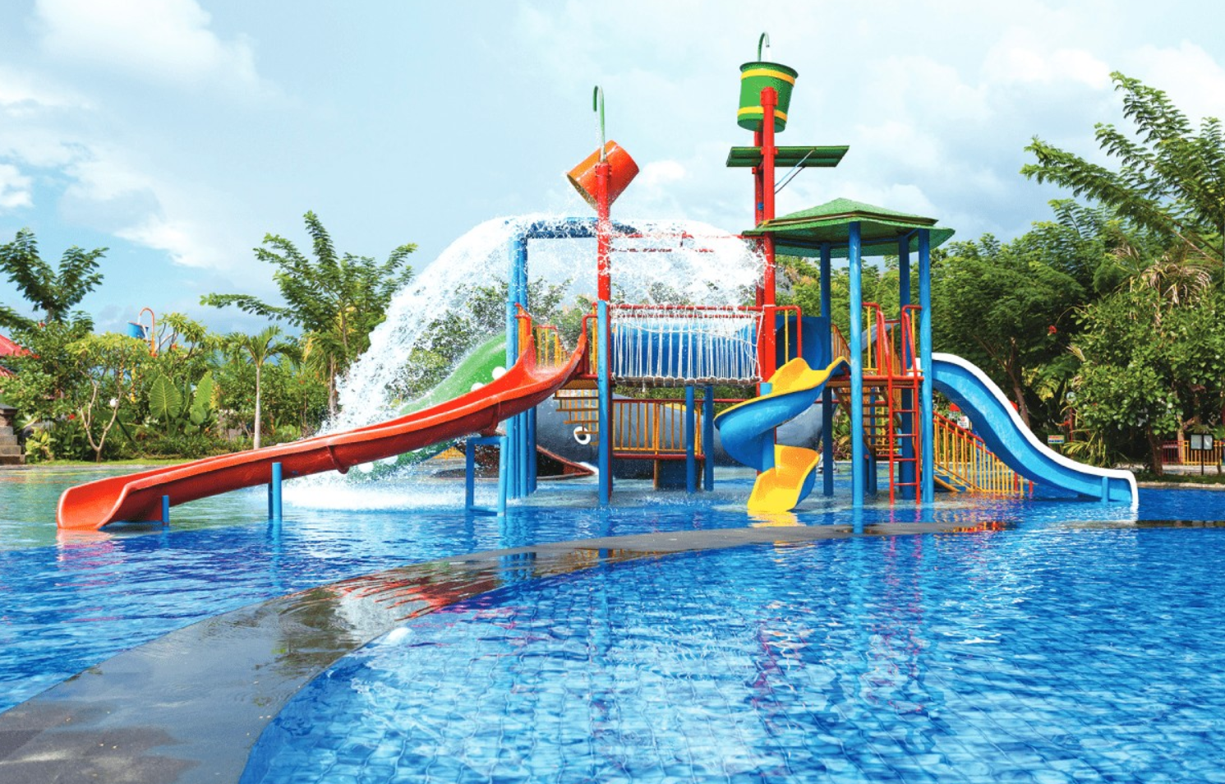
Vocabulary
water park
/ˈwɔːtə pɑːk/
Công viên nước

Slide 7
Vocabulary
food stall
: Gian hàng thực phẩm
bookshop
: Hiệu sách
supermarket
: Siêu thị
bakery
: Hiệu bánh mì
water park
: Công viên nước

Slide 8
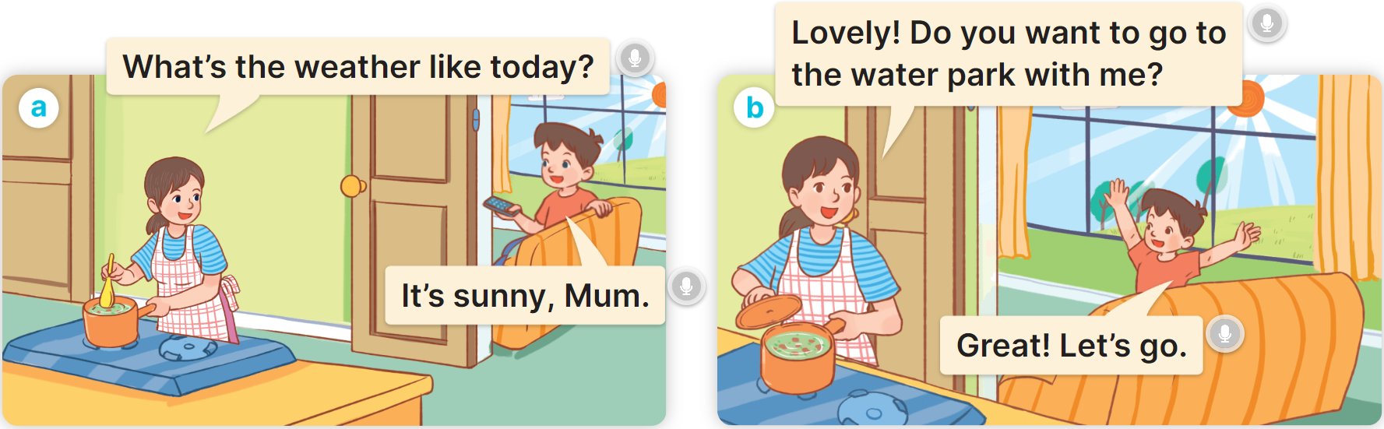


1
Look, listen and read.
MsPham
0936082789

Slide 9



1
Cách hỏi trường bạn (hoặc1 nơi nào đó) ở đâu:
Do you want to go to the __________?
(Bạn có muốn đi
_______ không?)
Great! Let’s go.
(Tuyệt quá! Cùng đi nào.)
Sorry. I can’t.
Xin lỗi. Tớ không thể đi được.)
Ex:

Slide 10
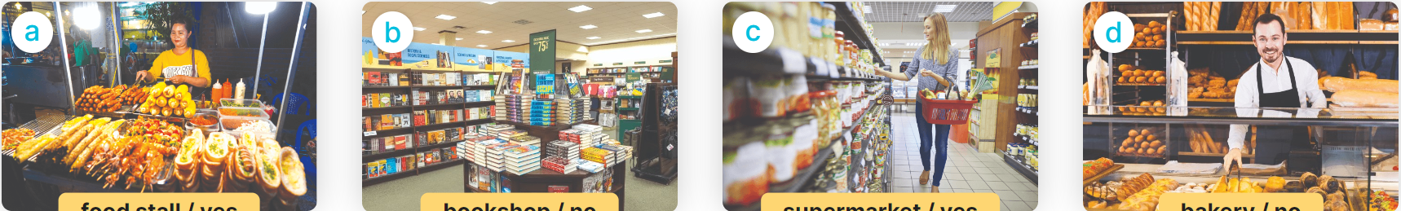
2
Listen, point and say.
Do you want to go to the __________?
Great! Let’s go.
Sorry. I can’t.
food stall/yes
bookshop/no
supermarket/yes
bakery/no

Slide 11


2
Listen, point and say.
food stall/yes
Do you want to go to the food stall?
Great! Let’s go.

Slide 12

2
Listen, point and say.
bookshop/no
Do you want to go to the bookshop?
Sorry. I can’t.

Slide 13
2
Listen, point and say.
supermarket/yes
Do you want to go to the supermarket?
Great! Let’s go.

Slide 14
2
Listen, point and say.
bakery/no
Do you want to go to the bakery?
Sorry. I can’t.

Slide 15
2
Listen, point and say.
Do you want to go to the __________?
Great! Let’s go.
Sorry. I can’t.
food stall/yes
bookshop/no
supermarket/yes
bakery/no

Slide 16
Great! Let’s go.
Sorry. I can’t.
Do you want to go to the _________?
MsPham
0936082789
food stall
water park
bakery
supermarket
bookshop

