Slide 1
Unit 16
weather
Lesson 2 – Period 2

Slide 2


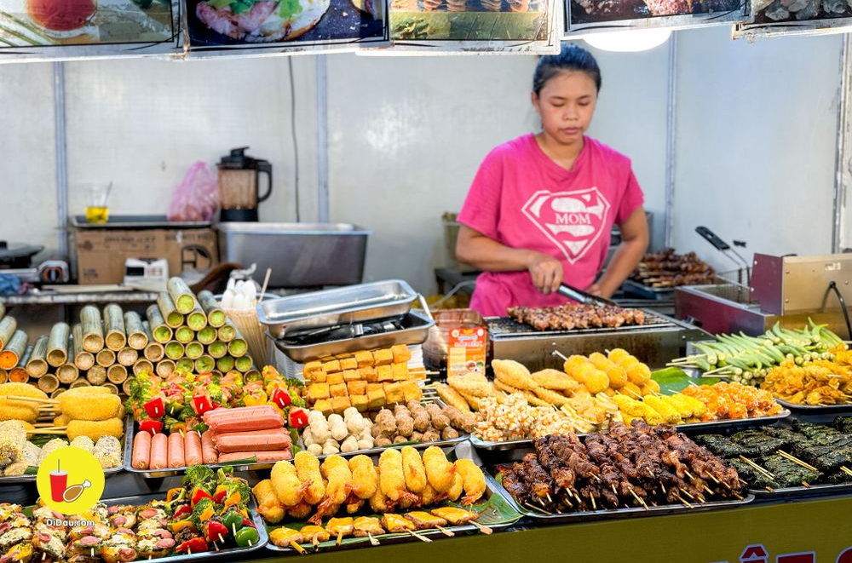
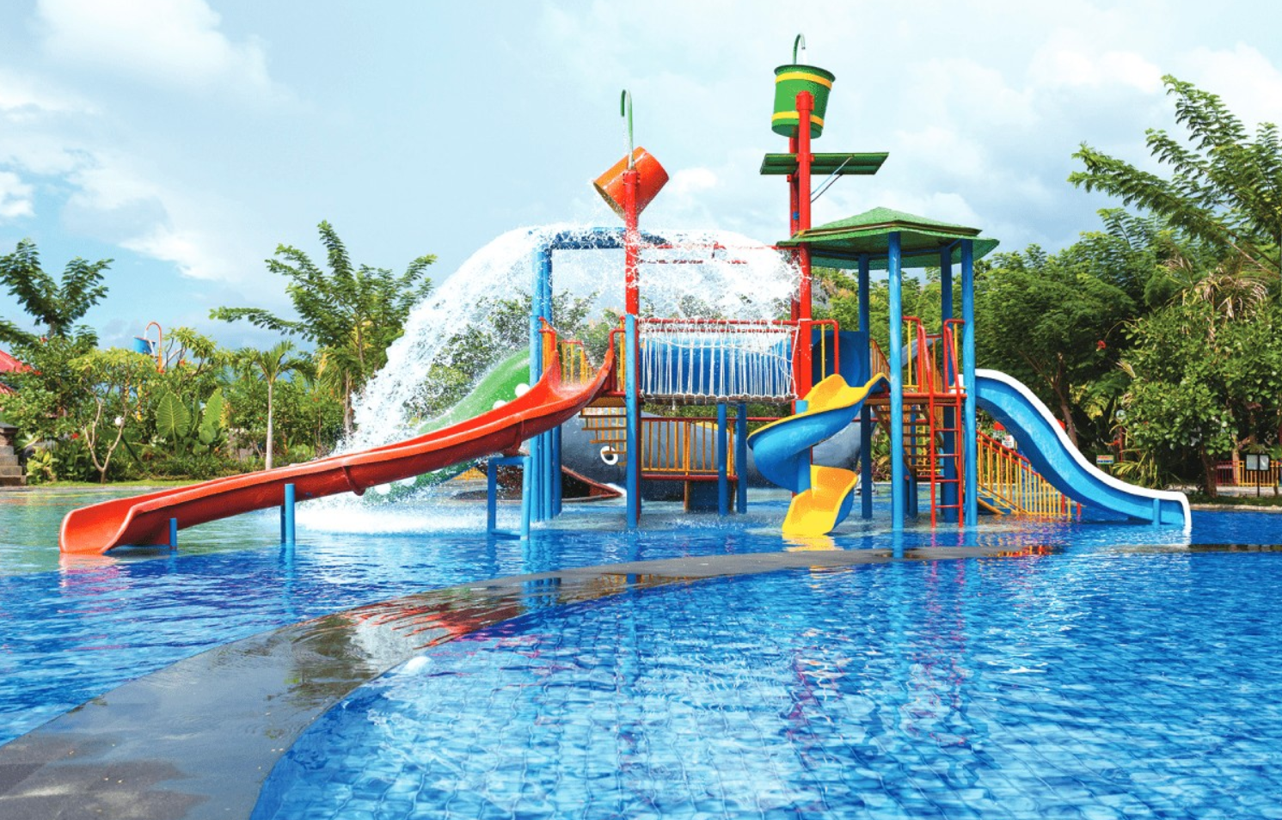

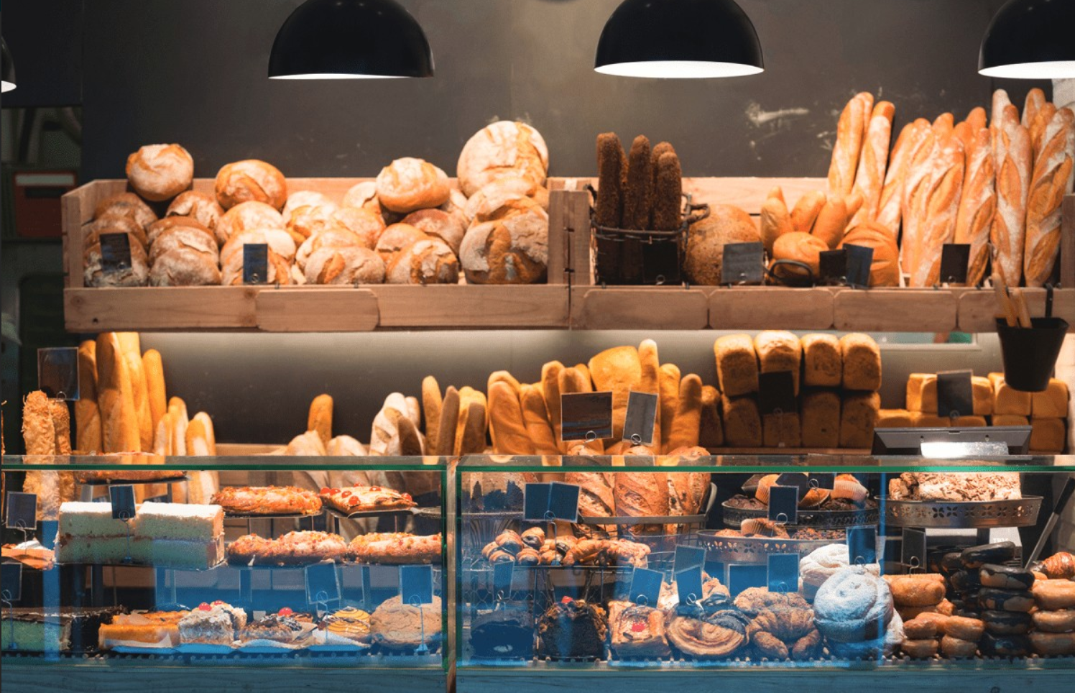
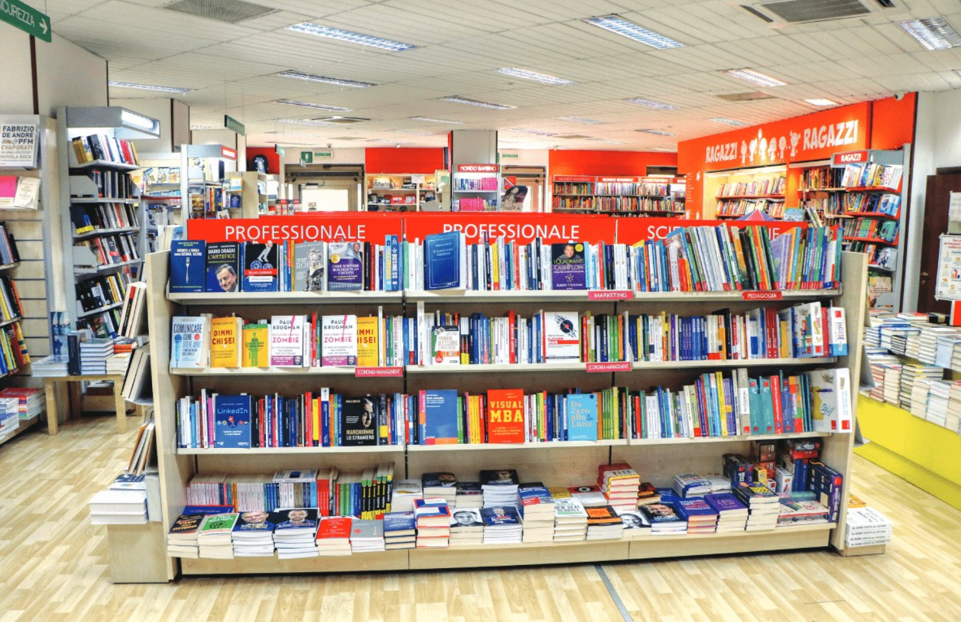
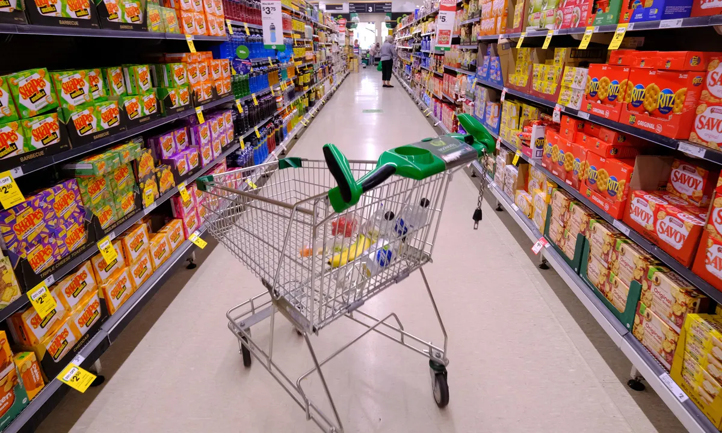
Great! Let’s go.
Sorry. I can’t.
Do you want to go to the _________?
MsPham
0936082789
food stall
water park
bakery
supermarket
bookshop

Slide 3

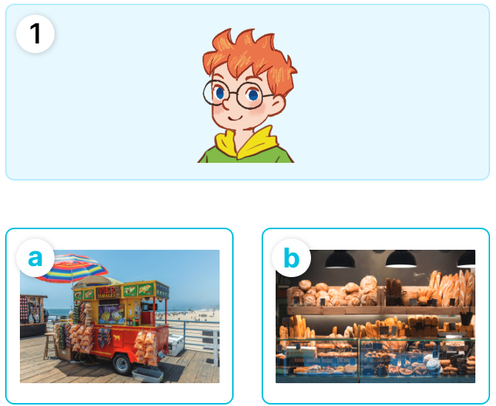
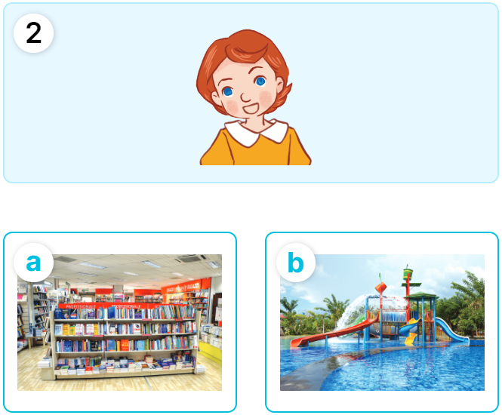
MsPham
0936082789
4
Listen and match.

Slide 4
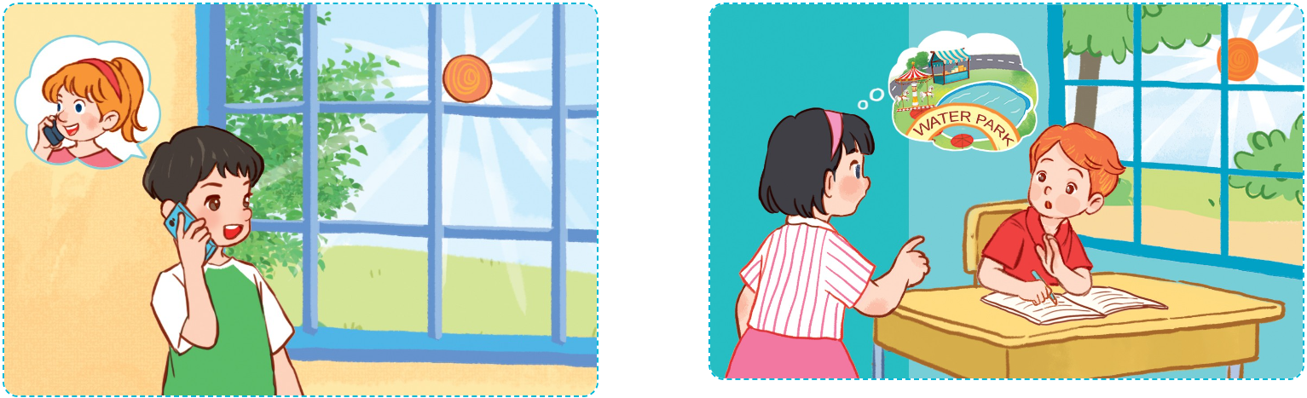
5
Look, complete and read.
MsPham
0936082789
A: Look! It's sunny today.
B: Yes, it is.
A: Do you want to go to the __________ with me?
B: Sorry, ______. I'm doing
my homework.
A: What's the weather like today?
B: It’s _________.
A: Lovely! Do you want to go to the bookshop?
B: _________! Let's go.
sunny
water park
I can’t
Great

Slide 5
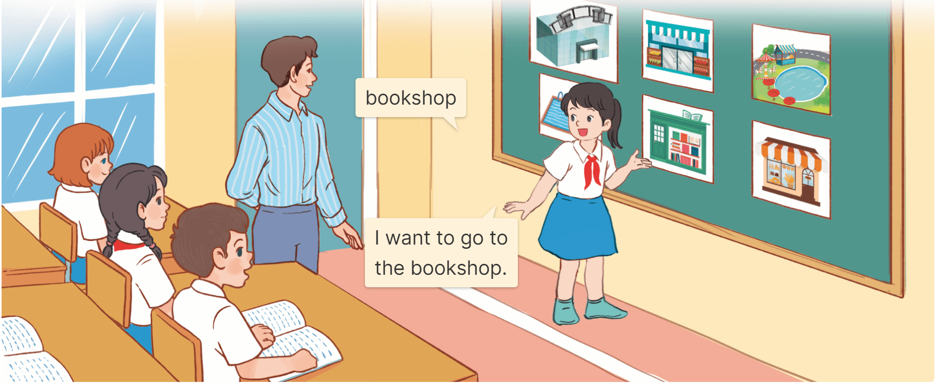
6
Let’s play.
Slap the board and say

Slide 6
Great! Let’s go.
Sorry. I can’t.
Do you want to go to the _________?
MsPham
0936082789
food stall
water park
bakery
supermarket
bookshop

