Slide 1
Unit 16
weather
Lesson 3 – Period 2

Slide 2





What was the weather like last weekend?
It was _______.
rainy
windy
sunny
cloudy

Slide 3


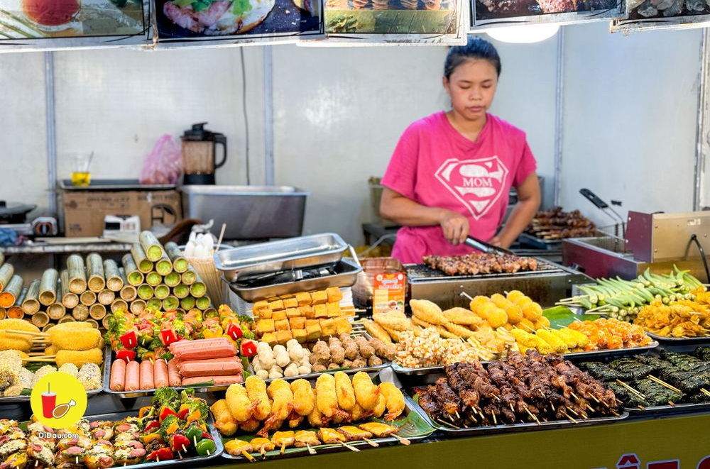
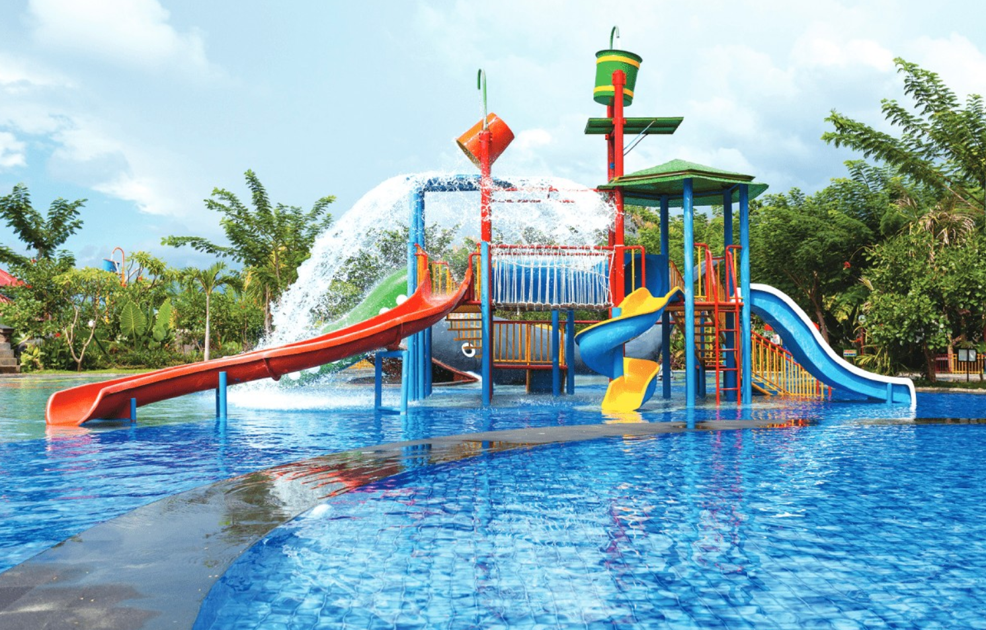
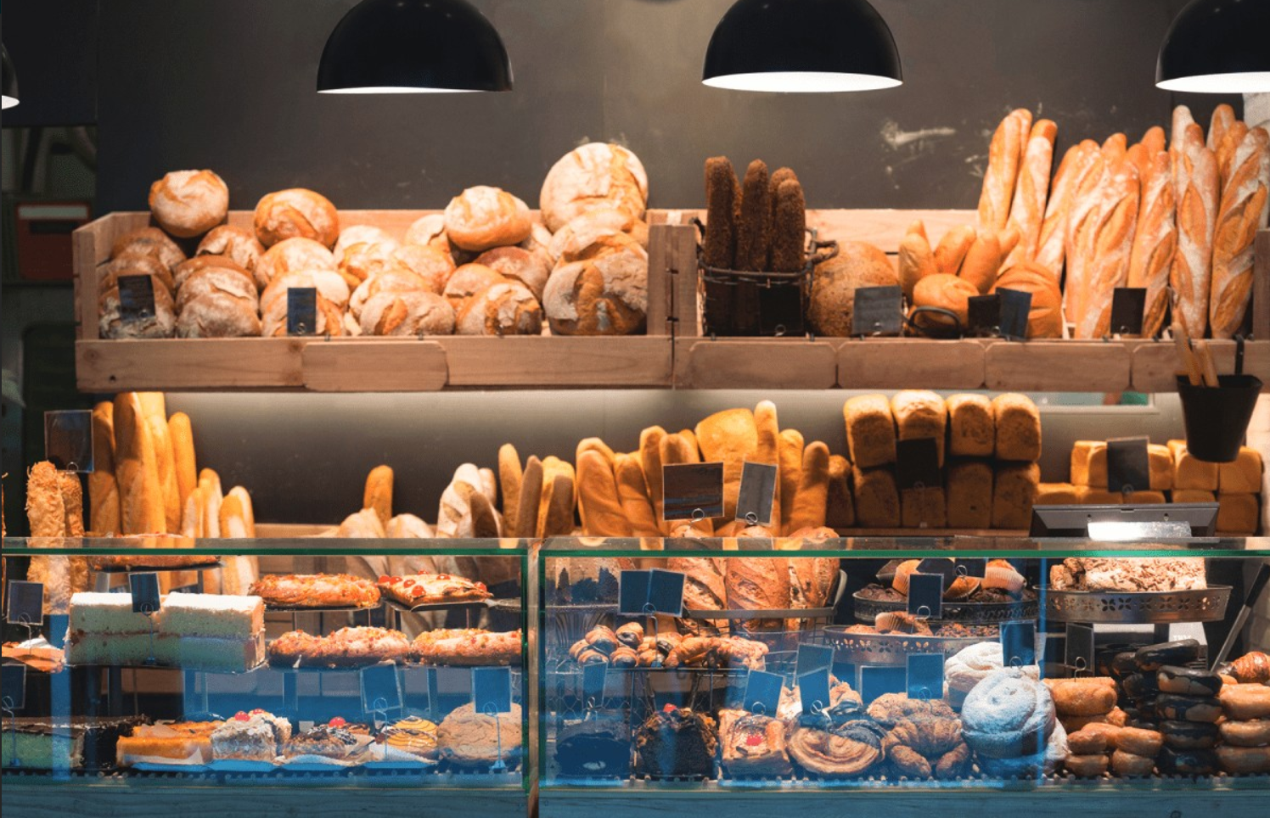
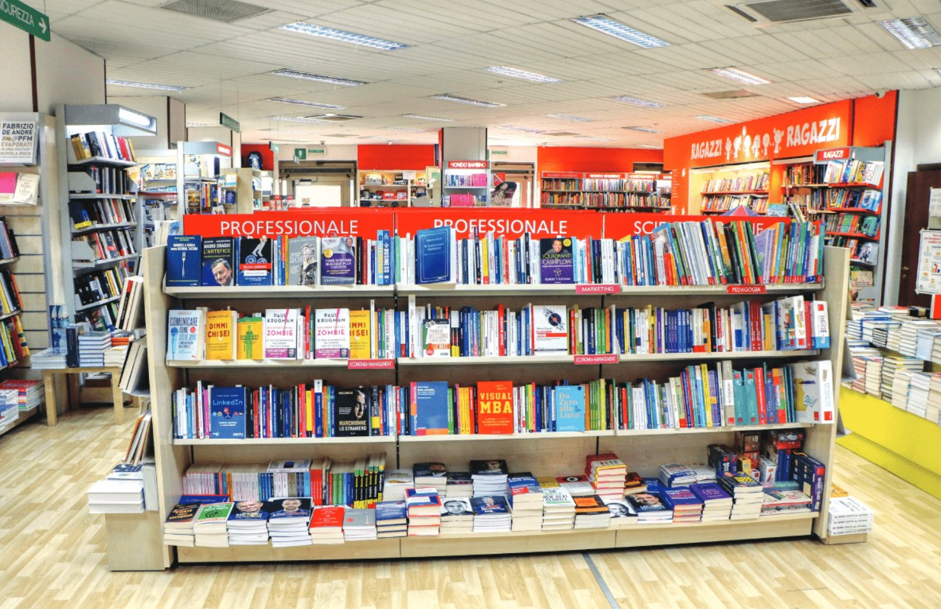
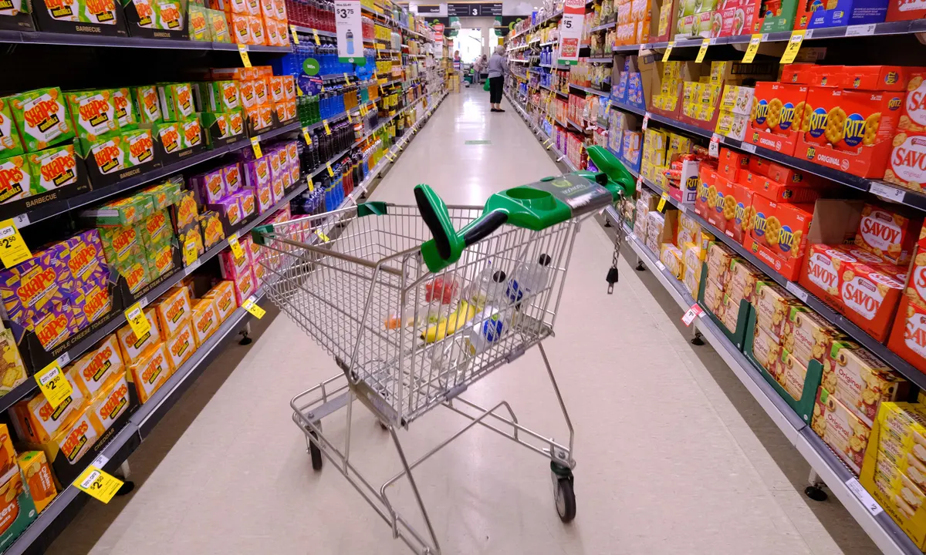
Great! Let’s go.
Do you want to go to the _________?
MsPham
0936082789
Sorry. I can’t.
MsPham
0936082789
food stall
water park
bakery
supermarket
bookshop

Slide 4
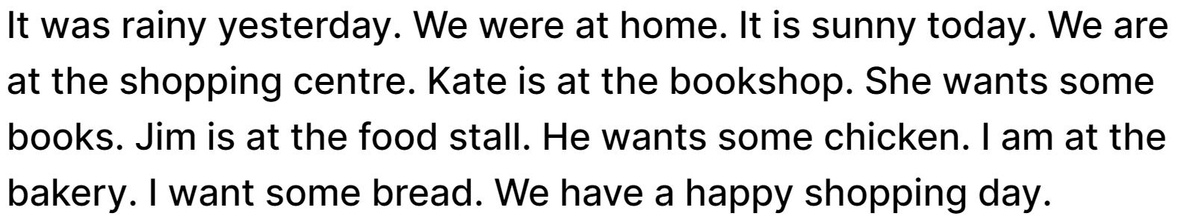
4
Read and circle.
1. lt was _________yesterday.
a. cloudy b. sunny c. rainy
2. It is _________today.
a. windy b. rainy c. sunny
3. Kate is at the _________.
a. bookshop b. bakery c. food stall
4. Jim is at the _________.
a. food stall b. bookshop c. bakery

Slide 5
5
Let’s write
My family go shopping
- What is the weather like today?
- Where do your family go?
- What do your parents want to buy?
- What do you want to buy?
- What does your brother / sister want to buy?
It is _____________ today.
My family go to the ___________.
My parents want to buy ____________.
I want to buy ____________.
My brother / sister want to buy ____________.

Slide 6
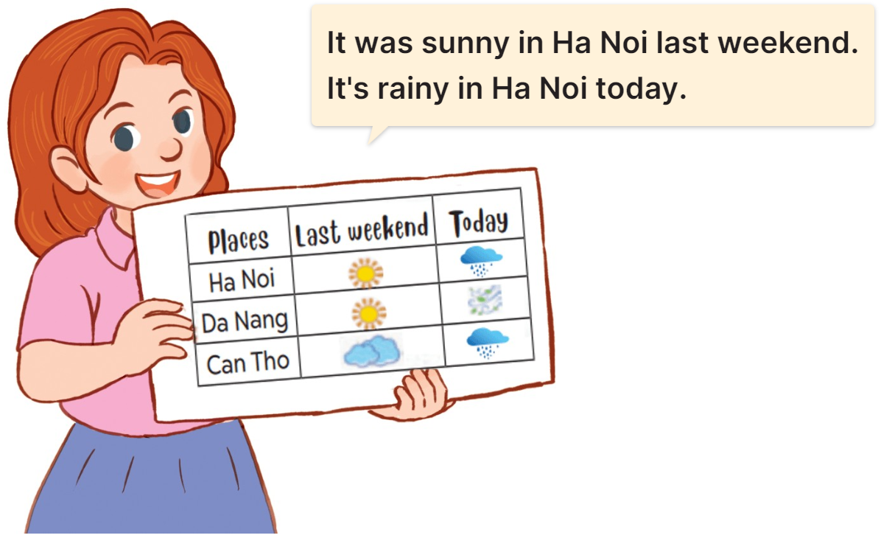
6
Project
MsPham
0936082789

