Slide 1

UNIT 18:MEANS OF
TRANSPORT
LESSON 1 ( 1, 2, 3)
Made by: Mrs Phuong
Notes:
MADE BY FACEBOOK :TRAN THI THANH TAM

Slide 2
Warm - up
Notes:
MADE BY FACEBOOK :TRAN THI THANH TAM

Slide 3
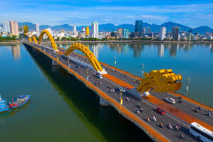
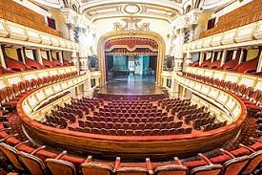
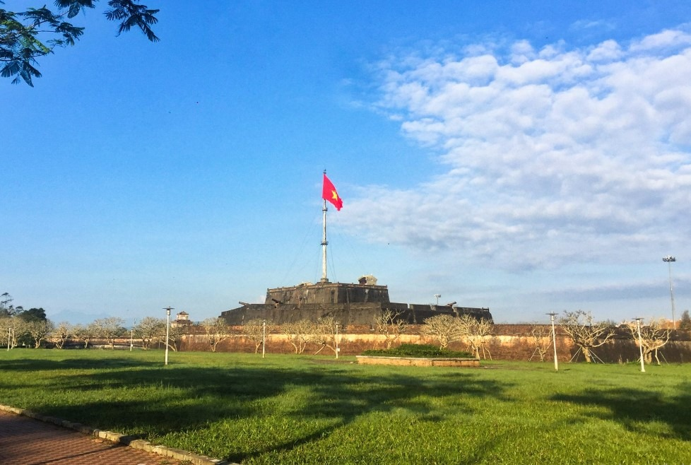
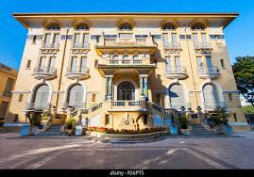
Where is this place?
Made by: Mrs Phuong
In Da Nang
In Ha Noi
In Hue
In Ho Chi Minh City
Notes:
MADE BY FACEBOOK :TRAN THI THANH TAM

Slide 4

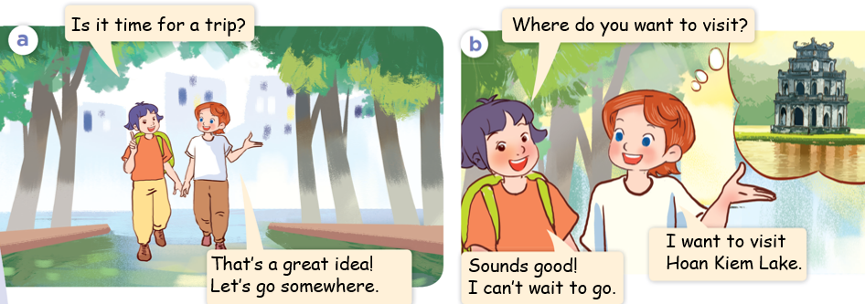
1.Look, listen and repeat
Notes:
MADE BY FACEBOOK :TRAN THI THANH TAM

Slide 5
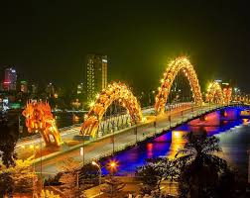
Dragon Bridge /ˈdræɡən brɪdʒ/
:Cầu Rồng
Notes:
MADE BY FACEBOOK :TRAN THI THANH TAM

Slide 6
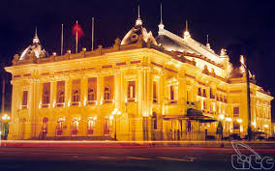
Ha Noi Opera House
/ha nɒɪ ˈɒprə haʊs/
: Nhà Hát lớn Hà Nội
Notes:
MADE BY FACEBOOK :TRAN THI THANH TAM

Slide 7
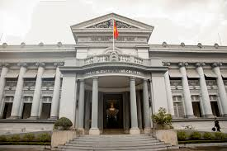
Ho Chi Minh City Museum
/hɒ tʃɪ mɪnh ˈsɪti mjuˈziːəm/
: Bảo tàng Hồ Chí Minh
Notes:
MADE BY FACEBOOK :TRAN THI THANH TAM

Slide 8
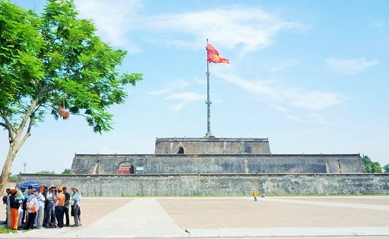
Ngo Mon Square /ŋɒ mɒn skweə/
: Quảng trường Ngọ Môn
Notes:
MADE BY FACEBOOK :TRAN THI THANH TAM

Slide 9
Let's play
Check vocabulary
MATCHING
Notes:
Made by Facebook: TRAN THI THANH TAM

Slide 10
1.Dragon Bridge
A
2.Ngo Mon Square
B
3.Ha Noi Opera House
C
4.Ho Chi Minh City Museum
D
Notes:
MADE BY FACEBOOK :TRAN THI THANH TAM

Slide 11
Hỏi và trả lời xem ai đó muốn thăm nơi nào
Where do you want to visit?
( Bạn muốn thăm nơi nào vậy?)
I want to visit Ha Noi Opera House.
( Tôi muốn thăm nhà hát lớn Hà Nội.)

Slide 12
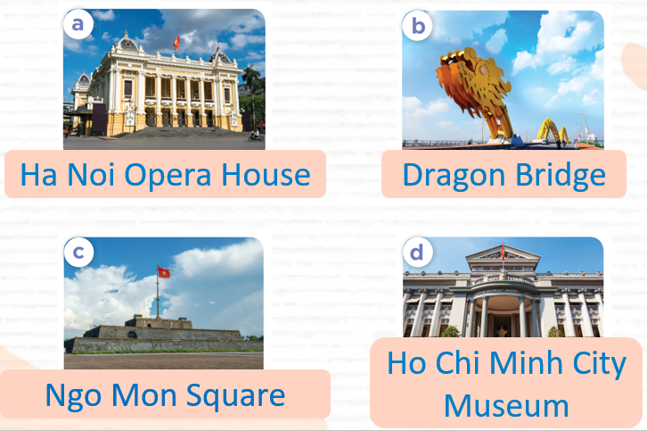
2.Listen, point and say
Ha Noi Opera House
Where do you want to visit?
I want to visit……………..................
Notes:
MADE BY FACEBOOK :TRAN THI THANH TAM

Slide 13
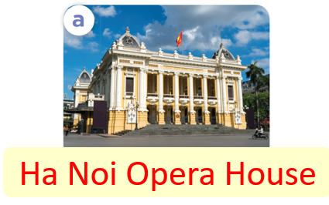
Where do you want to visit?
Ha Noi Opera House
I want to visit……………..................
Notes:
MADE BY FACEBOOK :TRAN THI THANH TAM

Slide 14
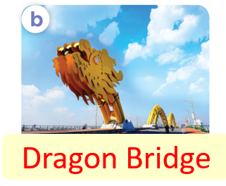
Where do you want to visit?
Dragon Bridge
I want to visit……………..................
Notes:
MADE BY FACEBOOK :TRAN THI THANH TAM

Slide 15
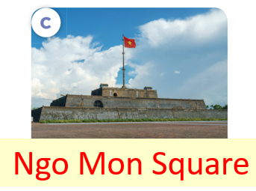
Where do you want to visit?
Ngo Mon Square
I want to visit……………..................
Notes:
MADE BY FACEBOOK :TRAN THI THANH TAM

Slide 16

Where do you want to visit?
Ho Chi Minh City Museum
I want to visit……….……………..................
Notes:
MADE BY FACEBOOK :TRAN THI THANH TAM

Slide 17
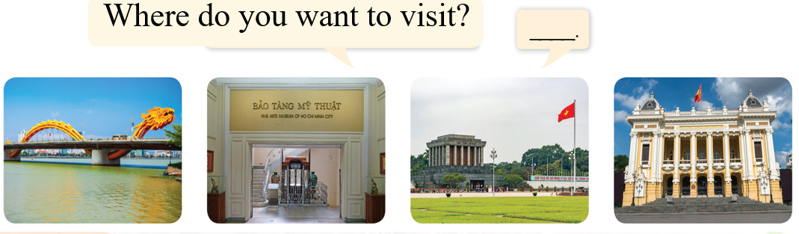
3. Let’s talk
Notes:
MADE BY FACEBOOK :TRAN THI THANH TAM

