Slide 1

UNIT 18:MEANS OF TRANSPORT
LESSON 2 ( 1, 2, 3)
Made by :Thu Phuong
Notes:
MADE BY FACEBOOK :TRAN THI THANH TAM

Slide 2
LET’S PLAY
Chinese Whispers

Slide 3
Chinese Whispers
Group 1
Group 2
I want to go to Ngo Mon Square.
I want to go to Hoan Kiem Lake.
Notes:
Made by Facebook: TRAN THI THANH TAM

Slide 4

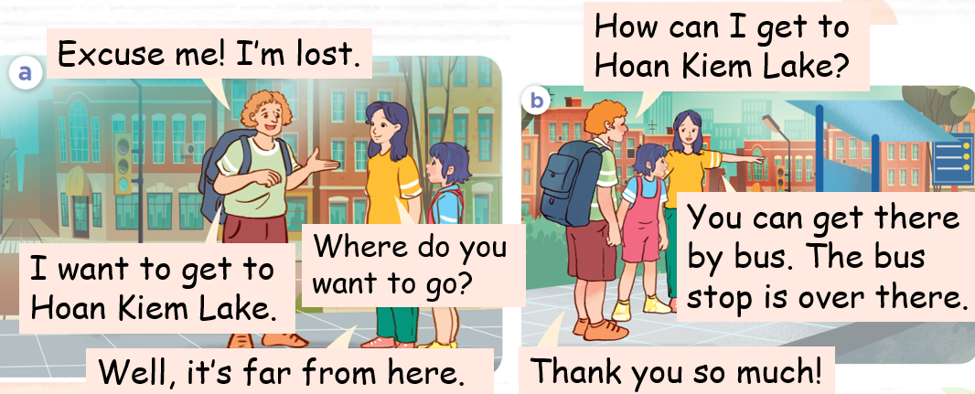
1.Look, listen and repeat
Notes:
MADE BY FACEBOOK :TRAN THI THANH TAM

Slide 5

Made by :Thu Phuong
by bicycle/baɪ ˈbaɪsɪkl/: bằng xe đạp
Notes:
MADE BY FACEBOOK :TRAN THI THANH TAM

Slide 6

Made by :Thu Phuong
by bus /baɪ bʌs/: bằng xe buýt
Notes:
MADE BY FACEBOOK :TRAN THI THANH TAM

Slide 7

Made by :Thu Phuong
by taxi /baɪ ˈtæksi/: bằng xe tắc xi
Notes:
MADE BY FACEBOOK :TRAN THI THANH TAM

Slide 8

on foot /ɒn fʊt/ : đi bộ
Notes:
MADE BY FACEBOOK :TRAN THI THANH TAM

Slide 9
VOCABULARY
By bicycle: bằng xe đạp
By bus: bằng xe buýt
By taxi: bằng xe taxi
On foot: đi bộ

Slide 10
Let's play
MATCHING
Notes:
Made by Facebook: TRAN THI THANH TAM

Slide 11
1.By bus
A
2.On foot
B
3.By bicycle
C
4. By taxi
D
Notes:
MADE BY FACEBOOK :TRAN THI THANH TAM

Slide 12
Hỏi và trả lời xem đến một nơi bằng cách nào
How can I get to Hoan Kiem Lake?
(Tôi có thể đến hồ Hoàn Kiếm bằng cách nào vậy?)
You can get there by bus.
(Bạn có thể đến đó bằng xe buýt.)
Notes:
MADE BY FACEBOOK :TRAN THI THANH TAM

Slide 13

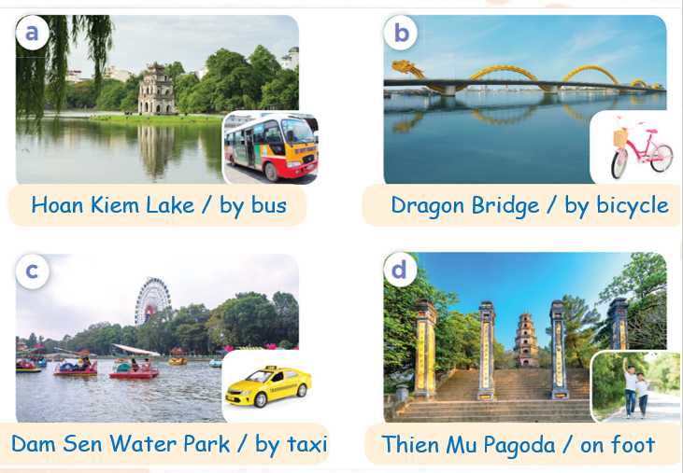
2.Listen, point and say
Hoan Kiem Lake
How can I get to...............................
by bus
You can get there …...............
Notes:
MADE BY FACEBOOK :TRAN THI THANH TAM

Slide 14

Hoan Kiem Lake
How can I get to...............................
Made by :Thu Phuong
by bus
You can get there …...............
Notes:
MADE BY FACEBOOK :TRAN THI THANH TAM

Slide 15

Dragon Bridge
How can I get to...............................
Made by :Thu Phuong
by bicycle
You can get there …...............
Notes:
MADE BY FACEBOOK :TRAN THI THANH TAM

Slide 16
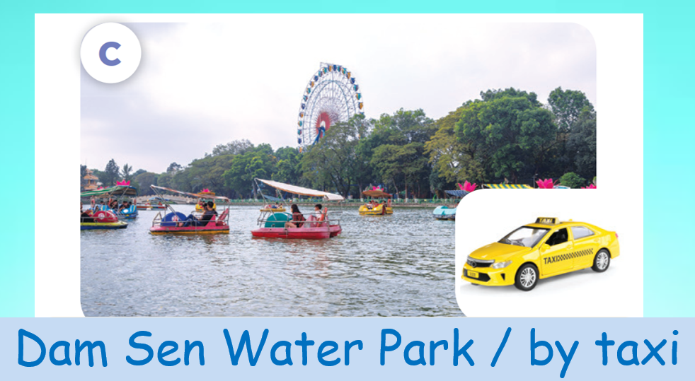
Dam Sen Water Park
How can I get to.......................................
by taxi
You can get there …...............
Notes:
MADE BY FACEBOOK :TRAN THI THANH TAM

Slide 17

Thien Mu Pagoda
How can I get to...............................
on foot
You can get there …...............
Notes:
MADE BY FACEBOOK :TRAN THI THANH TAM

Slide 18
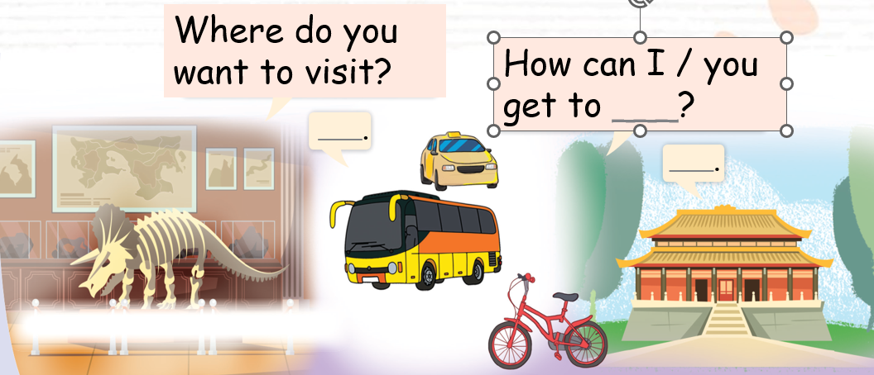
3. Let’s talk
Notes:
MADE BY FACEBOOK :TRAN THI THANH TAM

Slide 19
SUMMARY
1.Vocabulary:
By bicycle: bằng xe đạp
By bus: bằng xe buýt
By taxi: bằng xe taxi
On foot: đi bộ
2. Sentence pattern:
-How can I get to Hoan Kiem Lake?
(Tôi có thể đến hồ Hoàn Kiếm bằng cách nào vậy?
-> You can get there by bicycle.
(Bạn có thể đến đó bằng xe đạp.)

Slide 20

Homework:
- Learn by heart vocabulary and sentence pattern
- Prepare Unit 18- lesson 2 ( 4, 5, 6)
Notes:
MADE BY FACEBOOK :TRAN THI THANH TAM

