Slide 1
UNIT 18: MEANS OF TRANSPORTS
LESSON 2 ( 4, 5, 6)
Notes:
MADE BY FACEBOOK :TRAN THI THANH TAM

Slide 2
Warm - up
Notes:
MADE BY FACEBOOK :TRAN THI THANH TAM

Slide 3
Let's play
WHAT’S MISSING?
Notes:
MADE BY FACEBOOK :TRAN THI THANH TAM

Slide 4


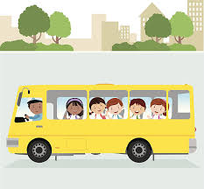
By bus
?
Notes:
MADE BY FACEBOOK :TRAN THI THANH TAM

Slide 5
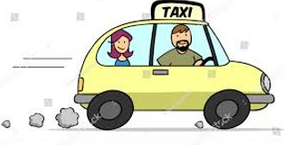
By taxi
?
Notes:
MADE BY FACEBOOK :TRAN THI THANH TAM

Slide 6

On foot
?
Notes:
MADE BY FACEBOOK :TRAN THI THANH TAM

Slide 7

By bicycle
?
Notes:
MADE BY FACEBOOK :TRAN THI THANH TAM

Slide 8

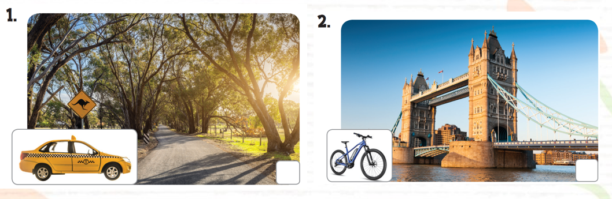
4. Listen and tick or cross
✓
✗
Notes:
MADE BY FACEBOOK :TRAN THI THANH TAM

Slide 9
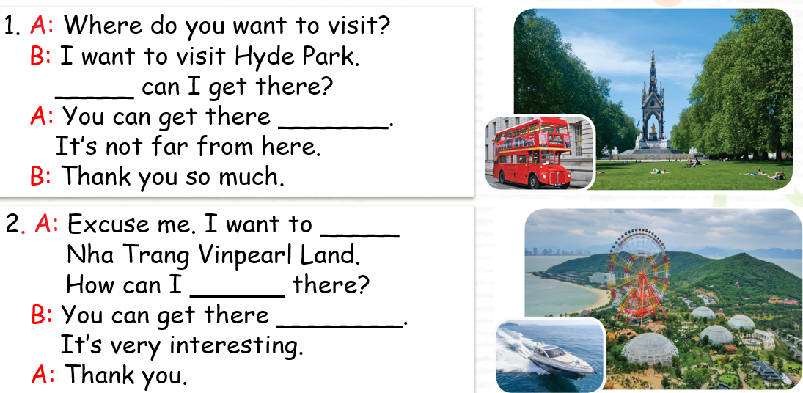
5. Read and complete
How
by bus
visit
get
by boat
Notes:
MADE BY FACEBOOK :TRAN THI THANH TAM

Slide 10
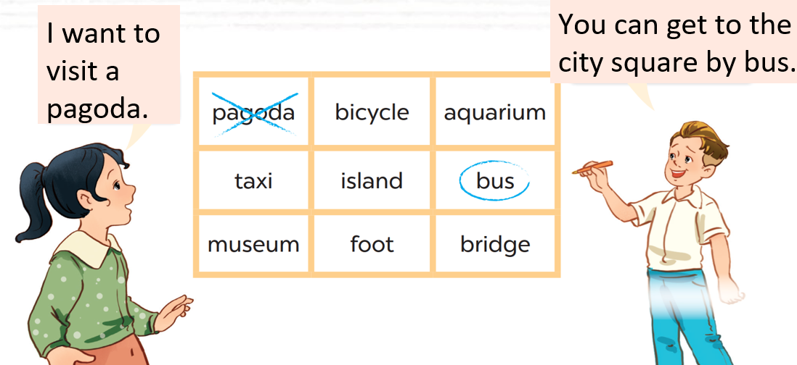
6. Let’s play
Notes:
MADE BY FACEBOOK :TRAN THI THANH TAM

Slide 11
LET’S PLAY
CHOOSE THE BEST ANSWER

Slide 12






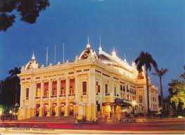

I want to go to Ha Noi Opera House by………
bus
taxi
motorbike
Notes:
MADE BY FACEBOOK :TRAN THI THANH TAM

Slide 13
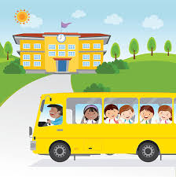
I want to go to my school by………
bus
taxi
car
Notes:
MADE BY FACEBOOK :TRAN THI THANH TAM

Slide 14
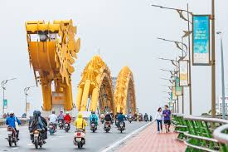
I want to go to Drago Bridge by………
taxi
bus
motorbike
Notes:
MADE BY FACEBOOK :TRAN THI THANH TAM

Slide 15
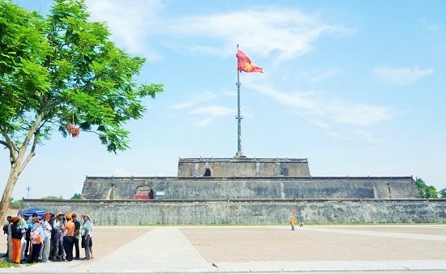

I want to go to Ngo Mon Square………
By taxi
On foot
By bicycle
Notes:
MADE BY FACEBOOK :TRAN THI THANH TAM

