Slide 1

UNIT 18:MEANS OF TRANSPORTS
LESSON 3 (1, 2, 3)
Notes:
MADE BY FACEBOOK :TRAN THI THANH TAM

Slide 2

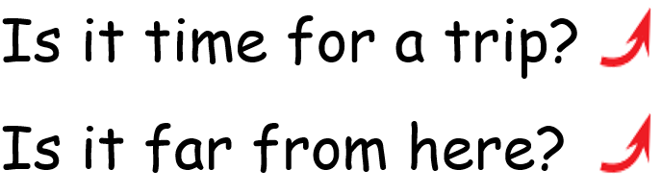
1.Listen and repeat
Made by: Mrs PHUONG
Notes:
MADE BY FACEBOOK :TRAN THI THANH TAM

Slide 3
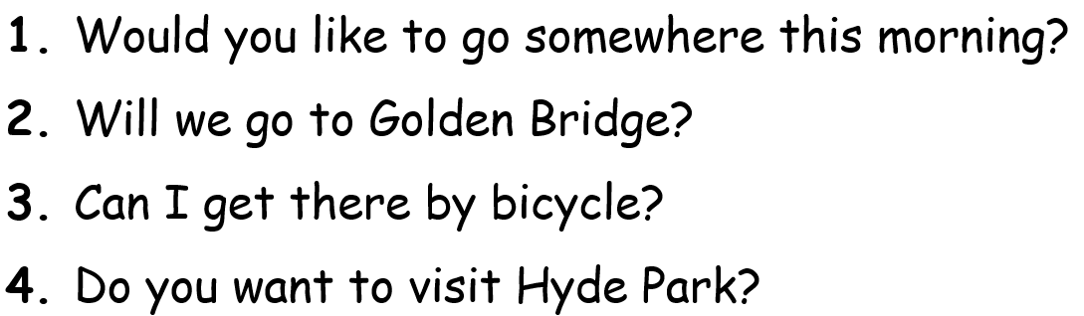

2. Listen and repeat. Pay attention to the intonation.
Notes:
MADE BY FACEBOOK :TRAN THI THANH TAM

Slide 4

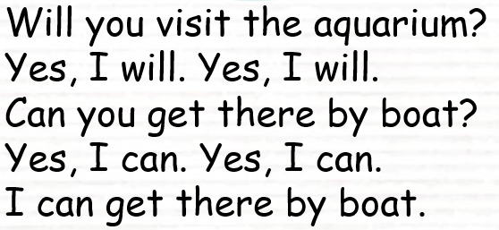

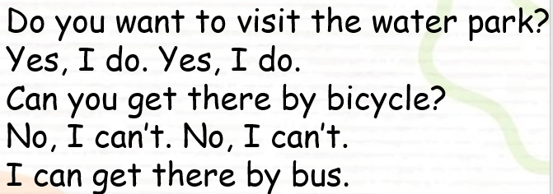
3. Let’s chant
Notes:
MADE BY FACEBOOK :TRAN THI THANH TAM

