Slide 1


UNIT 18:MEANS OF TRANSPORT
LESSON 3 ( 4, 5, 6)

Slide 2



4. Read and answer
Hi Linh,
Welcome to Sydney! Tomorrow, we can take a hop-on hop-off bus to explore the city centre in a day. Firstly, we will see Sydney Harbour Bridge and Sydney Opera House. Next, we can go to Sea Life Sydney Aquarium by train. Also, we can get to Circular Quay on foot from my house and then go to Taronga Zoo by ferry. It is home to over 4,000 animals. Then, we can go back to Circular Quay to watch a beautiful sunset.
See you soon,
Mary
1. What sights will they see by taking a hop-on hop-off bus?
2. How can they get to Sea Life Sydney Aquarium?
3. How can they get to Circular Quay?
4. How many animals are there at Taronga Zoo?
-> Sydney Harbour Bridge and Sydney Opera House.
-> By train.
-> On foot.
-> Over 4,0000 animals.
Notes:
MADE BY FACEBOOK :TRAN THI THANH TAM

Slide 3
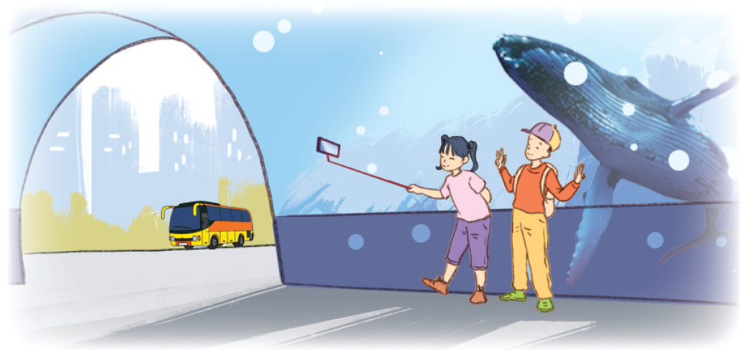
5. Let’s write
Write about a morning trip. (about 40 words)
Today is Sunday. We want to visit ______________. We will get there by________________________________________________________________________________________________________________________.
Notes:
MADE BY FACEBOOK :TRAN THI THANH TAM

Slide 4
5. Let’s write
Write about a morning trip. (about 40 words)
Suggested answer:
Today is Sunday. We want to visit the zoo in the city. We will get there by taxi. We will take some photos about animals in the zoo. Also, we want to see what do animals do in the zoo.
Notes:
MADE BY FACEBOOK :TRAN THI THANH TAM

Slide 5
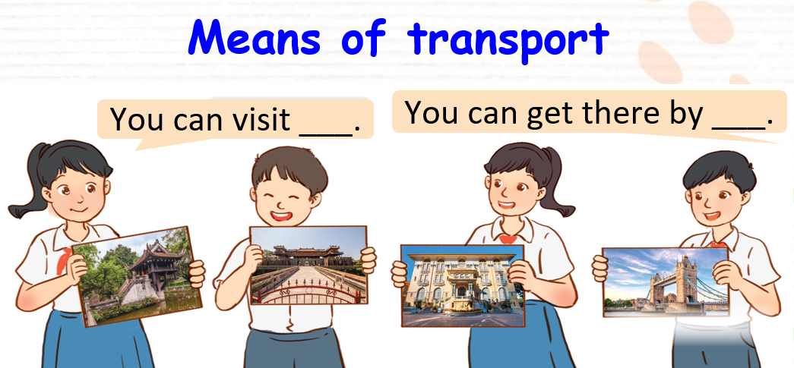
6. Project
Notes:
MADE BY FACEBOOK :TRAN THI THANH TAM

Slide 6
Play game
Reoder the words

