Slide 1

UNIT 19: PLACES OF INTEREST
LESSON 1 ( 1, 2, 3)
Notes:
MADE BY FACEBOOK :TRAN THI THANH TAM

Slide 2
Warm - up
Notes:
MADE BY FACEBOOK :TRAN THI THANH TAM

Slide 3

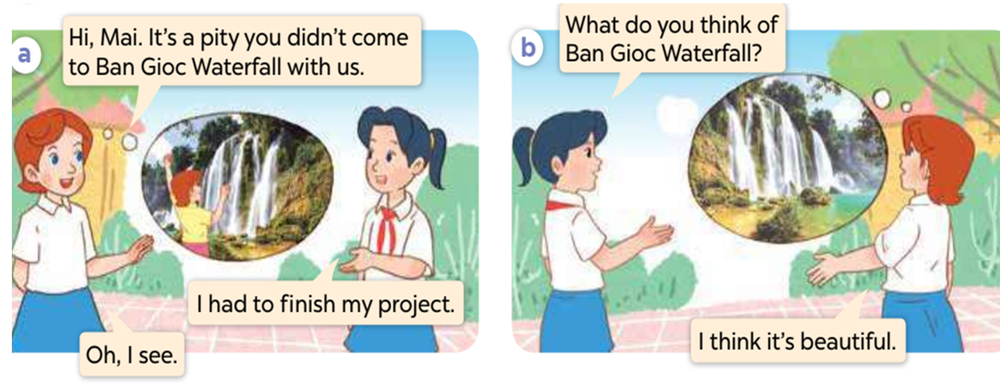
1.Look, listen and repeat
Notes:
MADE BY FACEBOOK :TRAN THI THANH TAM

Slide 4
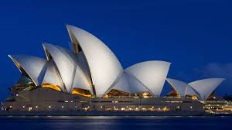
Sydney Opera House:Nhà Hát Opera Sydney
Notes:
MADE BY FACEBOOK :TRAN THI THANH TAM

Slide 5
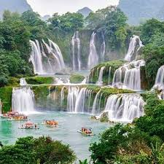
Ban Gioc Waterfall: Thác Bản Giốc
Notes:
MADE BY FACEBOOK :TRAN THI THANH TAM

Slide 6
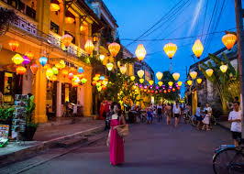
Hoi An Old Town: Phố cổ Hội An
Notes:
MADE BY FACEBOOK :TRAN THI THANH TAM

Slide 7
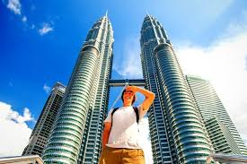
Petronas Twin Towers:Tòa tháp đôi
Notes:
MADE BY FACEBOOK :TRAN THI THANH TAM

Slide 8
-Beautiful: đẹp
-Peaceful: yên bình
-Exciting: hứng thú
-Fantastic: tuyệt vời
Notes:
MADE BY FACEBOOK :TRAN THI THANH TAM

Slide 9
VOCABULARY
- Sydney Opera House:Nhà hát Opera Sydney
- Ban Gioc Waterfall: thác Bản Giốc
- Hoi An Old Town: Phố cổ Hội An
- Petronas Twin Towers :tòa tháp đôi
- Beautiful: đẹp
- Peaceful: yên bình
- Exciting: hứng thú
- Fantastic: tuyệt vời

Slide 10
Hỏi và trả lời xem bạn đến từ đâu
What do you think of Ban Gioc Waterfall?
(Bạn nghĩ gì về thác Bản Giốc?)
I think it’s peaceful.
( Tôi nghĩ nó yên bình.)

Slide 11
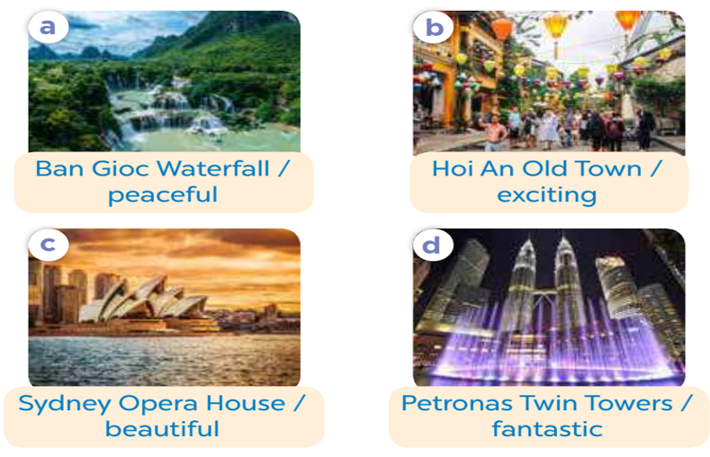
2.Listen, point and say
Ban Gioc Waterfall
What do you think of…………….................?
peaceful
I think it’s….................
Notes:
MADE BY FACEBOOK :TRAN THI THANH TAM

Slide 12
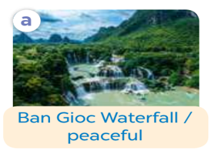
Ban Gioc Waterfall
What do you think of…………….................?
peaceful
I think it’s….................
Notes:
MADE BY FACEBOOK :TRAN THI THANH TAM

Slide 13
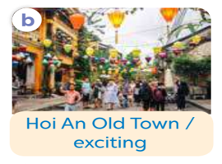
Hoi An Old Town
What do you think of…………….................?
exciting
I think it’s….................
Notes:
MADE BY FACEBOOK :TRAN THI THANH TAM

Slide 14
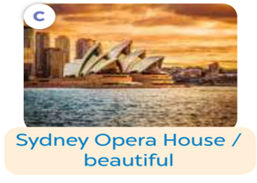
Sydney Opera House
What do you think of…………….................?
beautiful
I think it’s….................
Notes:
MADE BY FACEBOOK :TRAN THI THANH TAM

Slide 15
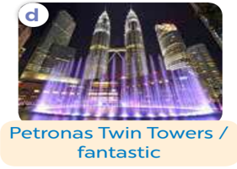
Petronas Twin Towers
What do you think of..…………….................?
fantastic
I think they’re….................
Notes:
MADE BY FACEBOOK :TRAN THI THANH TAM

Slide 16
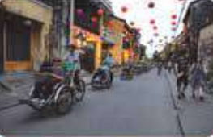
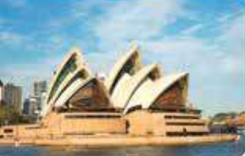
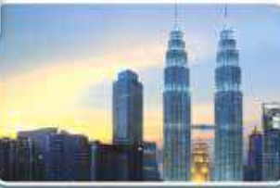
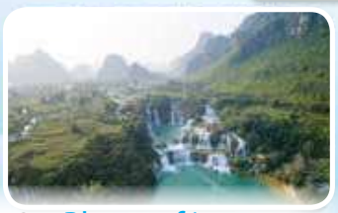
3. Let’s talk
What do you think of……………...........?
I think …..….................
Notes:
MADE BY FACEBOOK :TRAN THI THANH TAM

Slide 17


Hot seat
Game

Slide 18

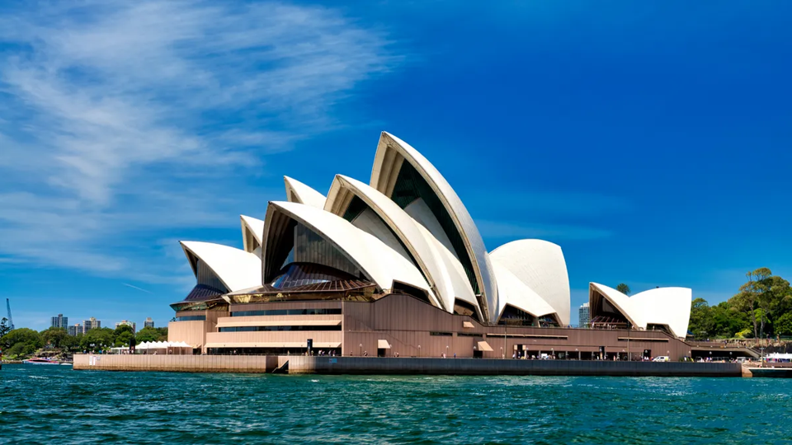
Sydney Opera House
What do you think of...............................................?
beautiful
I think it’s.................................
Notes:
MADE BY FACEBOOK :TRAN THI THANH TAM

Slide 19

Notes:
MADE BY FACEBOOK :TRAN THI THANH TAM

Slide 20
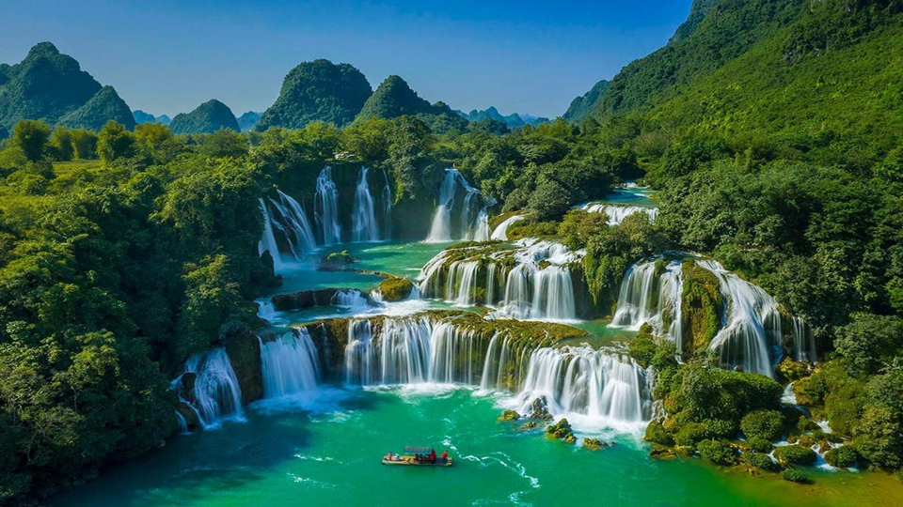
Ban Gioc Waterfal
What do you think of...............................................?
peaceful
I think it’s.................................
Notes:
MADE BY FACEBOOK :TRAN THI THANH TAM

Slide 21
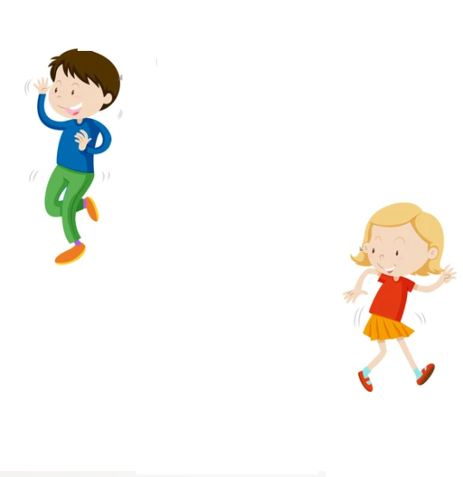
Notes:
MADE BY FACEBOOK :TRAN THI THANH TAM

Slide 22
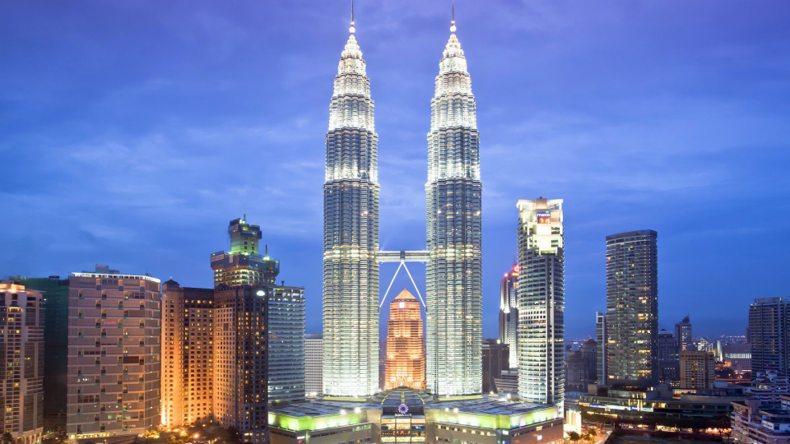
Petronas Twins Towers
What do you think of...............................................?
fantastic
I think it’s.................................
Notes:
MADE BY FACEBOOK :TRAN THI THANH TAM

Slide 23
Notes:
MADE BY FACEBOOK :TRAN THI THANH TAM

Slide 24
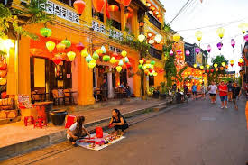
Hoi An Old Town
What do you think of...............................................?
exciting
I think it’s.................................
Notes:
MADE BY FACEBOOK :TRAN THI THANH TAM

