Slide 1

UNIT 19:PLACES OF INTEREST
LESSON 1 (4, 5, 6)
Notes:
MADE BY FACEBOOK :TRAN THI THANH TAM

Slide 2
PLAY GAME
GUESSING GAME

Slide 3
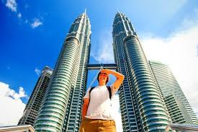
Guessing
Guessing?
Petronas Twin Towers
Notes:
MADE BY FACEBOOK :TRAN THI THANH TAM

Slide 4
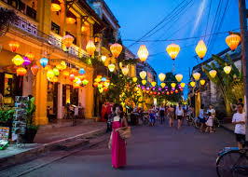
Guessing
Guessing?
Hoi An Old Town
Notes:
MADE BY FACEBOOK :TRAN THI THANH TAM

Slide 5
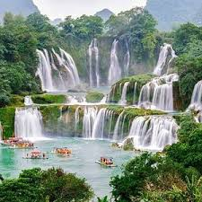
Guessing
Guessing?
Ban Gioc Waterfall
Notes:
MADE BY FACEBOOK :TRAN THI THANH TAM

Slide 6
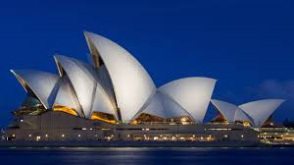
Guessing
Guessing?
Sydney Opera House
Notes:
MADE BY FACEBOOK :TRAN THI THANH TAM

Slide 7

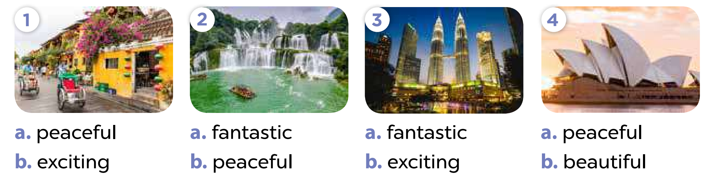
4. Listen and circle
Notes:
MADE BY FACEBOOK :TRAN THI THANH TAM

Slide 8
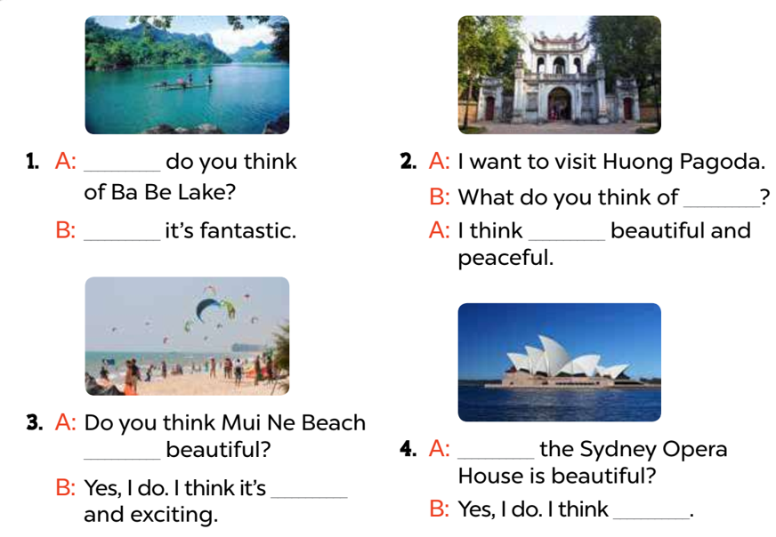
5. Read and complete
What
it
I think
Huong Pagoda
is
Do you think
beautiful
it’s beautiful
Notes:
MADE BY FACEBOOK :TRAN THI THANH TAM

Slide 9
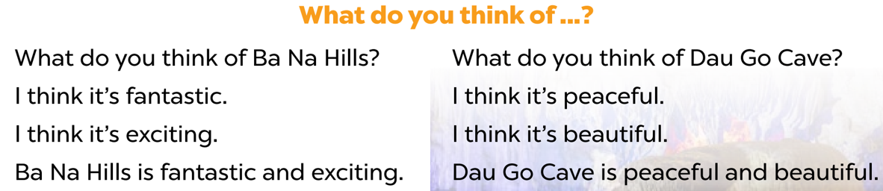
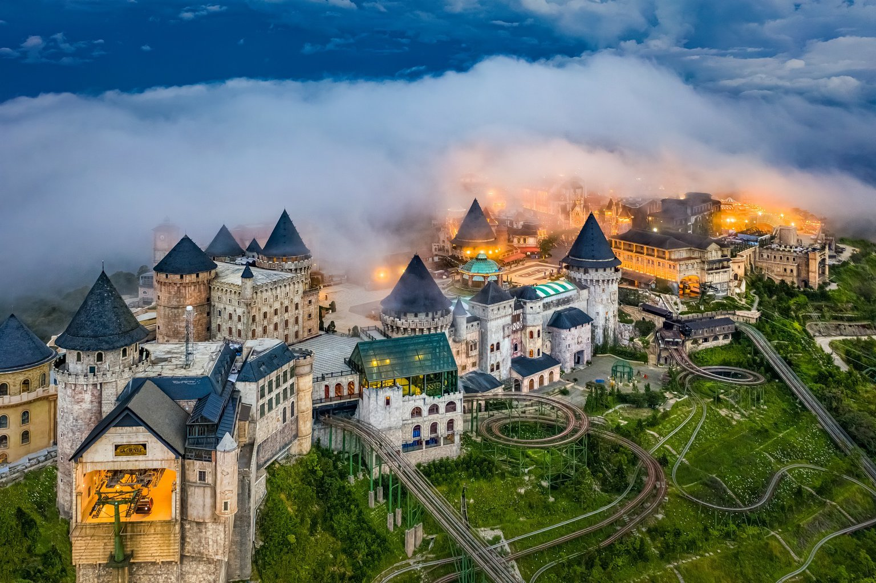
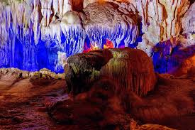
6. Let’s sing
Notes:
MADE BY FACEBOOK :TRAN THI THANH TAM

