Slide 1

UNIT 19: PLACES OF INTEREST
LESSON 2 ( 1, 2, 3)
Made by: Thu Phuong
Notes:
MADE BY FACEBOOK :TRAN THI THANH TAM

Slide 2

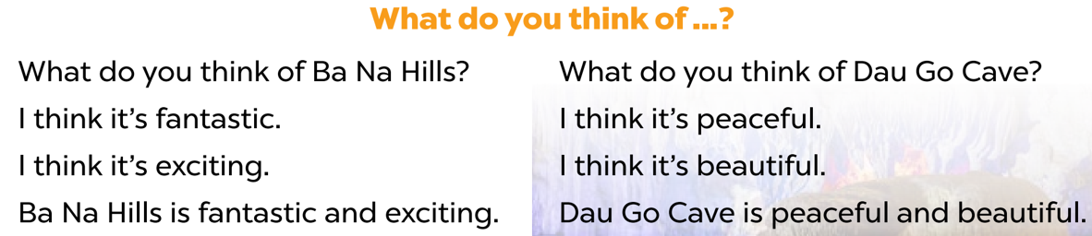

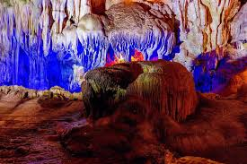
*Let’s sing the song
Notes:
MADE BY FACEBOOK :TRAN THI THANH TAM

Slide 3
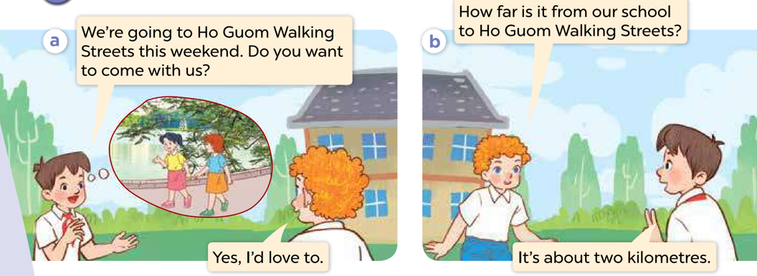
1.Look, listen and repeat
Notes:
MADE BY FACEBOOK :TRAN THI THANH TAM

Slide 4
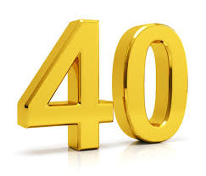
forty/ˈfɔːti/ số bốn mươi
Notes:
MADE BY FACEBOOK :TRAN THI THANH TAM

Slide 5

twenty-nine /ˈtwenti naɪn/ số hai mươi chín
Notes:
MADE BY FACEBOOK :TRAN THI THANH TAM

Slide 6

one hundred /wʌn ˈhʌndrəd/:số một trăm
Notes:
MADE BY FACEBOOK :TRAN THI THANH TAM

Slide 7

one hundred and twenty-nine
/ wʌn ˈhʌndrəd ənd ˈtwenti naɪn/
:số một trăm hai mươi chín
Notes:
MADE BY FACEBOOK :TRAN THI THANH TAM

Slide 8
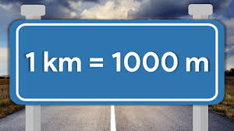
Kilometre /kɪˈlɒm.ɪ.tər/: ki lô mét
Notes:
MADE BY FACEBOOK :TRAN THI THANH TAM

Slide 9

VOCABULARY
Forty: số 40
Twenty –nine: số 29
One hundred: số 100
On hundred and tweny-nine: số 129
Kilometre: ki lô mét

Slide 10
1.forty
A
2.kilometre
B
3. One hundred
C
4. Twenty-nine
5. One hundred and twenty-nine
D
Notes:
MADE BY FACEBOOK :TRAN THI THANH TAM

Slide 11
Hỏi và trả lời về khoảng cách từ nơi nào đến đâu
How far is it from Can Tho to Vinh Long?
( Khoảng cách từ Cần Thơ đến Vĩnh Long là bao nhiêu? )
It’s about 40 kilometres.
(Khoảng 40 ki lô mét.)
Notes:
MADE BY FACEBOOK :TRAN THI THANH TAM

Slide 12
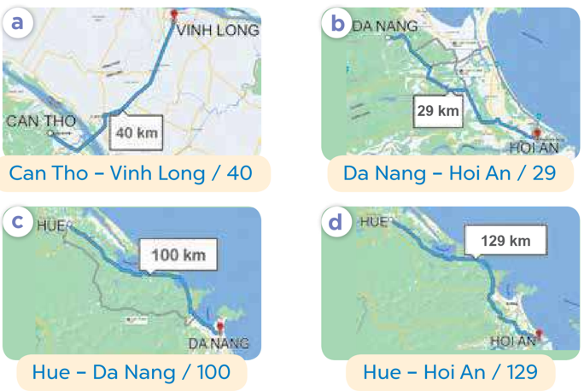
2.Listen, point and say
Can Tho
Vinh Long
How far is it from.....................to…………….?
40
It’s about….........kilometres.
Notes:
MADE BY FACEBOOK :TRAN THI THANH TAM

Slide 13
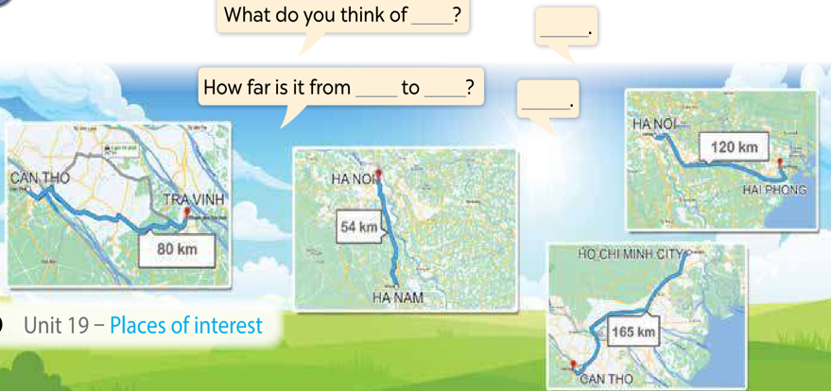
3. Let’s talk
Notes:
MADE BY FACEBOOK :TRAN THI THANH TAM

Slide 14



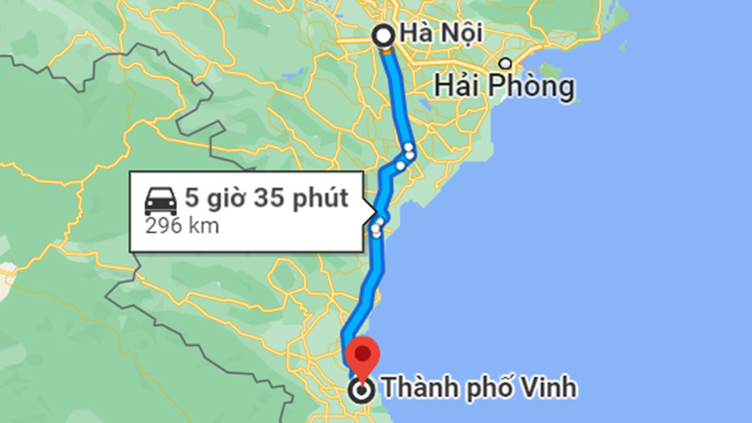


Ha Noi
Vinh
How far is it from.....................to…………….?
100 km
100
It’s about….........kilometres.
Notes:
Click Red Arrow to back to the Flower Picking slide.

Slide 15
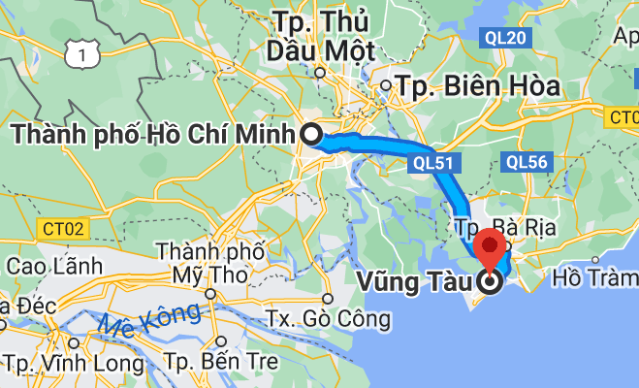
Ho Chi Minh
Vung Tau
How far is it from..........................to……............?
96 km
96
It’s about….........kilometres.
Notes:
Click Red Arrow to back to the Flower Picking slide.

