Slide 1
UNIT 19: PLACES OF INTERSET
LESSON 2 ( 4, 5, 6)
Notes:
MADE BY FACEBOOK :TRAN THI THANH TAM

Slide 2

PLAY GAME
Unscramble the letters
Notes:
MADE BY FACEBOOK :TRAN THI THANH TAM

Slide 3
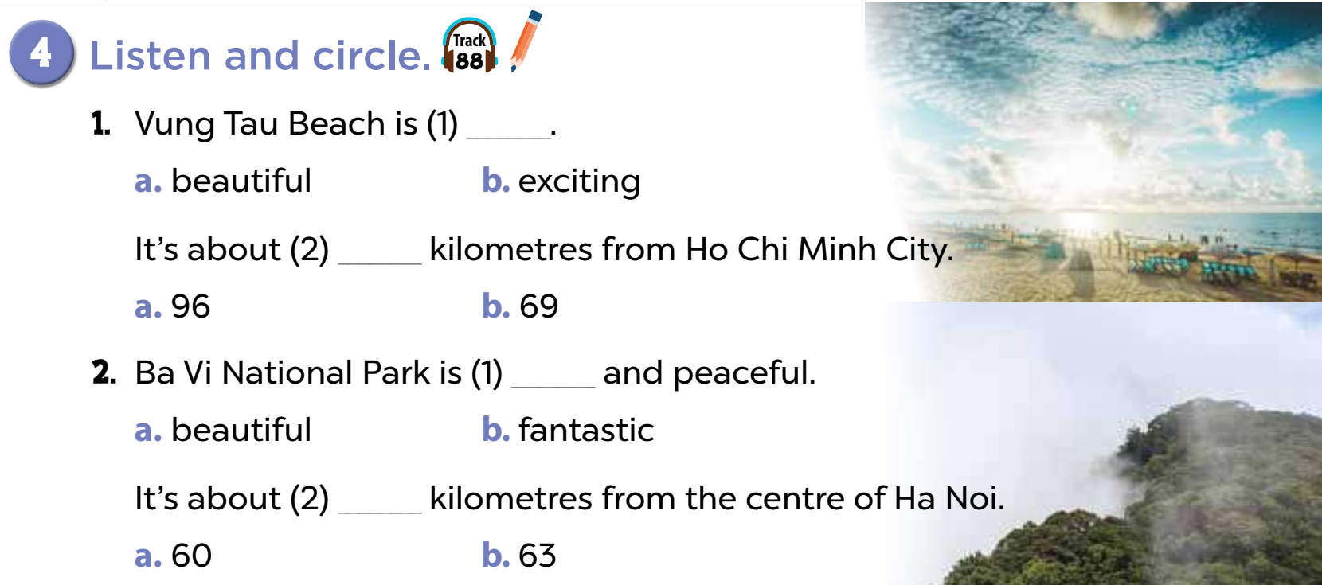

Notes:
MADE BY FACEBOOK :TRAN THI THANH TAM

Slide 4
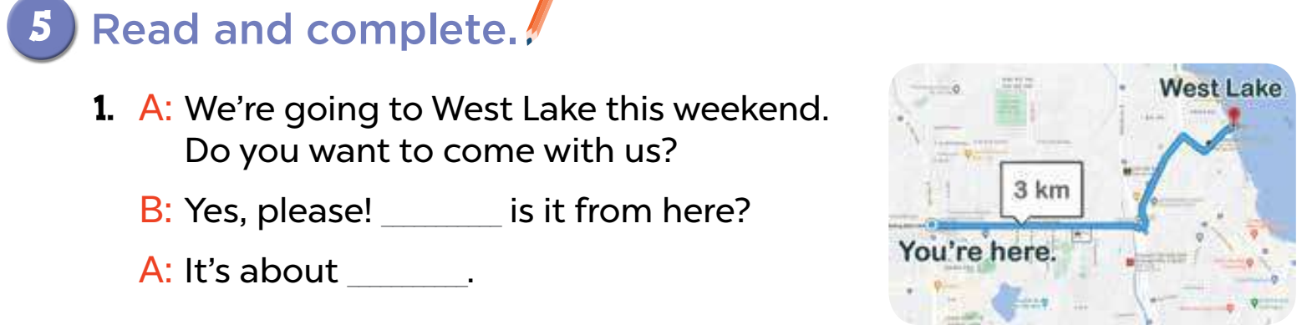
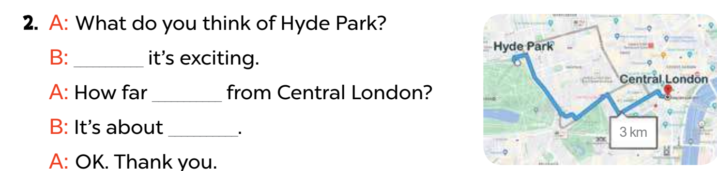
How far
3 kilometers
I think
is it
3 kilometers
Notes:
MADE BY FACEBOOK :TRAN THI THANH TAM

Slide 5
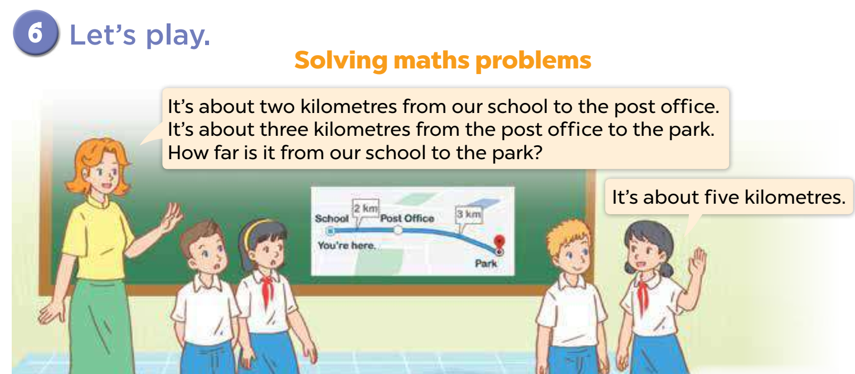
Notes:
MADE BY FACEBOOK :TRAN THI THANH TAM

