Slide 1

UNIT 19:PLACES OF
INTEREST
LESSON 3 (1, 2, 3)
Notes:
MADE BY FACEBOOK :TRAN THI THANH TAM

Slide 2

SPIN AND SAY
think
peceaful
from
near
How far
Click the needle to start and then again to stop the wheel. Then READ ALOUD.
exciting

Slide 3

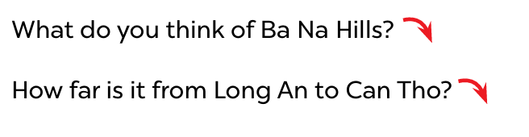

1.Listen and repeat
Notes:
MADE BY FACEBOOK :TRAN THI THANH TAM

Slide 4
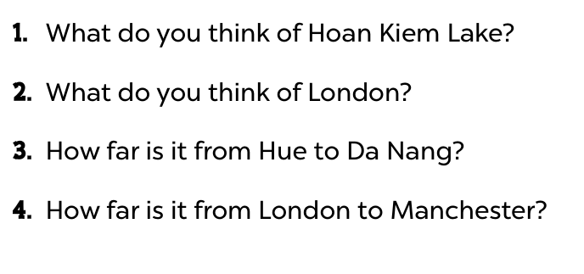

2. Listen and repeat. Pay attention to the intonation.
Notes:
MADE BY FACEBOOK :TRAN THI THANH TAM

Slide 5
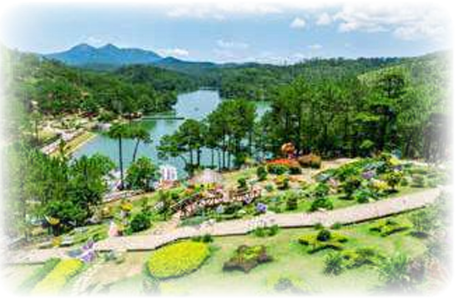
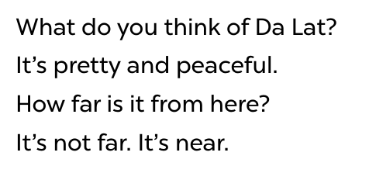
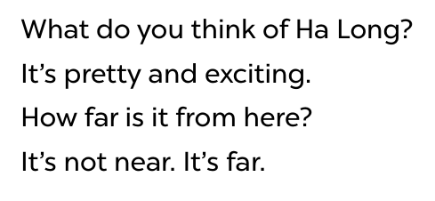
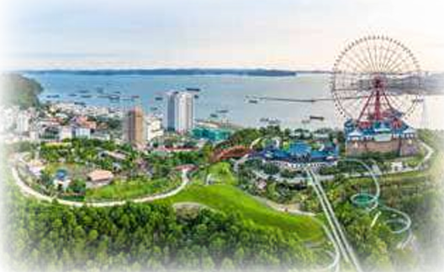
3. Let’s chant
Notes:
MADE BY FACEBOOK :TRAN THI THANH TAM

Slide 6








NEXT
+10
Lose all points

Slide 7


What do you think of Ba Be lake?
fantastic
BACK
I think it’s fantastic

Slide 8

What do you think of Huong Pagoda?
peaceful
BACK
I think it’s peaceful.

Slide 9

BACK

Slide 10
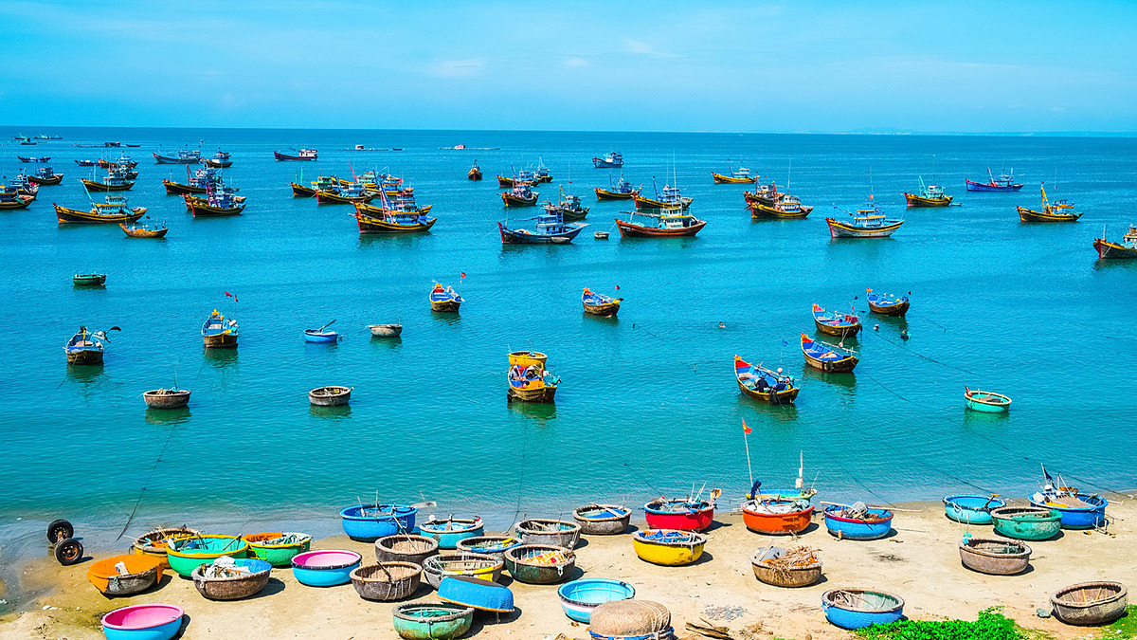
What do you think of Mui Ne Beach?
beautiful
BACK
I think it’s beautiful.

Slide 11
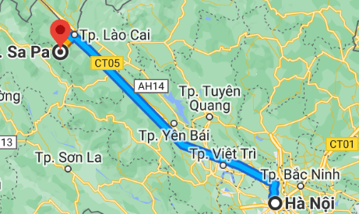
How far is it from Ha Noi to Sa Pa?
314 km
BACK
It’s about 314 kilometres.

Slide 12
BACK

