Slide 1
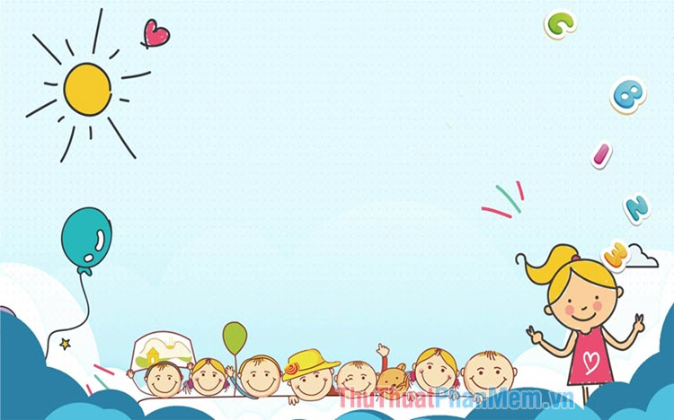

UNIT 19:PLACES OF INTEREST
LESSON 3 ( 4, 5, 6)

Slide 2
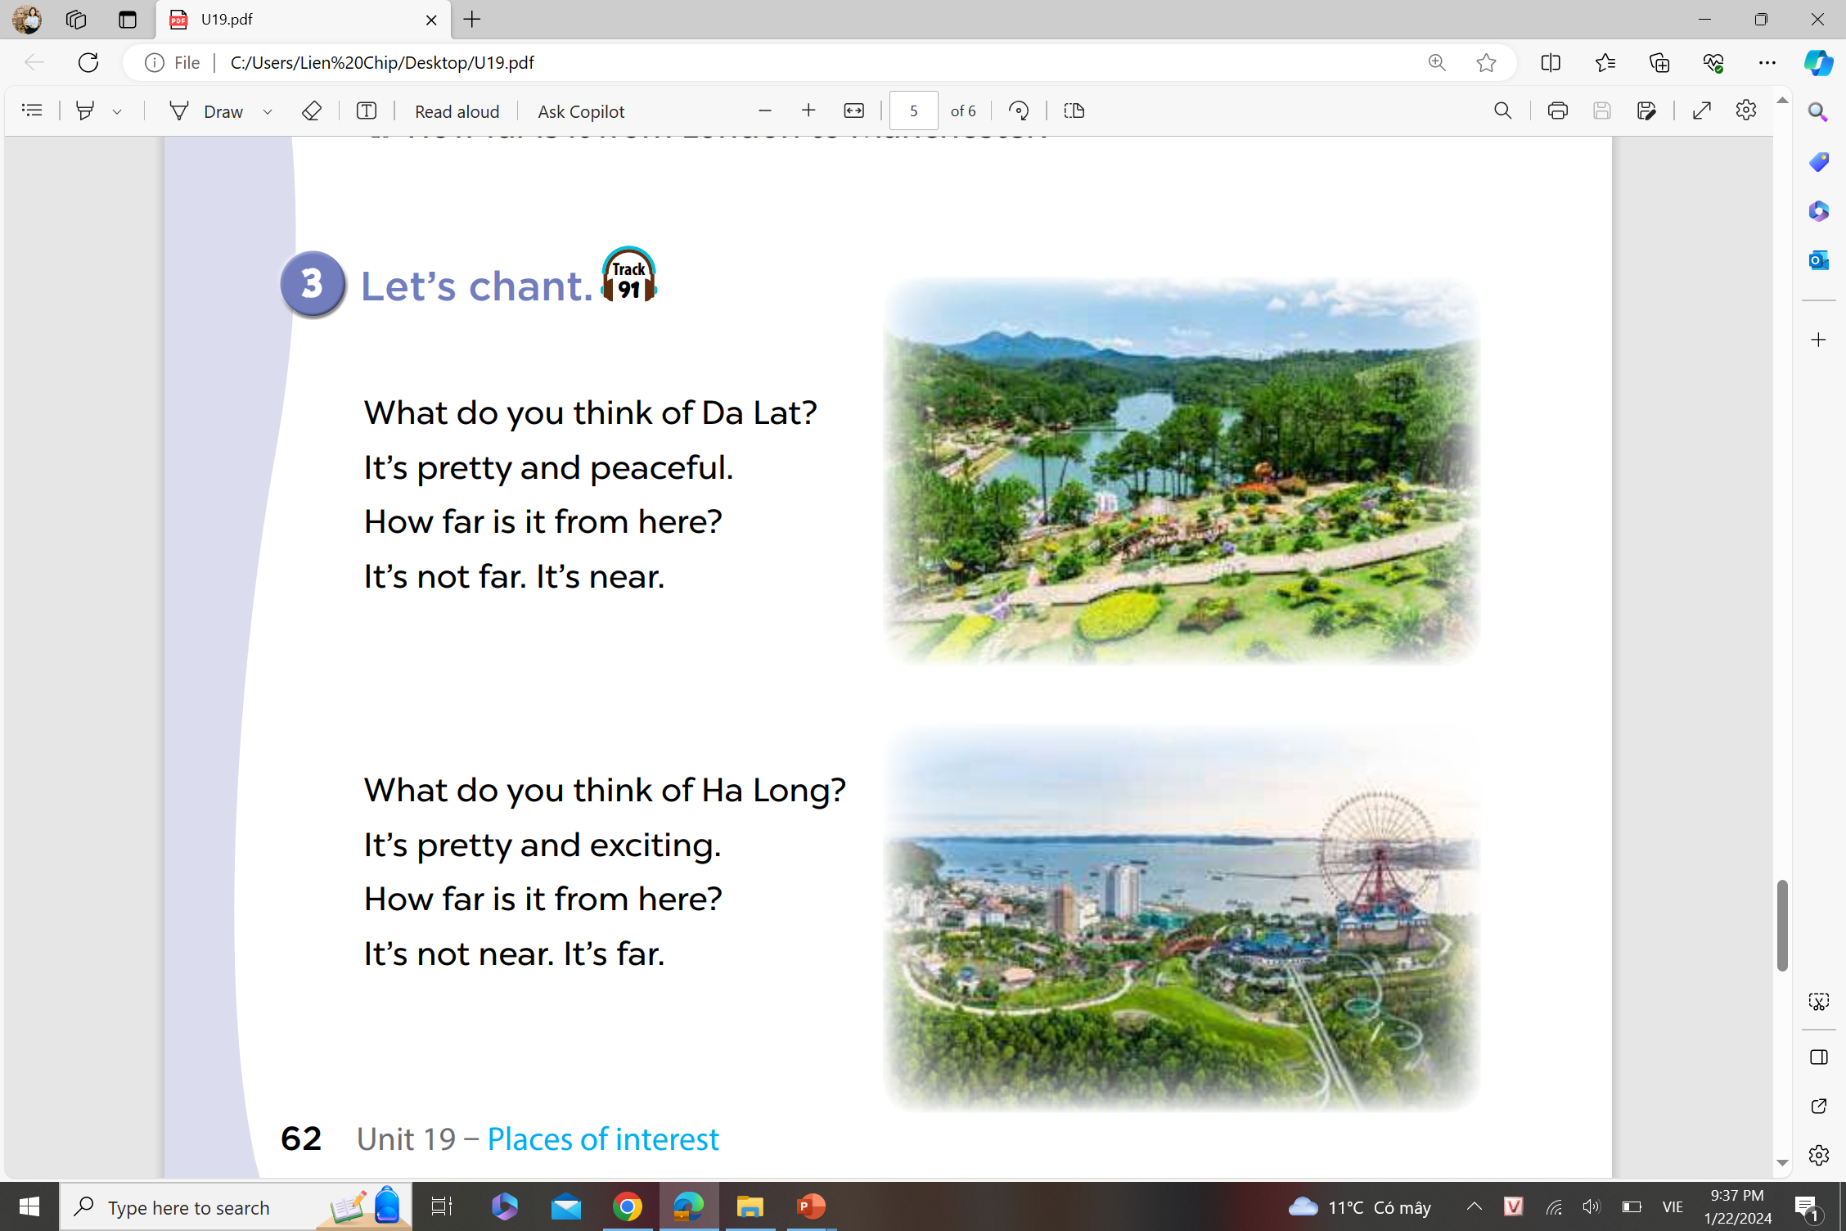



Let’s read the chant
80%
40%
54%

Slide 3
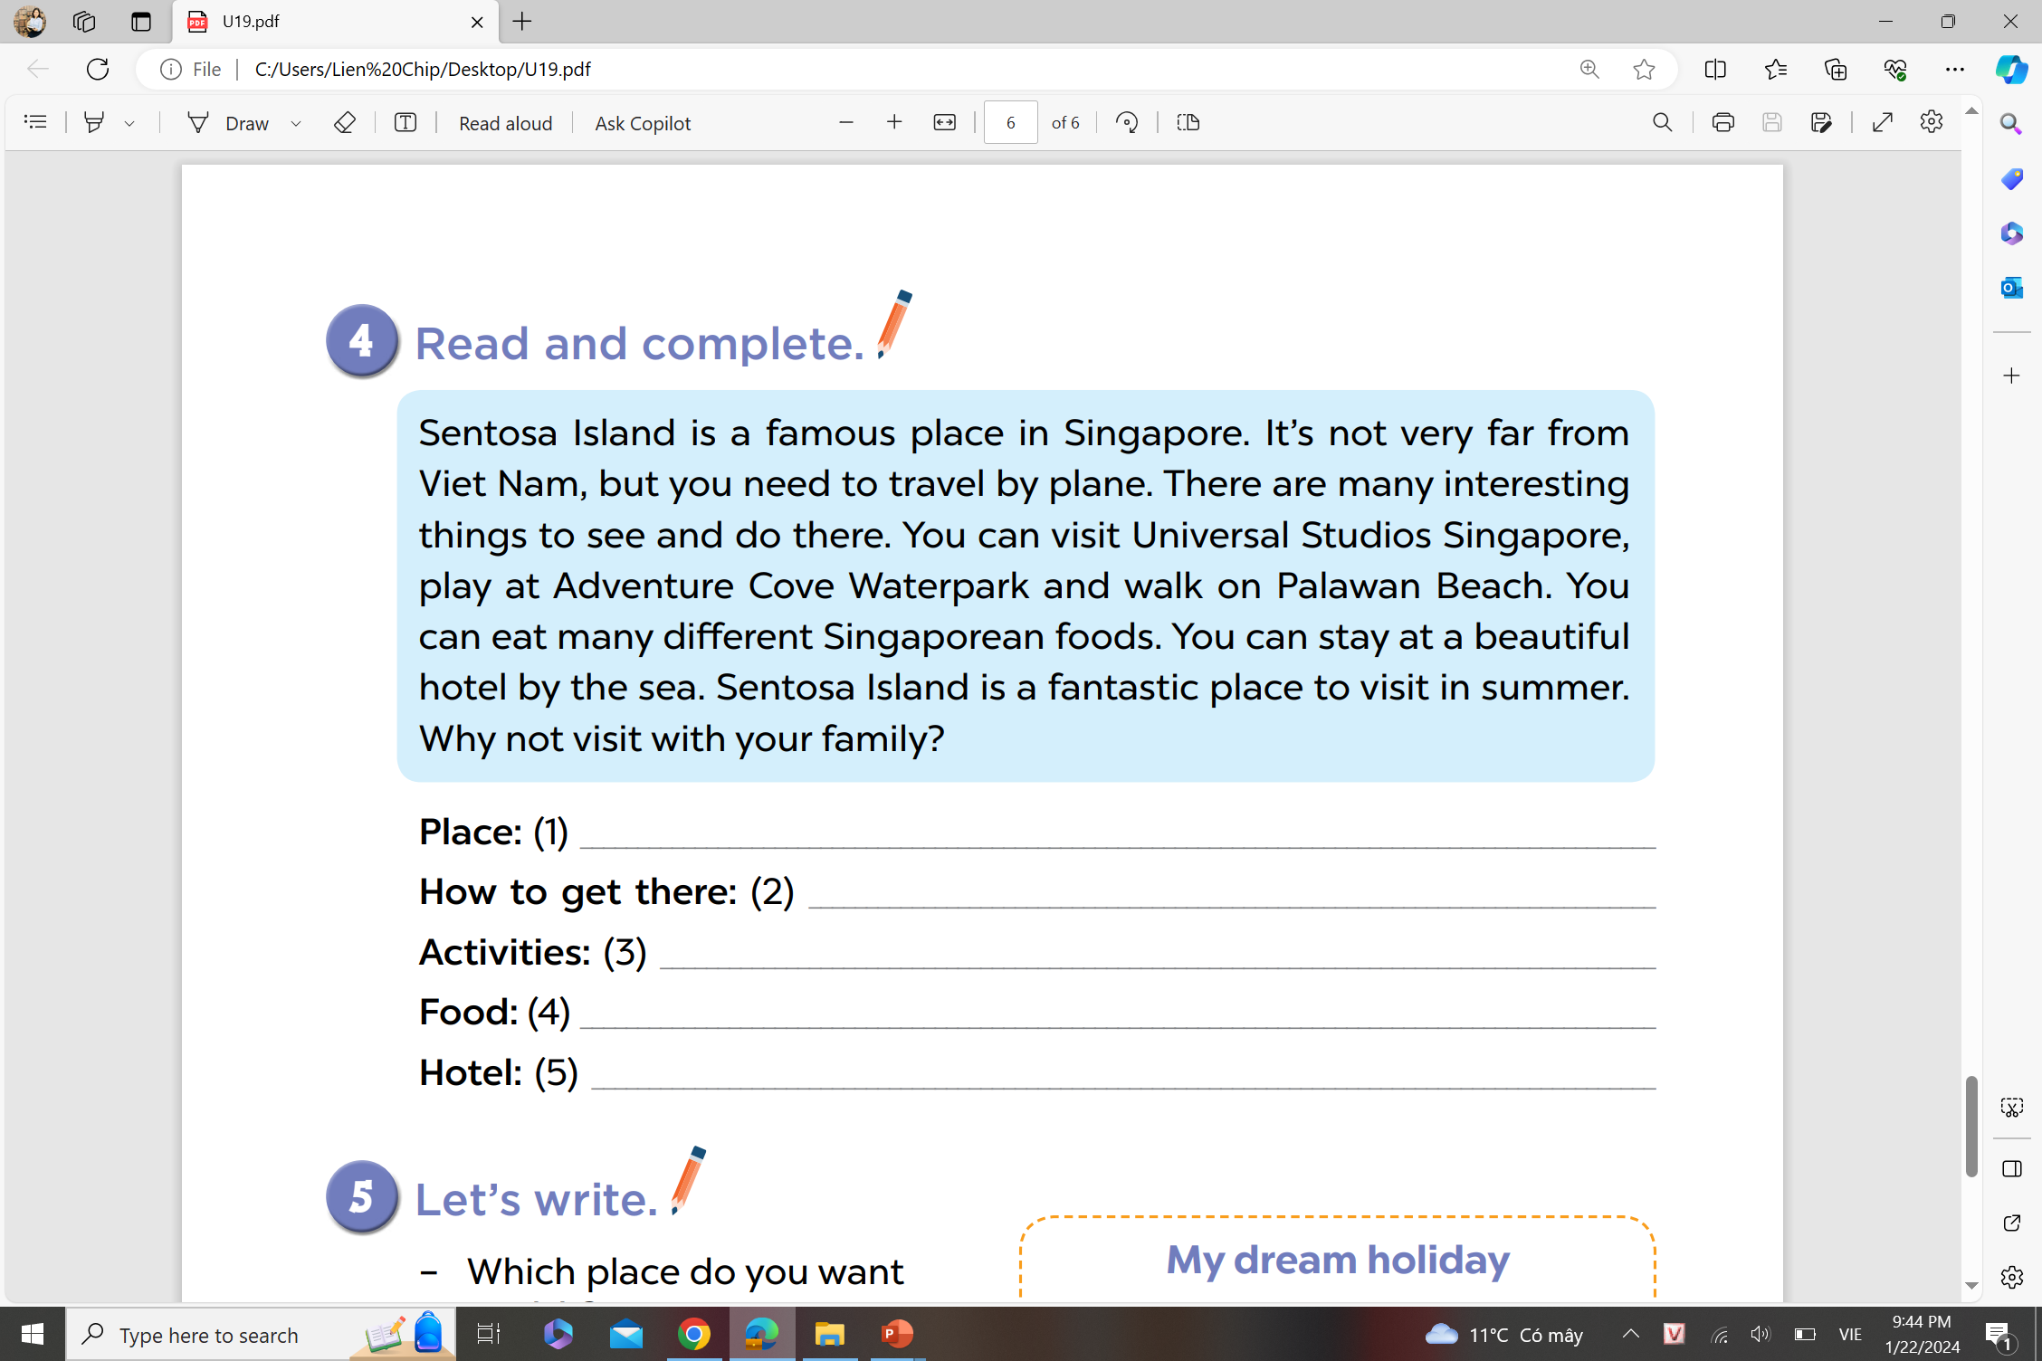





4. Read and complete
Sentosa Island, in Singapore
by plane
visit Universal Studios, play at Adventure Cove Waterpark, walk on Palawan Beach
eat many different Singaporean foods
a beautiful hotel by the sea
Notes:
MADE BY FACEBOOK :TRAN THI THANH TAM

Slide 4
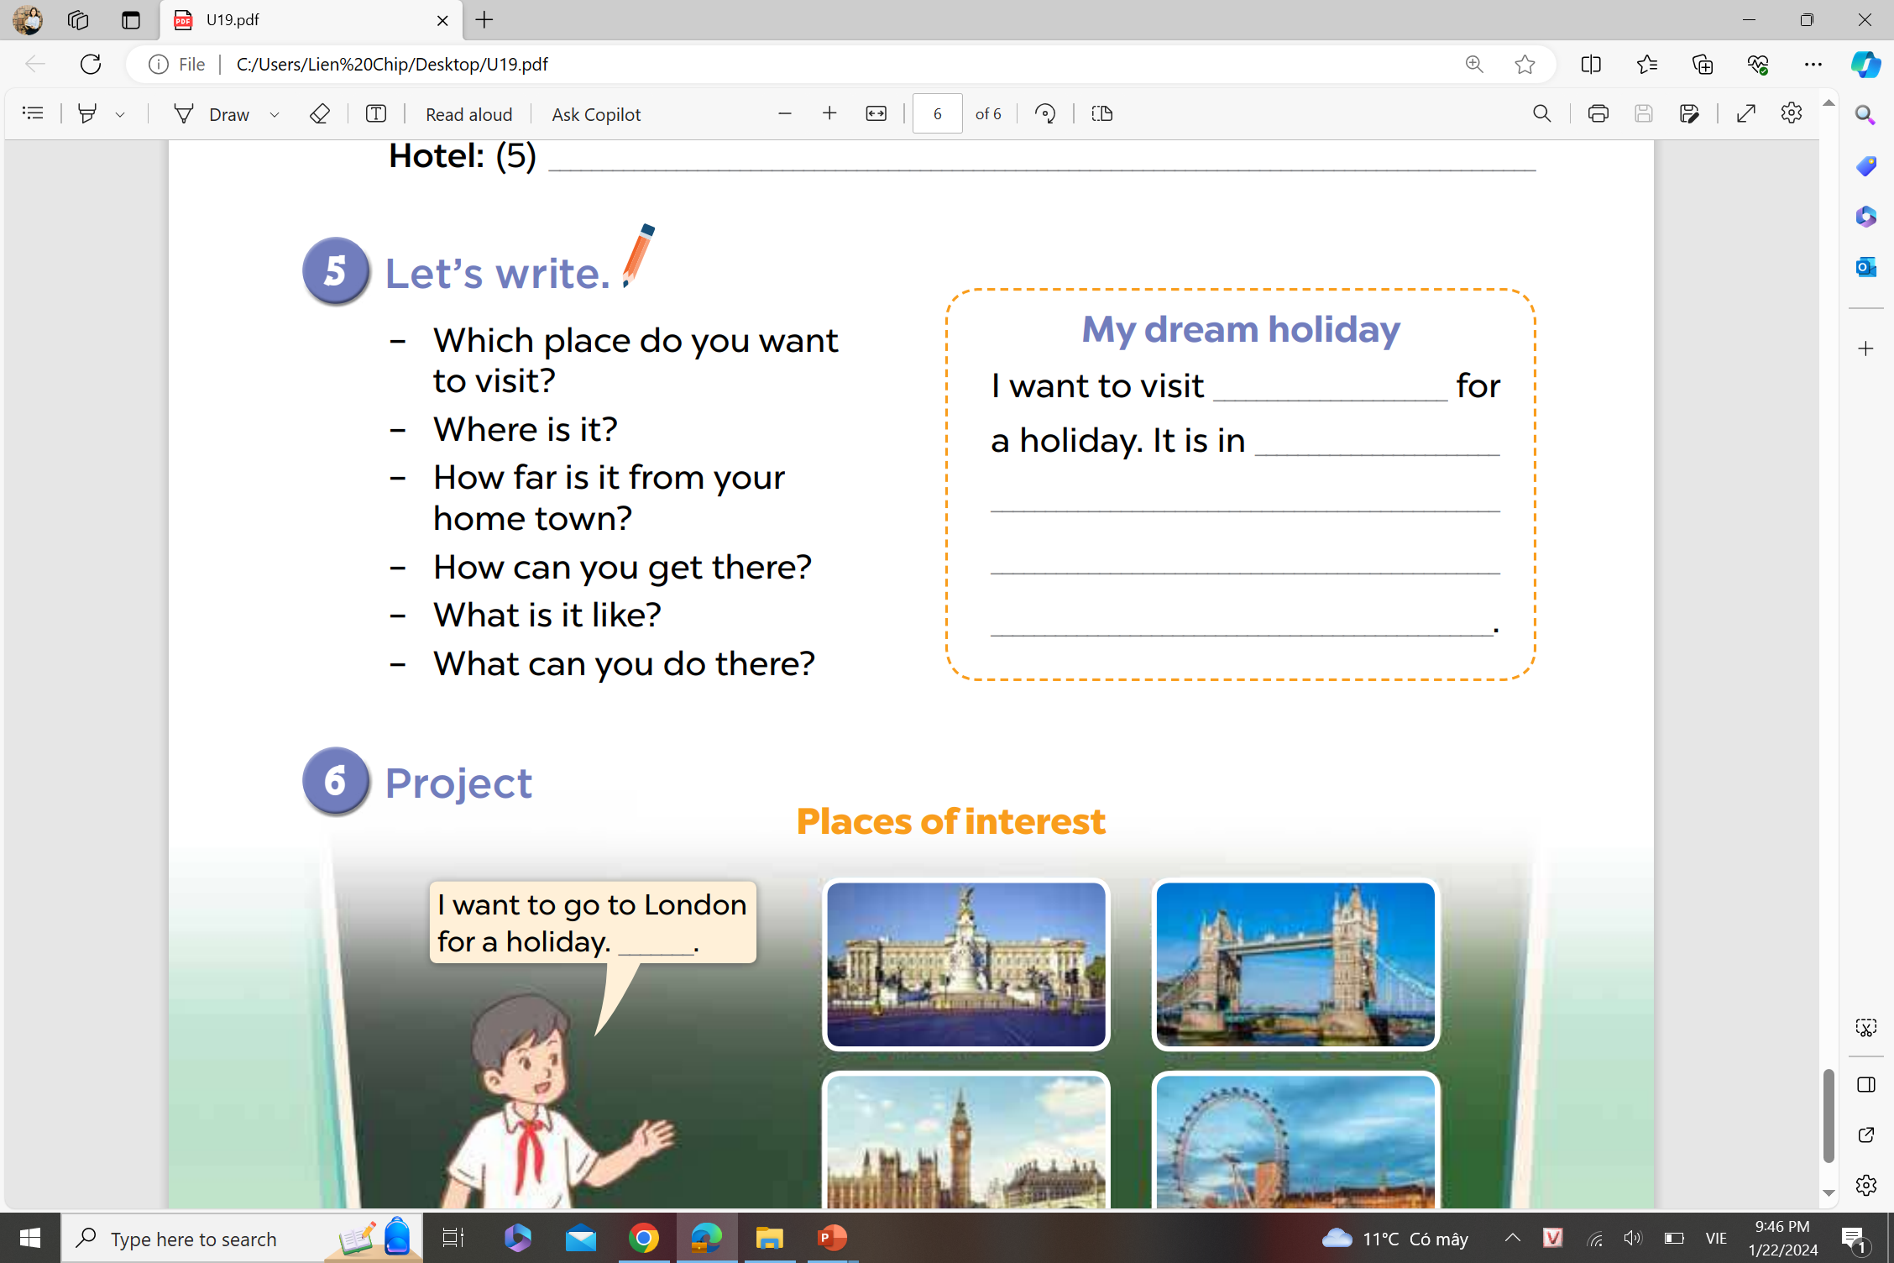
5. Let’s write
Write about your dream holiday. (about 40 words)
Notes:
MADE BY FACEBOOK :TRAN THI THANH TAM

Slide 5
5. Let’s write
Write about your dream holiday. (about 40 words)
My dream holiday
I want to visit Quy Nhon City for my holiday. It is very beautiful and exciting. It is about eighty kilometres from my place. I can go there by coach or taxi. I can swim in the sea, build sandcastle on the beach, eat sea food and stay in a hotel by the sea. Let’s go to Quy Nhon City and enjoy your holiday.
Notes:
MADE BY FACEBOOK :TRAN THI THANH TAM

Slide 6
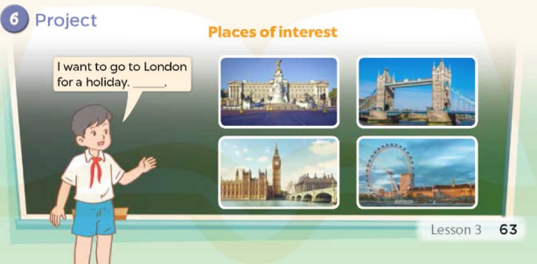
Notes:
MADE BY FACEBOOK :TRAN THI THANH TAM

Slide 7

PLAY GAME
RING THE GOLDEN BELL
Notes:
MADE BY FACEBOOK :TRAN THI THANH TAM

