Slide 1

UNIT 20:OUR SUMMER HOLIDAYS
LESSON 1 ( 1, 2, 3)
Notes:
MADE BY FACEBOOK :TRAN THI THANH TAM

Slide 2
Warm - up
Notes:
MADE BY FACEBOOK :TRAN THI THANH TAM

Slide 3




PLAY GAME
GUESSING GAME
Notes:
Step 2: Have groups put the posters on the desk and practice the presentation. Encourage all members in the group to present. Go around the classroom and offer help where necessary.

Slide 4
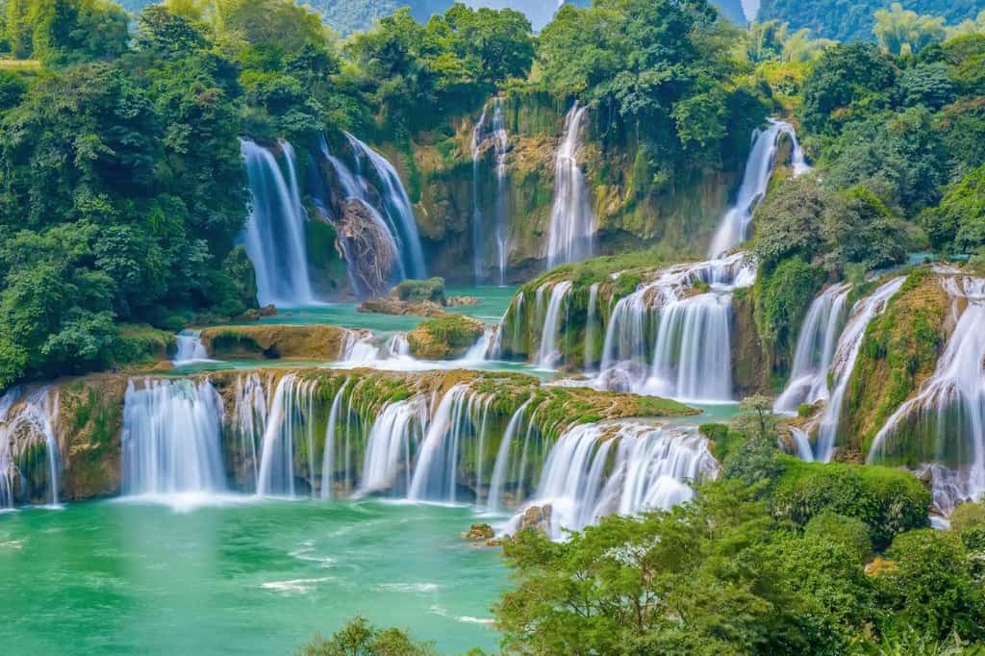
Ban Gioc Waterfall
SHOW

Slide 5
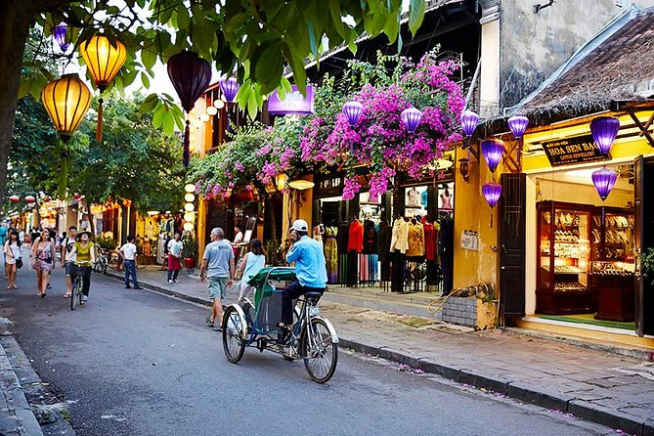
Hoi An Old Town
SHOW

Slide 6
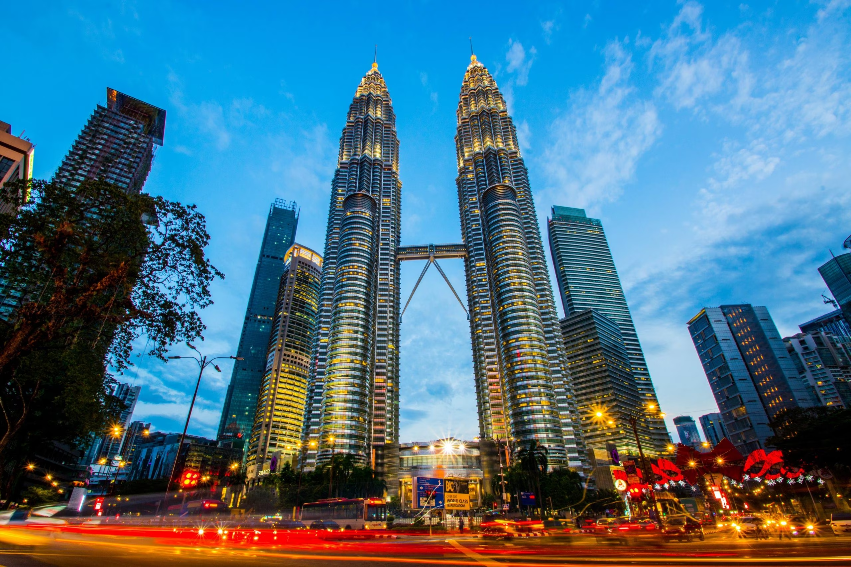
Petronas Twin Towers
SHOW

Slide 7
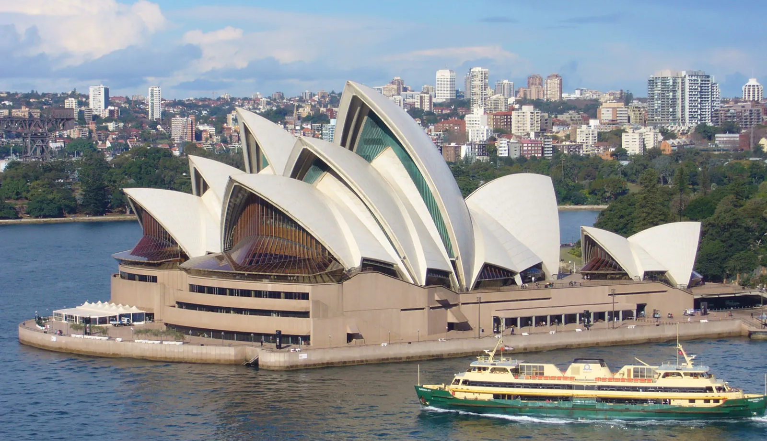
Sydney Opera House
SHOW

Slide 8
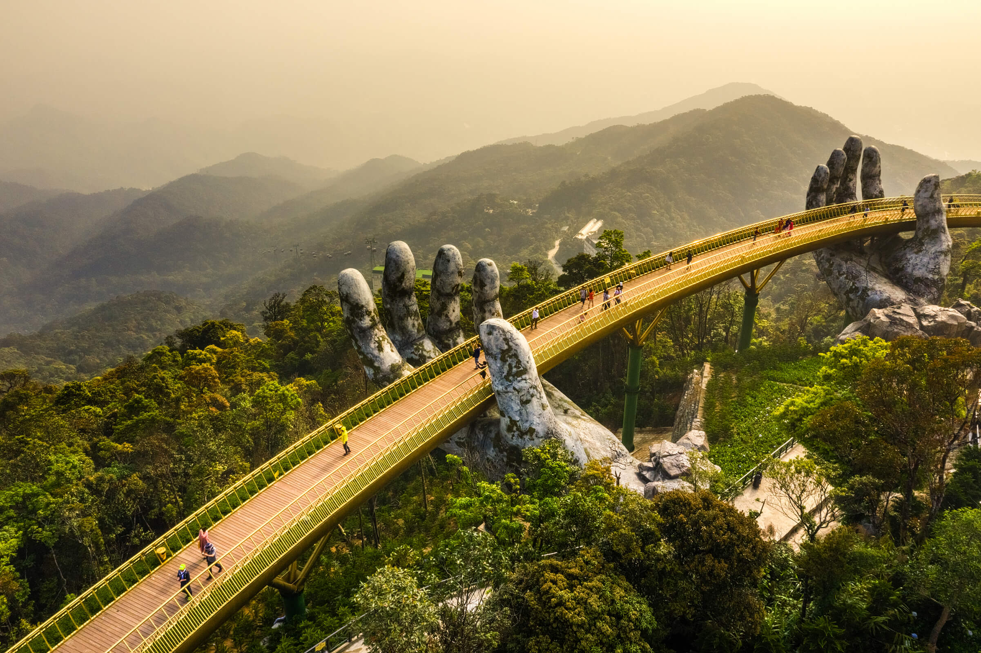
Ba Na Hills
SHOW

Slide 9
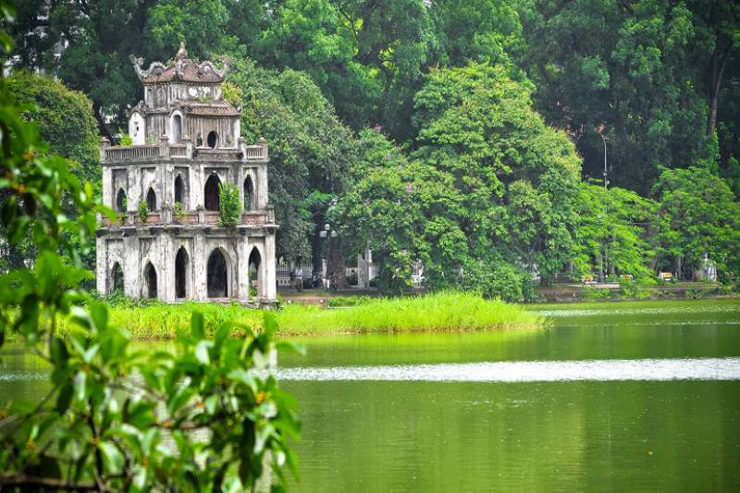
Hoan Kiem Lake
SHOW

Slide 10

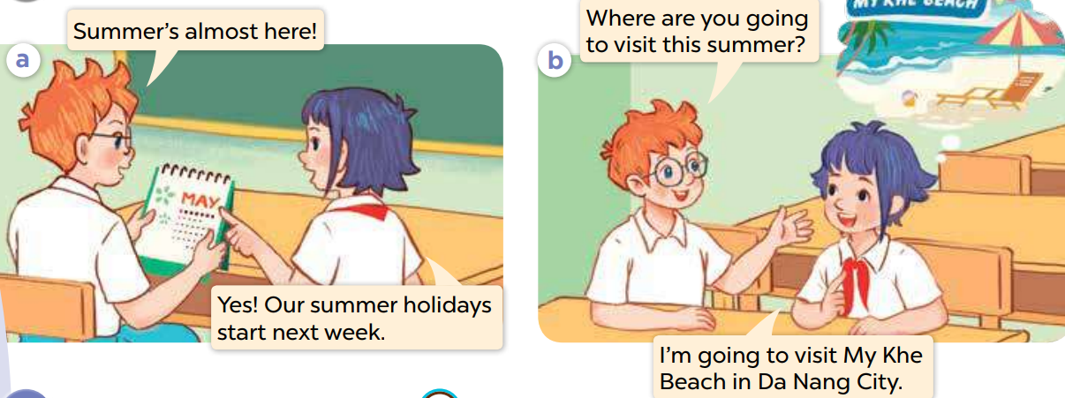
1.Look, listen and repeat
Notes:
MADE BY FACEBOOK :TRAN THI THANH TAM

Slide 11
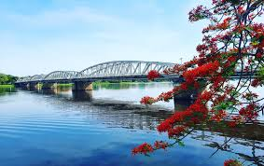
Huong River/hʊəŋ ˈrɪvə(r)/: Sông Hương
Notes:
MADE BY FACEBOOK :TRAN THI THANH TAM

Slide 12
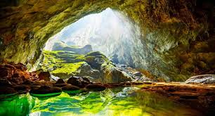
Phong Nha Cave/fɔŋ nha keɪv/
: Động Phong Nha
Notes:
MADE BY FACEBOOK :TRAN THI THANH TAM

Slide 13
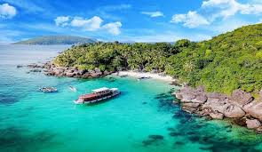
Phu Quoc Island/fʊ kwʊɔkˈaɪlənd/
: Đảo Phú Quốc
Notes:
MADE BY FACEBOOK :TRAN THI THANH TAM

Slide 14
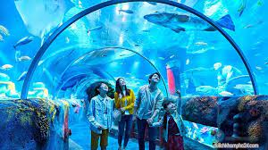
Dam Sen Aquarium/dam sen əˈkweəriəm/
: Thủy cung Đầm Sen
Notes:
MADE BY FACEBOOK :TRAN THI THANH TAM

Slide 15
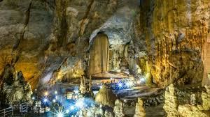
1.Phong Nha Cave
A
2.Dam sen Aquarium
B
3.Huong River
C
4. Phu Quoc Island
D
Notes:
MADE BY FACEBOOK :TRAN THI THANH TAM

Slide 16
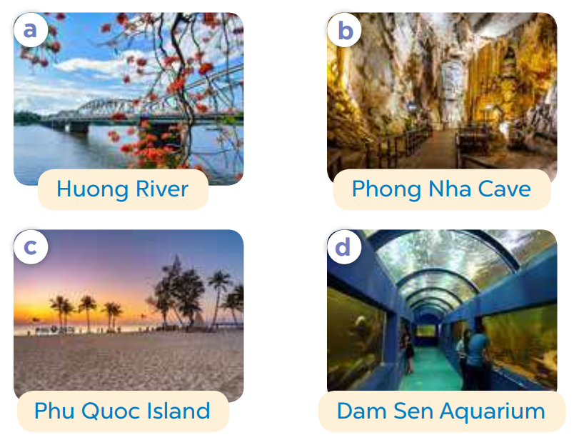
2.Listen, point and say
Where are you going to visit this summer?
Huong River
I’m going to visit.....…..................
Notes:
MADE BY FACEBOOK :TRAN THI THANH TAM

Slide 17
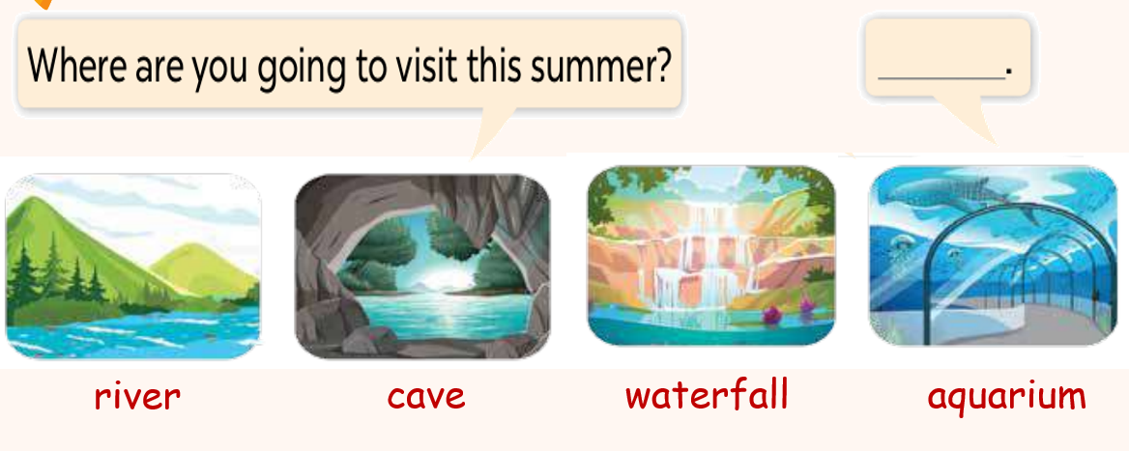
3. Let’s talk
Notes:
MADE BY FACEBOOK :TRAN THI THANH TAM

