Slide 1

UNIT 20:OUR SUMMER HOLIDAYS
LESSON 1 (4, 5, 6)
Notes:
MADE BY FACEBOOK :TRAN THI THANH TAM

Slide 2
Let's play
Kim’s game

Slide 3
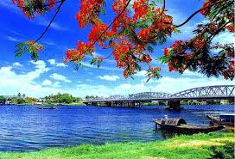
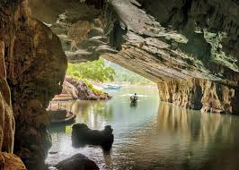
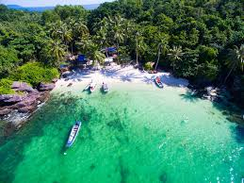
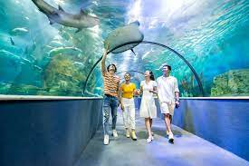
LET’S PLAY: KIM’S GAME
0:0
0:3
0:2
0:5
0:4
0:1
Start
Huong River
Phong Nha Cave
Phu Quoc Island
Dam Sen Aquarium

Slide 4

LET’S PLAY: KIM’S GAME
Let’s tell about places that you have seen in the pictures

Slide 5
LET’S CHECK AND READ
Huong River
Phong Nha Cave
Phu Quoc Island
Dam Sen Aquarium

Slide 6

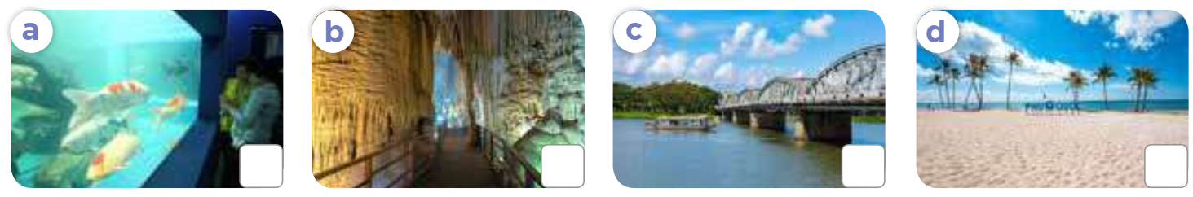
4. Listen and number
4
2
3
1
Notes:
MADE BY FACEBOOK :TRAN THI THANH TAM

Slide 7
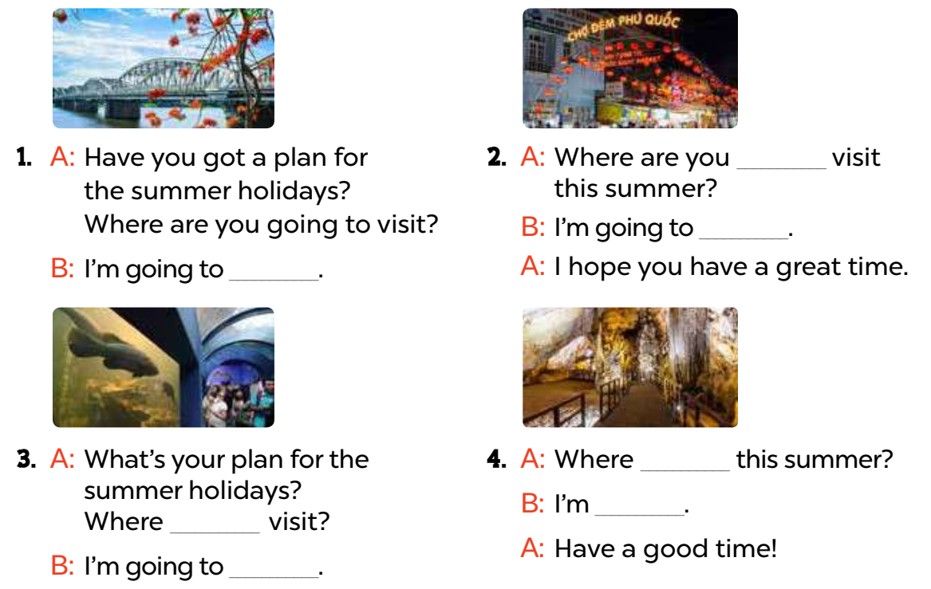
5. Read and complete
going to
visit Phu Quoc Island
visit Huong River
are you going to visit
are you going to
going to visit Phong Nha Cave
visit Dam Sen Aquarium
Notes:
MADE BY FACEBOOK :TRAN THI THANH TAM

Slide 8
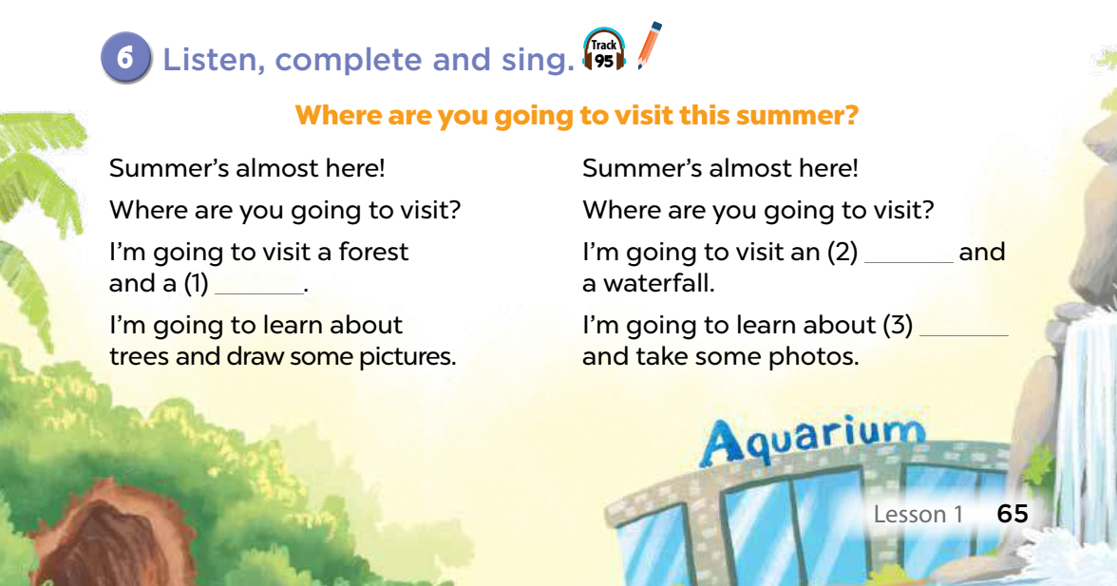
aquarium
___and
cave
fish
Notes:
MADE BY FACEBOOK :TRAN THI THANH TAM

