Slide 1

UNIT 20:OUR SUMMER
HOLIDAYS
LESSON 2 ( 1, 2, 3)
Notes:
MADE BY FACEBOOK :TRAN THI THANH TAM

Slide 2




I’m going to visit Phu Quoc Island.
Notes:
Step 5: Invite a few pairs to point at the pictures and say the questions and answers in front of the class.

Slide 3
Where are you going to visit this summer?
Notes:
Step 5: Invite a few pairs to point at the pictures and say the questions and answers in front of the class.

Slide 4
I’m going to visit Dam Sen Aquarium.
Notes:
Step 5: Invite a few pairs to point at the pictures and say the questions and answers in front of the class.

Slide 5
I hope you have a great time!
Notes:
Step 5: Invite a few pairs to point at the pictures and say the questions and answers in front of the class.

Slide 6

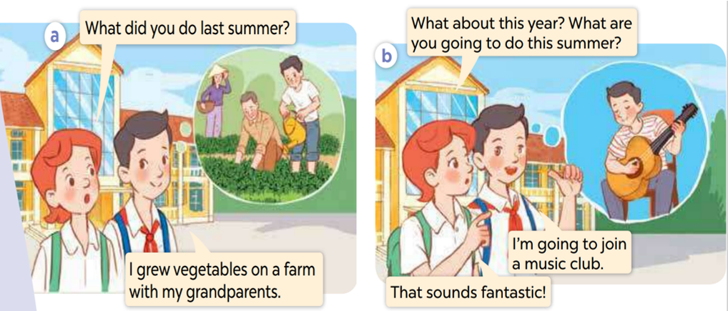
1.Look, listen and repeat
Notes:
MADE BY FACEBOOK :TRAN THI THANH TAM

Slide 7

join a music club/dʒɔɪn ə ˈmjuːzɪk klʌ/
: tham gia câu lạc bộ âm nhạc
Notes:
MADE BY FACEBOOK :TRAN THI THANH TAM

Slide 8
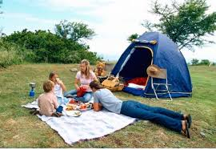
go camping /ɡəʊ ˈkæmpɪŋ/: đi cắm trại
Notes:
MADE BY FACEBOOK :TRAN THI THANH TAM

Slide 9

visit an eco-farm/ˈvɪzɪt ən iːkəʊ fɑːm/
: thăm trang trại sinh thái
Notes:
MADE BY FACEBOOK :TRAN THI THANH TAM

Slide 10
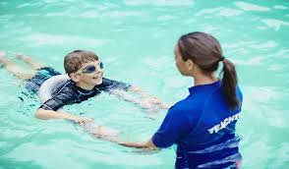
Practise swimming /ˈpræktɪsˈswɪmɪŋ/
: luyện tập bơi
Notes:
MADE BY FACEBOOK :TRAN THI THANH TAM

Slide 11

VOCABULARY
Join a music club: tham gia câu lạc bộ âm nhạc
Go camping:đi cắm trại
Visit an eco – farm: thăm trang trại sinh thái
Practise swimming:luyện tập bơi

Slide 12
Visit eco-farm
SHOW
Notes:
Game: What is this room?
-Pupils choose 1 color and guess the picture of 1 room hidden behind.
-Teacher shows the whole picture at the button SHOW and say out loud the name of the room.

Slide 13
Practise swimming
SHOW
Notes:
Game: What is this room?
-Pupils choose 1 color and guess the picture of 1 room hidden behind.
-Teacher shows the whole picture at the button SHOW and say out loud the name of the room.

Slide 14
Join a music club
SHOW
Notes:
Game: What is this room?
-Pupils choose 1 color and guess the picture of 1 room hidden behind.
-Teacher shows the whole picture at the button SHOW and say out loud the name of the room.

Slide 15
Go camping
SHOW
Notes:
Game: What is this room?
-Pupils choose 1 color and guess the picture of 1 room hidden behind.
-Teacher shows the whole picture at the button SHOW and say out loud the name of the room.

Slide 16
Hỏi và trả lời xem ai đó dự định làm gì vào mùa hè
What are you going to do this summer?
( Bạn dự định làm gì vào mùa hè vậy? )
I’m going to join a music club.
(Tôi dự định tham gia một câu lạc bộ âm nhạc.)
Notes:
MADE BY FACEBOOK :TRAN THI THANH TAM

Slide 17
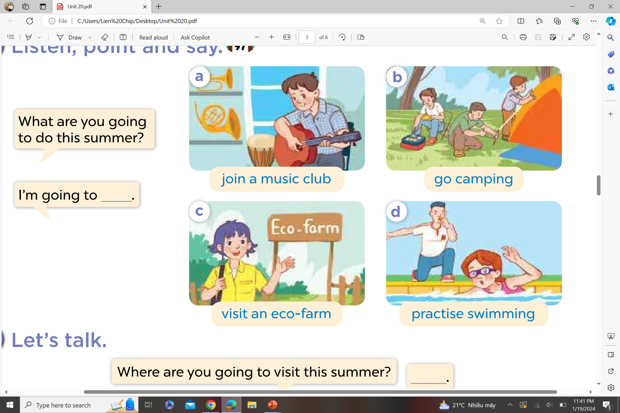
2.Listen, point and say
What are you going to do this summer?
join a music club
I’m going to ……..…..................
Notes:
MADE BY FACEBOOK :TRAN THI THANH TAM

Slide 18
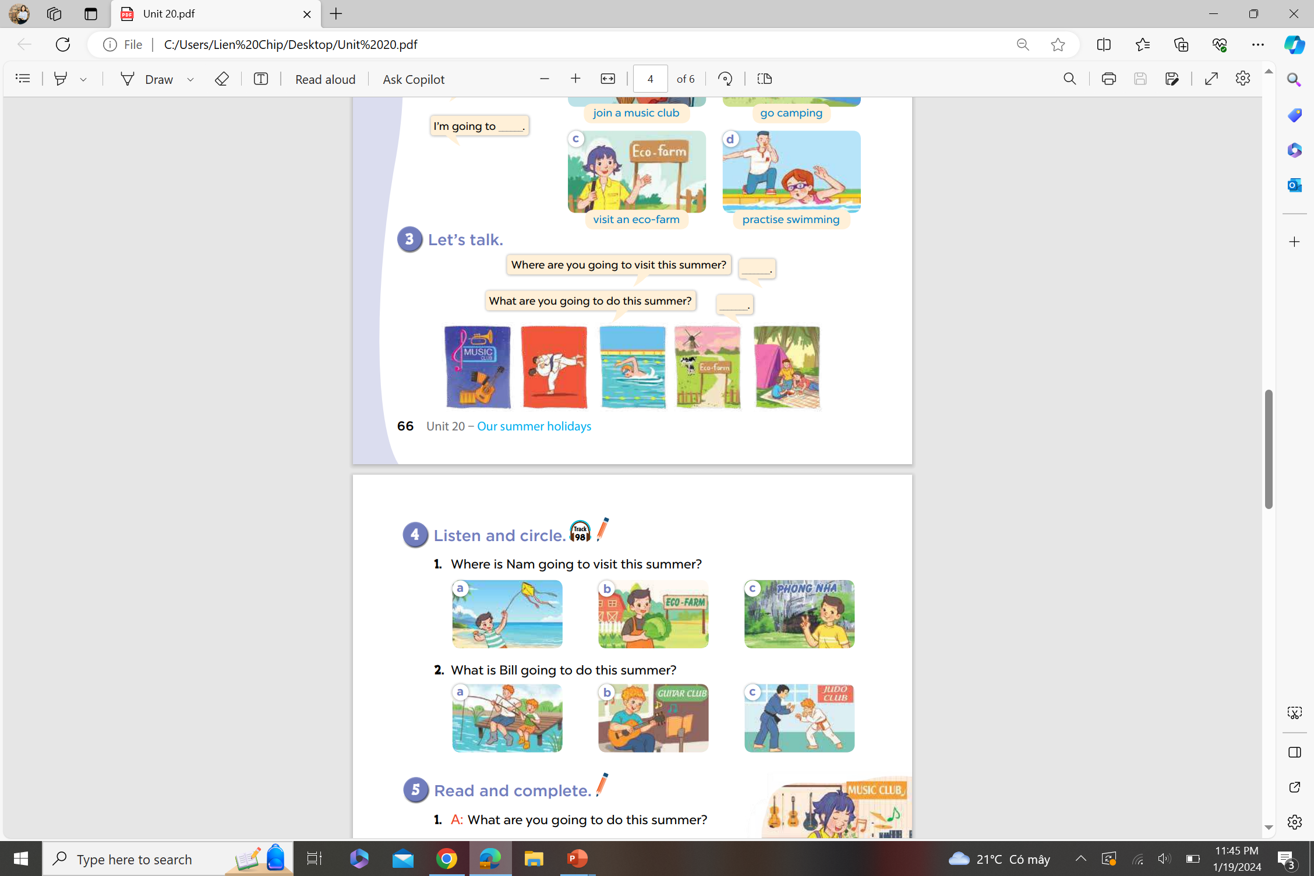
3. Let’s talk
Notes:
MADE BY FACEBOOK :TRAN THI THANH TAM

