Slide 1
UNIT 20: OUR SUMMER HOLIDAYS
LESSON 2 ( 4, 5, 6)
Notes:
MADE BY FACEBOOK :TRAN THI THANH TAM

Slide 2


Which place can you see in each picture?
an eco-farm
Phong Nha cave
a beach
Notes:
MADE BY FACEBOOK :TRAN THI THANH TAM

Slide 3

What activity can you see in each picture?
fishing
playing the guitar
join a judo club
Notes:
MADE BY FACEBOOK :TRAN THI THANH TAM

Slide 4

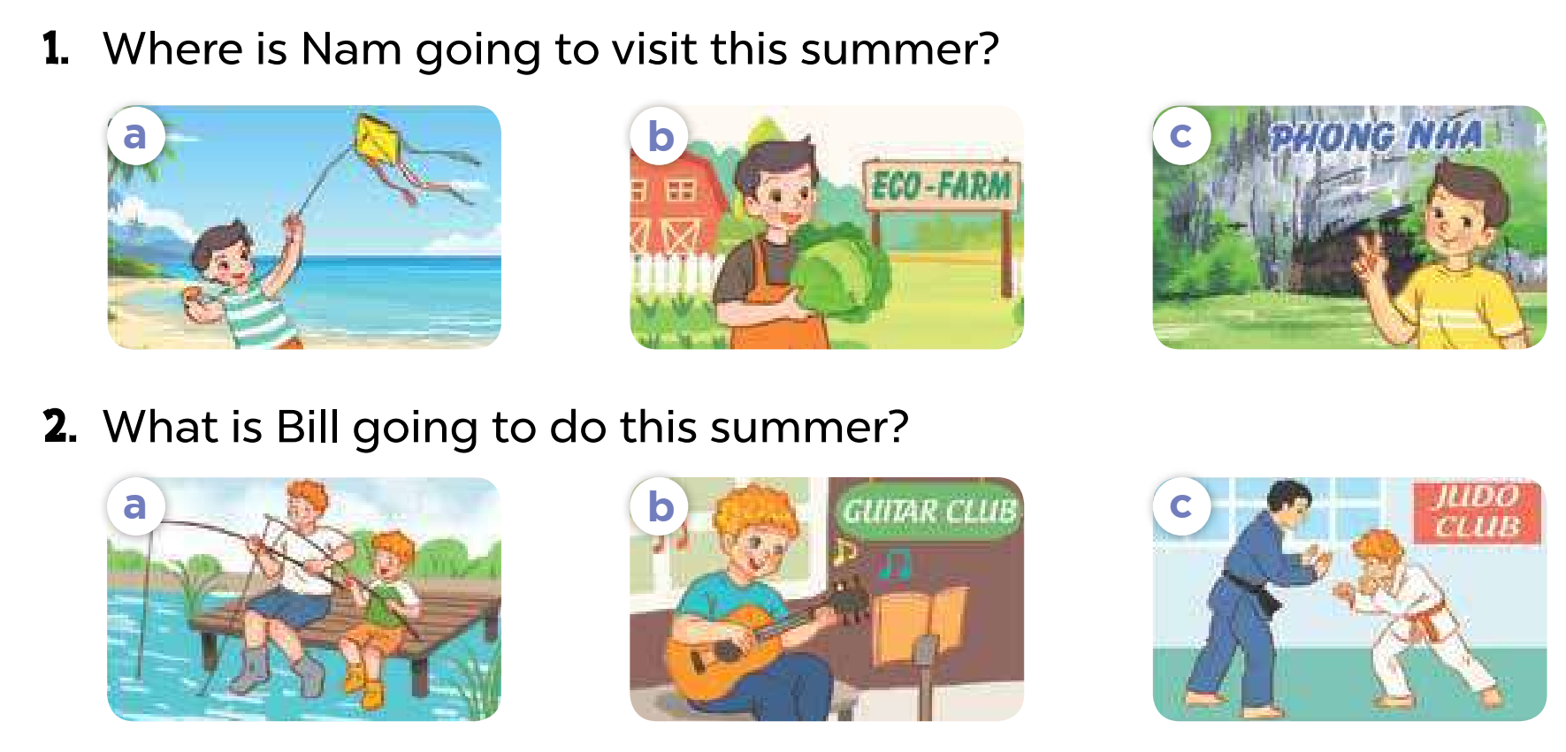
4. Listen and circle
Notes:
MADE BY FACEBOOK :TRAN THI THANH TAM

Slide 5

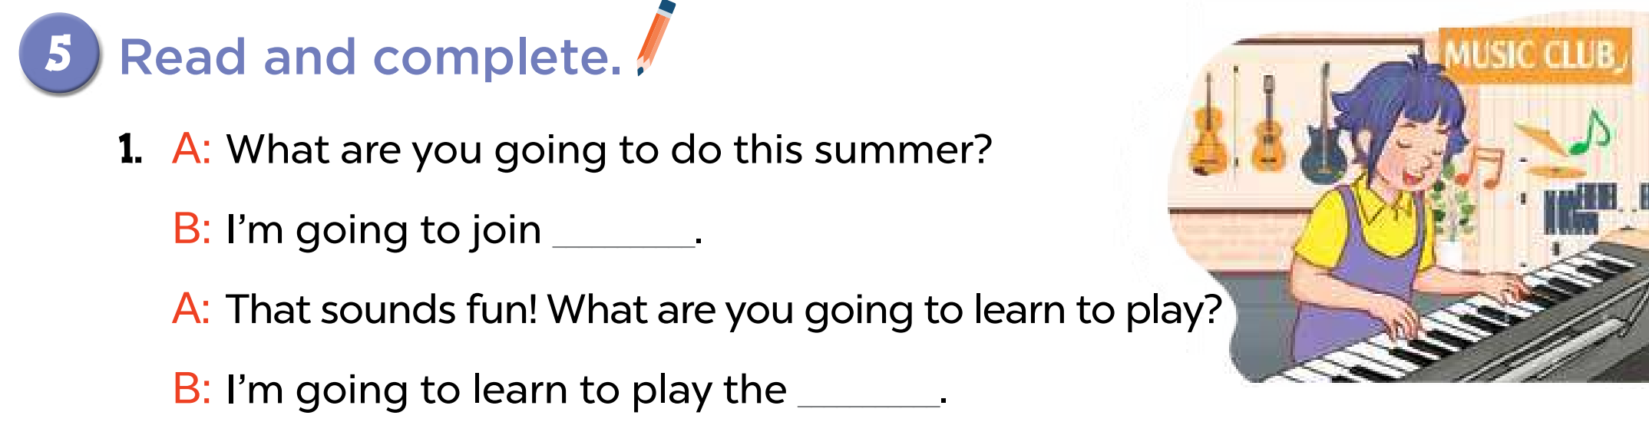
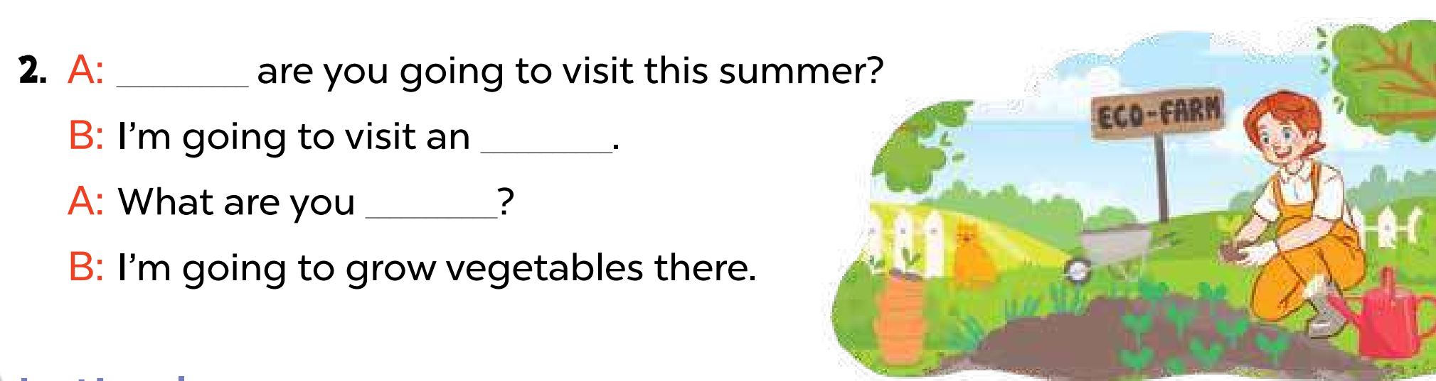
5. Read and complete
a music club
piano
Where
eco-farm
going to do ?
Notes:
MADE BY FACEBOOK :TRAN THI THANH TAM

Slide 6
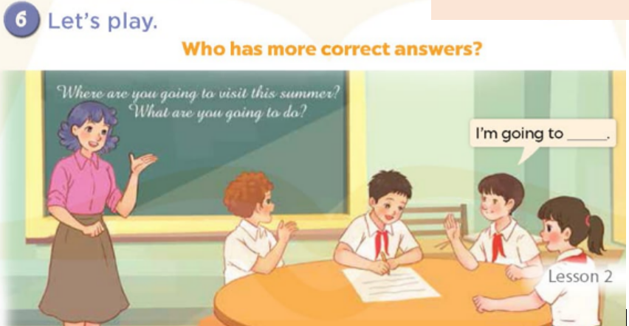
Notes:
MADE BY FACEBOOK :TRAN THI THANH TAM

Slide 7



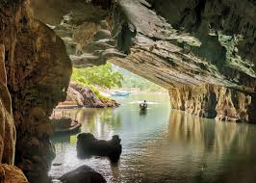

A. a cave
I'm going to visit ............
B. a waterfall
C. an aquarium
Notes:
Step 5: Invite a few pairs to point at the pictures and say the questions and answers in front of the class.

Slide 8
A. a cave
I'm going to visit .............. I like fish.
B. a forest
C. an aquarium
Notes:
Step 5: Invite a few pairs to point at the pictures and say the questions and answers in front of the class.

Slide 9
A. going
Where are you .......... visit this summer?
B. going to
C. will
Notes:
Step 5: Invite a few pairs to point at the pictures and say the questions and answers in front of the class.

Slide 10
A. visit
Where are you going ...........?
B. to visit
C. visiting
Notes:
Step 5: Invite a few pairs to point at the pictures and say the questions and answers in front of the class.

Slide 11
A. trees
I'm going to visit a forest to learn about .........
B. fish
C. the beach
Notes:
Step 5: Invite a few pairs to point at the pictures and say the questions and answers in front of the class.

Slide 12
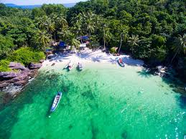
A. Aquarium
What's your plan for summer?- I’m going to Phu Quoc ……….
B. Cave
C. Island
Notes:
Step 5: Invite a few pairs to point at the pictures and say the questions and answers in front of the class.

