Slide 1

UNIT 13:OUR SPECIAL DAYS
LESSON 1 ( 1, 2, 3)
By Mrs Phuong- Quang Hung Primary
Notes:
MADE BY FACEBOOK :TRAN THI THANH TAM

Slide 2

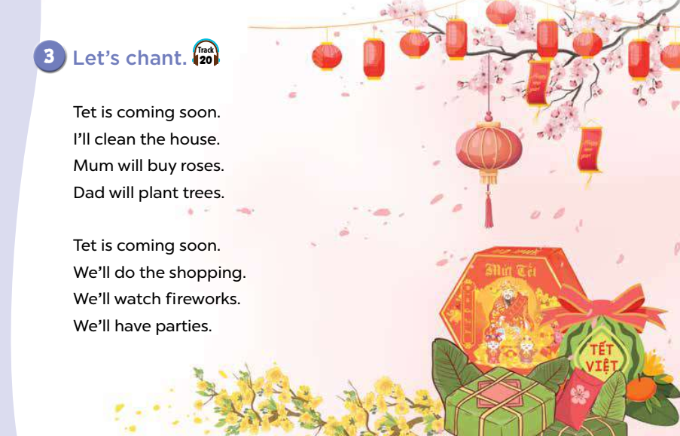
* CHANTING
Notes:
Made by FACEBOOK: TRAN THI THANH TAM

Slide 3
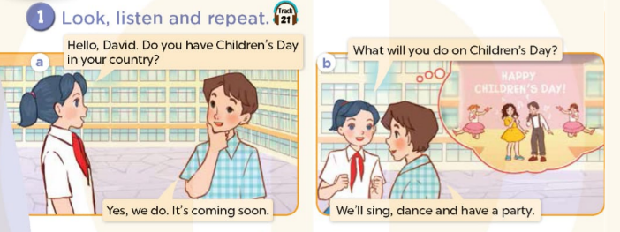
Notes:
MADE BY FACEBOOK :TRAN THI THANH TAM

Slide 4

On Children’s Day/ ɒn ˈtʃɪldrən’s dei/
:ngày Quốc tế Thiếu nhi
Notes:
MADE BY FACEBOOK :TRAN THI THANH TAM

Slide 5
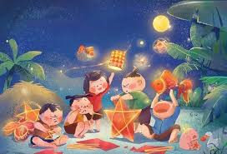
At Mid-Autumn Festival/ət ˈspɔːts deɪ/
:vào Tết Trung thu
Notes:
MADE BY FACEBOOK :TRAN THI THANH TAM

Slide 6
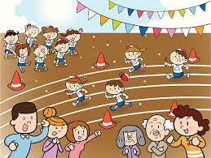
On Sports Day /ɒn ˈspɔːts deɪ/ : vào ngày hội thể thao
Notes:
MADE BY FACEBOOK :TRAN THI THANH TAM

Slide 7

on Teachers’ Day /ɒn ˈtiːtʃə(r)s deɪ/ :vào ngày Nhà giáo Việt Nam
Notes:
MADE BY FACEBOOK :TRAN THI THANH TAM

Slide 8
Hỏi và trả lời xem bạn đến từ đâu
What will you do on Children’s Day?
( Các bạn sẽ làm gì vào ngày quốc tế thiếu nhi?)
We’ll dance
( Chúng tôi sẽ nhảy.)

Slide 9
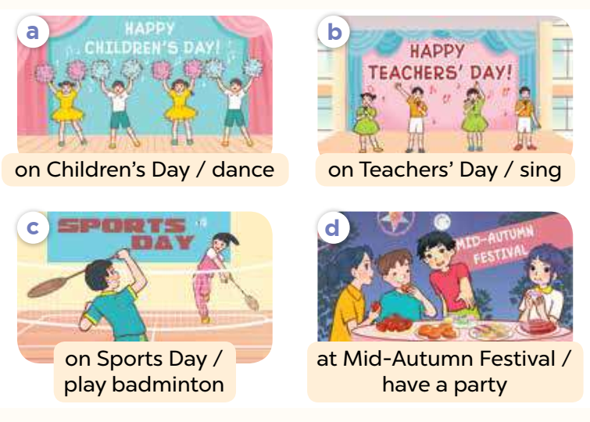
2.Listen, point and say
Children’s Day
What will you do on............................?
dance
We’ll …..................
Notes:
MADE BY FACEBOOK :TRAN THI THANH TAM

Slide 10
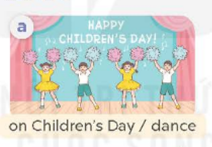
Children’s Day
What will you do on............................?
dance
We’ll …..................
Notes:
MADE BY FACEBOOK :TRAN THI THANH TAM

Slide 11

on Teachers’ Day
What will you do .................................?
sing
We’ll ….......................
Notes:
MADE BY FACEBOOK :TRAN THI THANH TAM

Slide 12
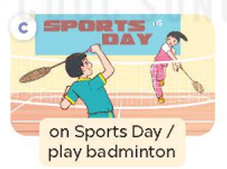
on Sports Day
What will you do ..................................?
play badminton
We’ll ….................................
Notes:
MADE BY FACEBOOK :TRAN THI THANH TAM

Slide 13
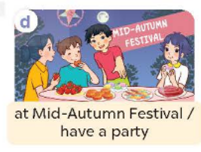
at Mid- Autumn Festival
What will you do....... .......................................?
have a party
We’ll ….................................
Notes:
MADE BY FACEBOOK :TRAN THI THANH TAM

Slide 14
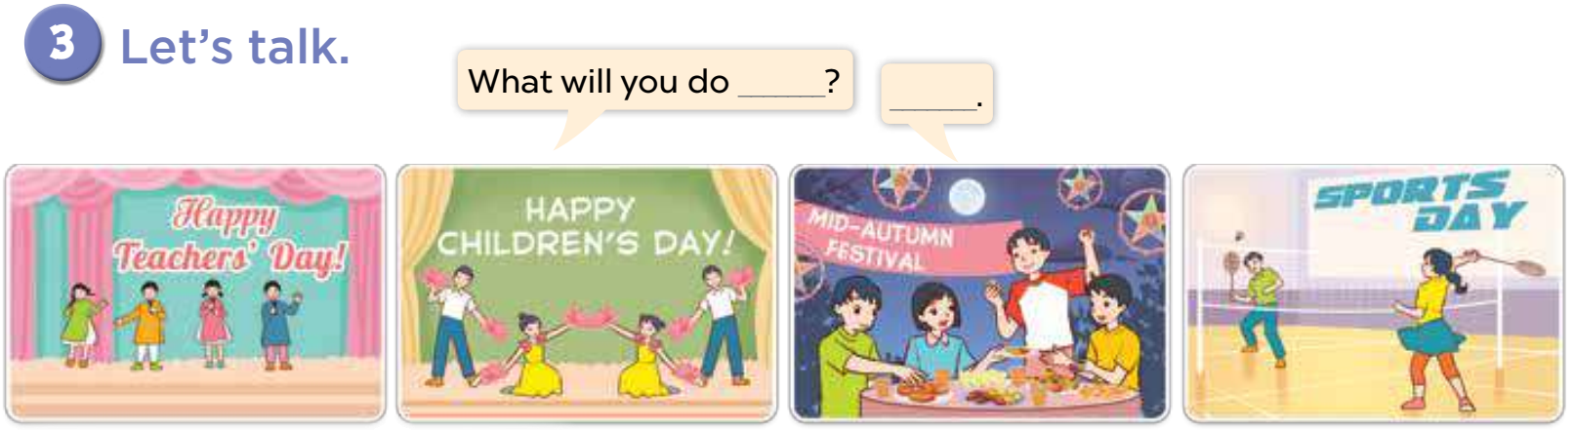
Notes:
MADE BY FACEBOOK :TRAN THI THANH TAM

