Slide 1

UNIT 13:OUR SPECIAL DAYS
LESSON 1 (4, 5, 6)
Notes:
MADE BY FACEBOOK :TRAN THI THANH TAM

Slide 2

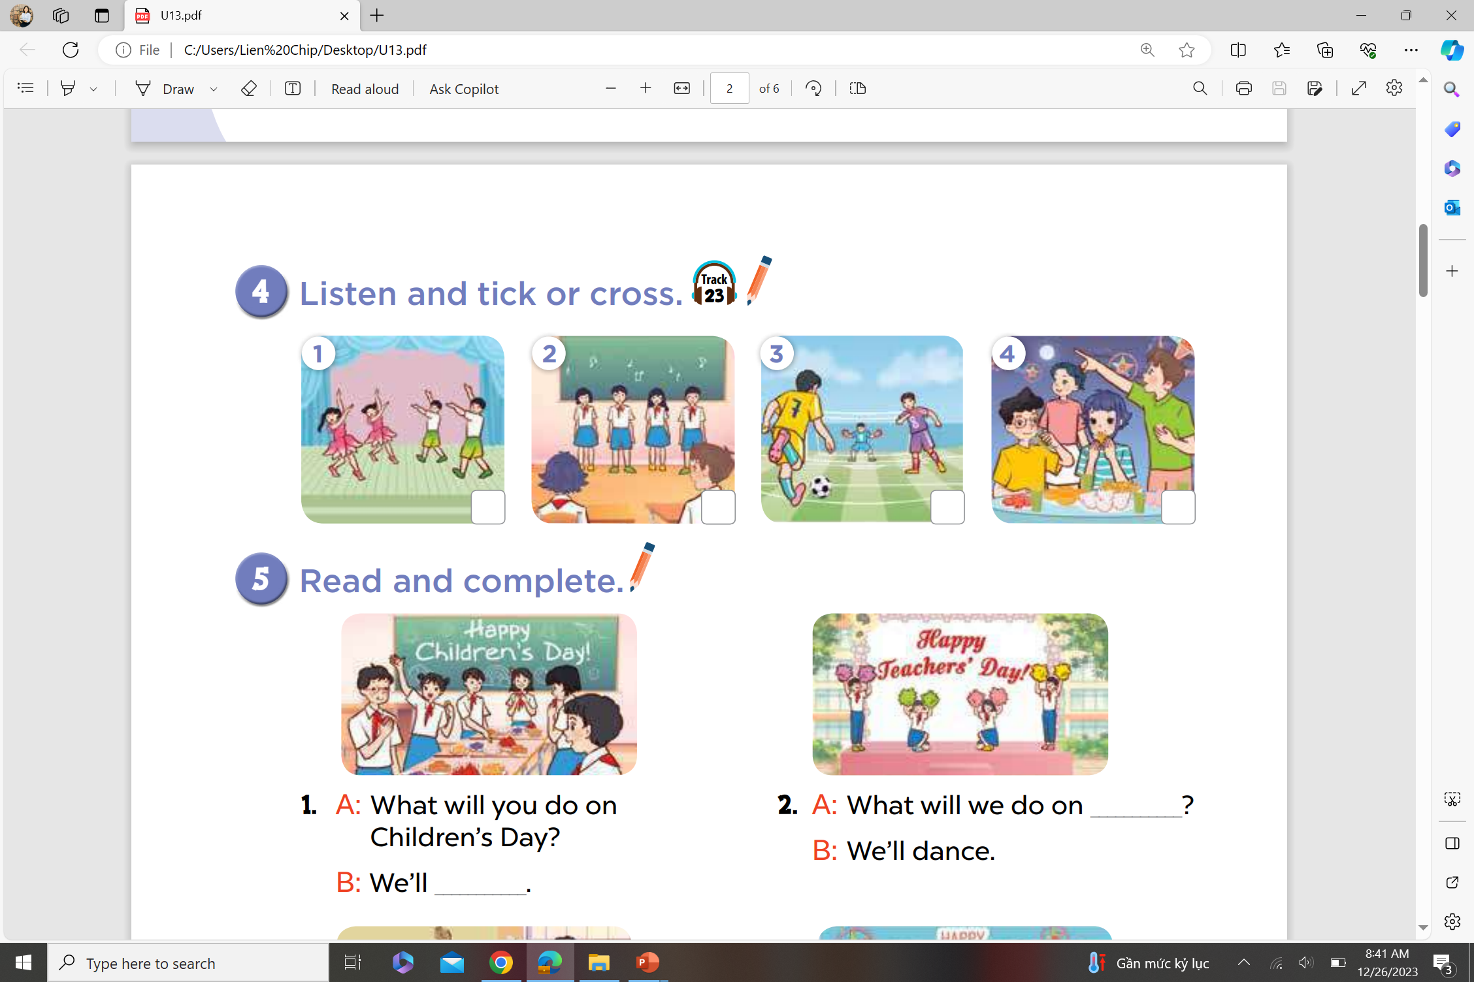

4. Listen and tick or cross
Notes:
MADE BY FACEBOOK :TRAN THI THANH TAM

Slide 3
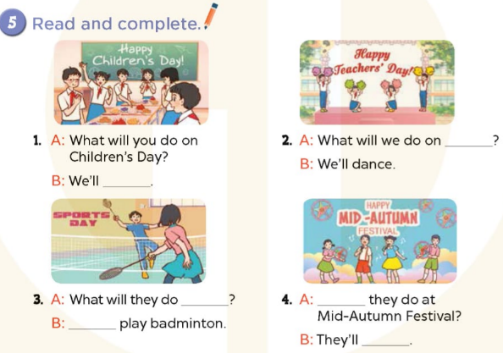
Notes:
MADE BY FACEBOOK :TRAN THI THANH TAM

Slide 4
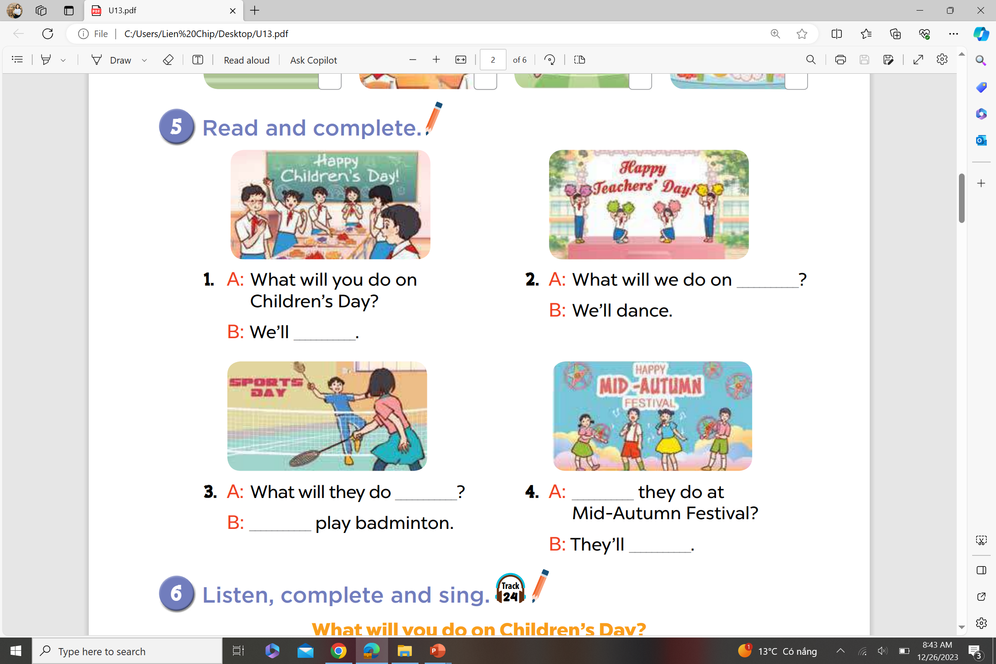
5. Read and complete
Teachers’ Day
have a party
Notes:
MADE BY FACEBOOK :TRAN THI THANH TAM

Slide 5
5. Read and complete
on Sports Day
What will
We’ll
sing and dance
Notes:
MADE BY FACEBOOK :TRAN THI THANH TAM

Slide 6
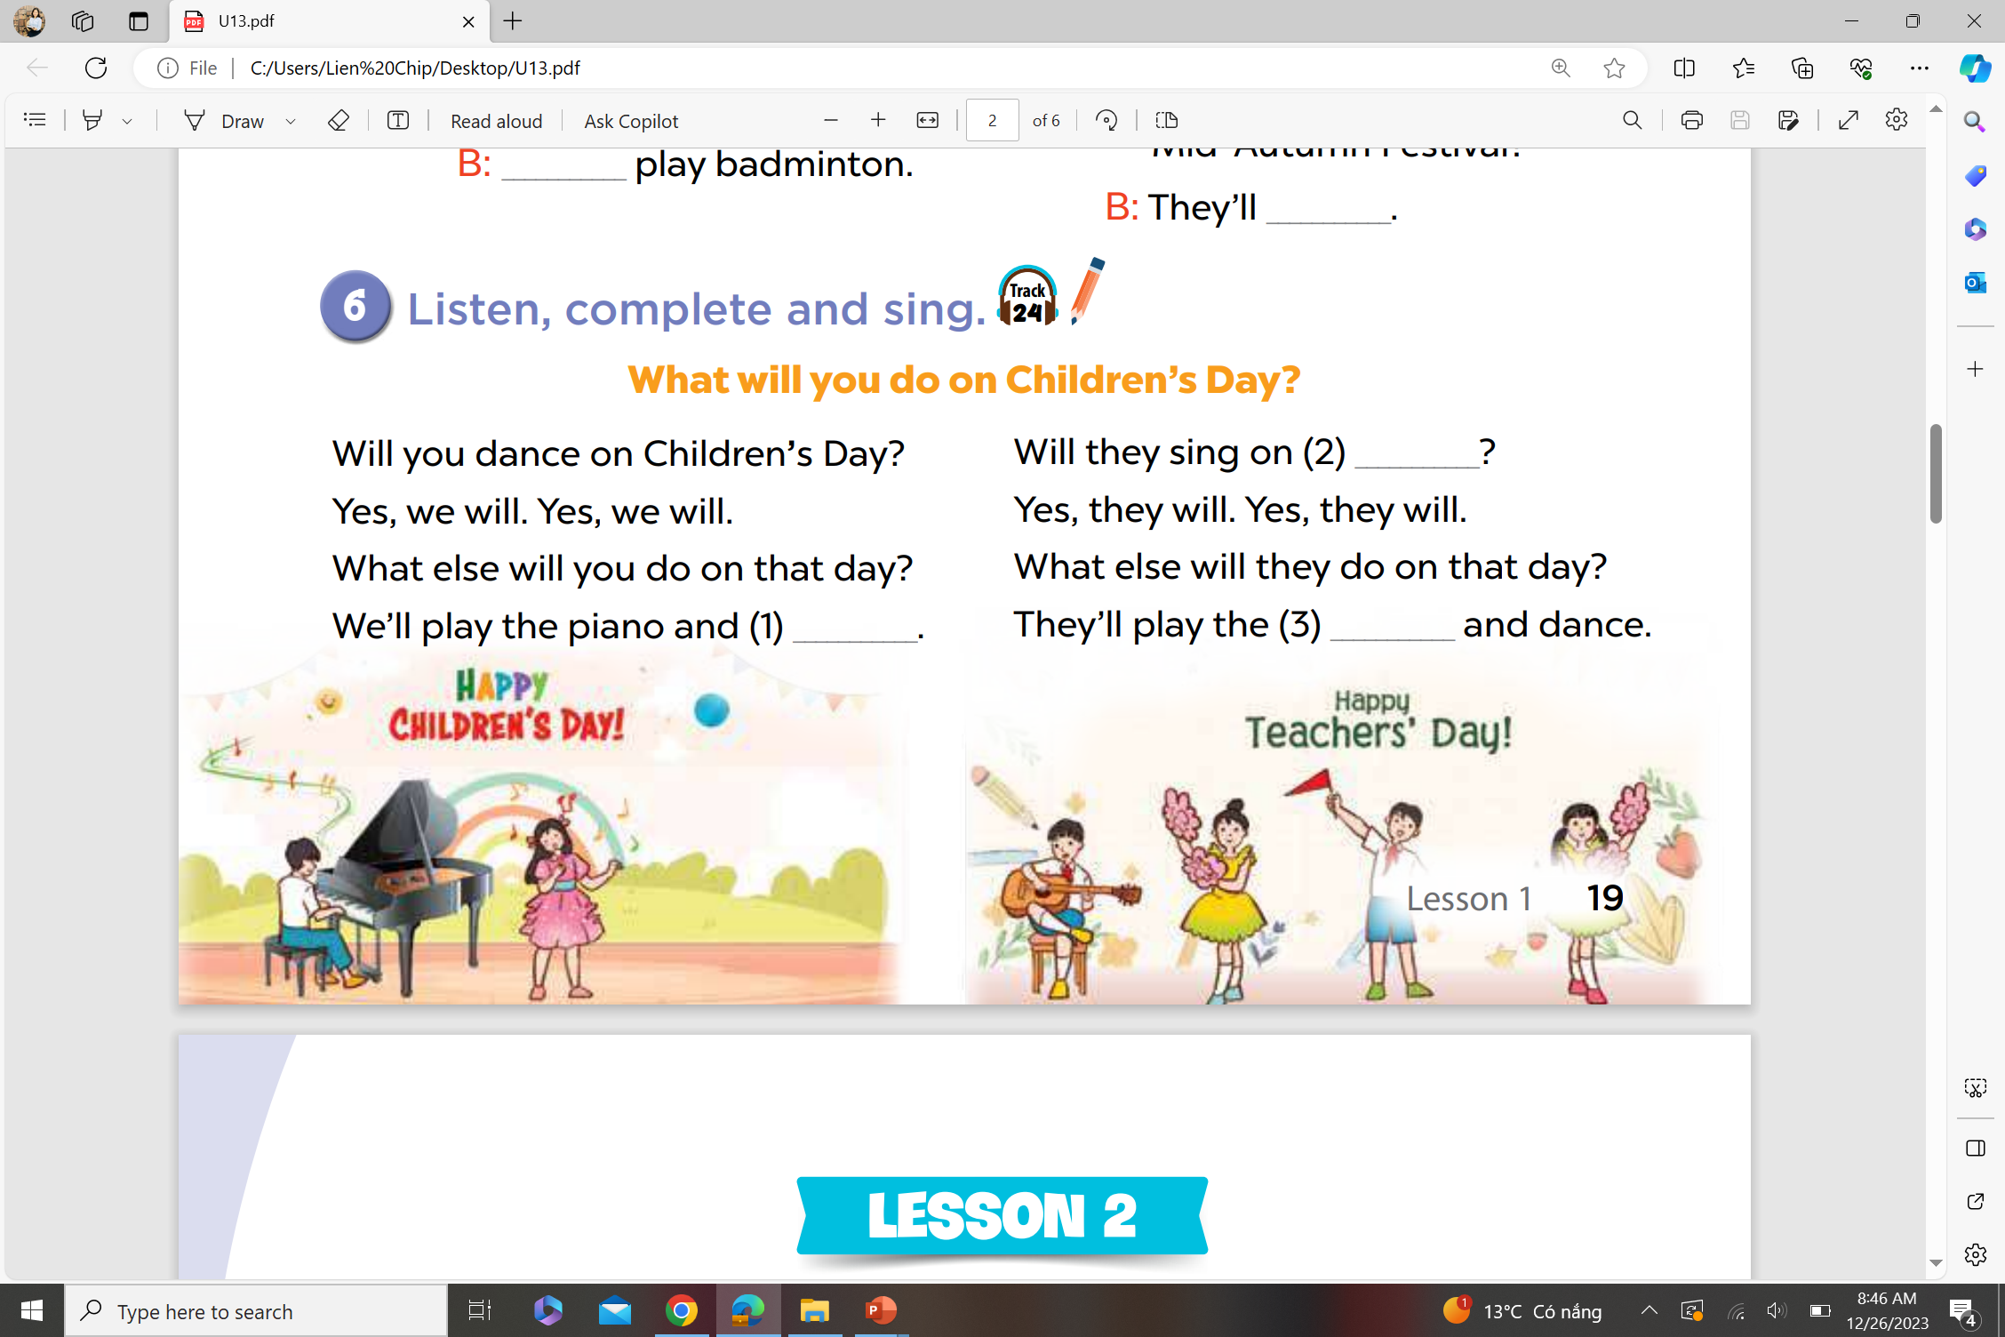
6. Listen, complete and sing
teachers’ Day ?
sing
guitar
Notes:
MADE BY FACEBOOK :TRAN THI THANH TAM

