Slide 1
UNIT 13:OUR SPECIAL DAYS
LESSON 2 ( 1, 2, 3)
Notes:
MADE BY FACEBOOK :TRAN THI THANH TAM

Slide 2
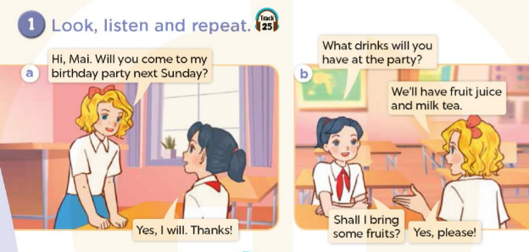

Notes:
MADE BY FACEBOOK :TRAN THI THANH TAM

Slide 3

apple juice /ˈæpl dʒuːs/ nước ép táo
Notes:
MADE BY FACEBOOK :TRAN THI THANH TAM

Slide 4
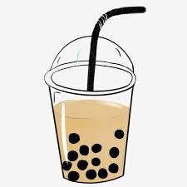
milk tea /mɪlk tiː/ trà sữa
Notes:
MADE BY FACEBOOK :TRAN THI THANH TAM

Slide 5

pizza /ˈpiːtsə/ bánh pi-za
Notes:
MADE BY FACEBOOK :TRAN THI THANH TAM

Slide 6
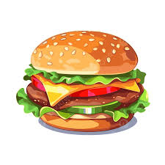
burgers /ˈbɜːɡəs/ bánh mì kẹp thịt
Notes:
MADE BY FACEBOOK :TRAN THI THANH TAM

Slide 7
Hỏi xem ai đó dùng thức ăn gì
What food will you have at the party ?
( Các bạn dùng thức ăn gì ở bữa tiệc vậy? )
We’ll have pizza
(Chúng tôi dùng bánh pi –za.)
Notes:
MADE BY FACEBOOK :TRAN THI THANH TAM

Slide 8
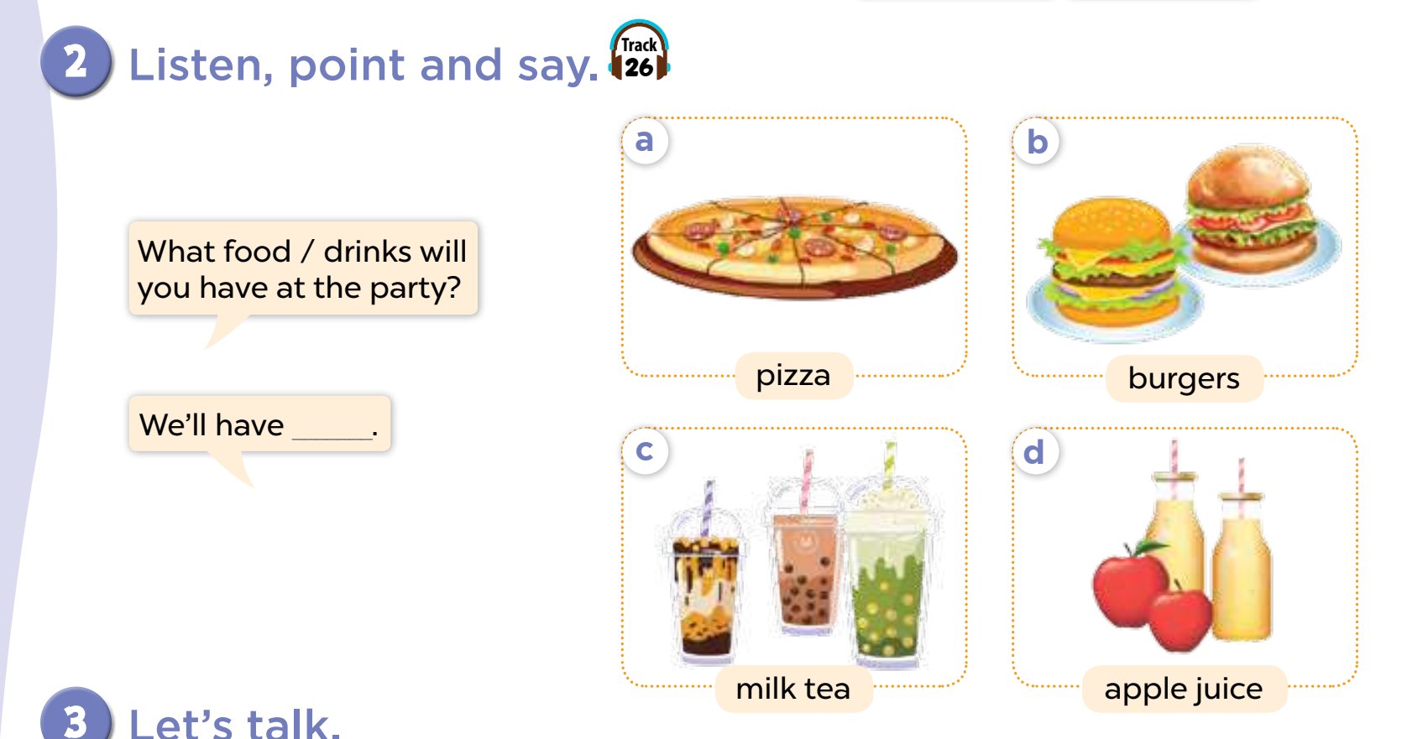
pizza
Notes:
MADE BY FACEBOOK :TRAN THI THANH TAM

Slide 9
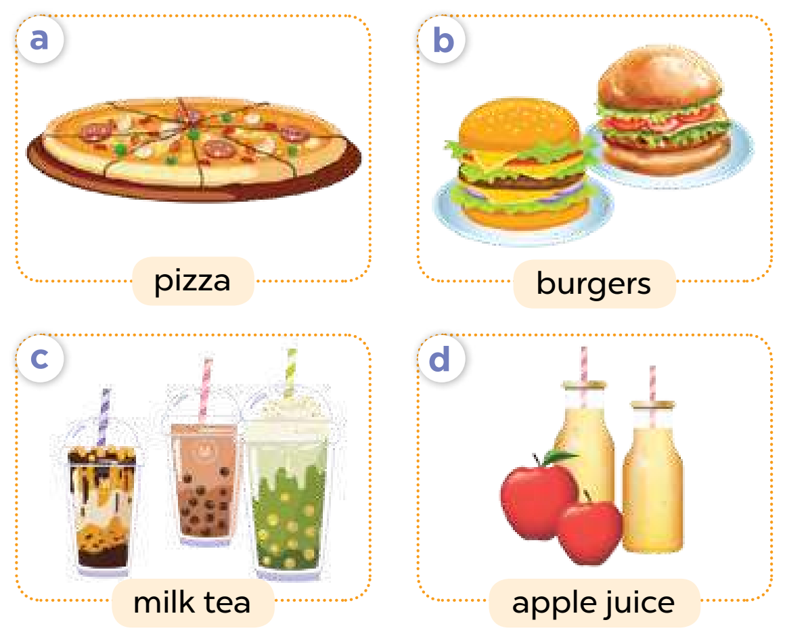
food
What ..............will you have at the party?
pizza
We’ll have…..................
Notes:
MADE BY FACEBOOK :TRAN THI THANH TAM

Slide 10
food
What ..............will you have at the party?
burgers
We’ll have…..................
Notes:
MADE BY FACEBOOK :TRAN THI THANH TAM

Slide 11
drinks
What ..............will you have at the party?
milk tea
We’ll have…..................
Notes:
MADE BY FACEBOOK :TRAN THI THANH TAM

Slide 12
drinks
What ..............will you have at the party?
apple juice
We’ll have…..................
Notes:
MADE BY FACEBOOK :TRAN THI THANH TAM

Slide 13
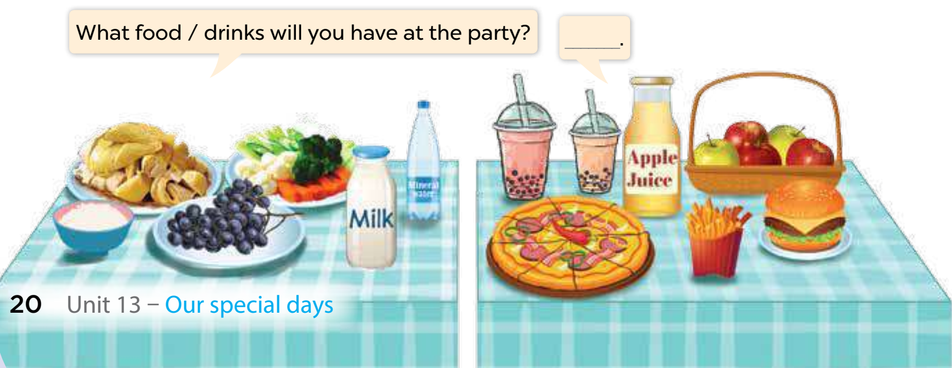
3. Let’s talk
What will you do at/ after the party?
Notes:
MADE BY FACEBOOK :TRAN THI THANH TAM

