Slide 1
UNIT 13: OUR SPECIAL DAYS
LESSON 2 ( 4, 5, 6)
Notes:
MADE BY FACEBOOK :TRAN THI THANH TAM

Slide 2

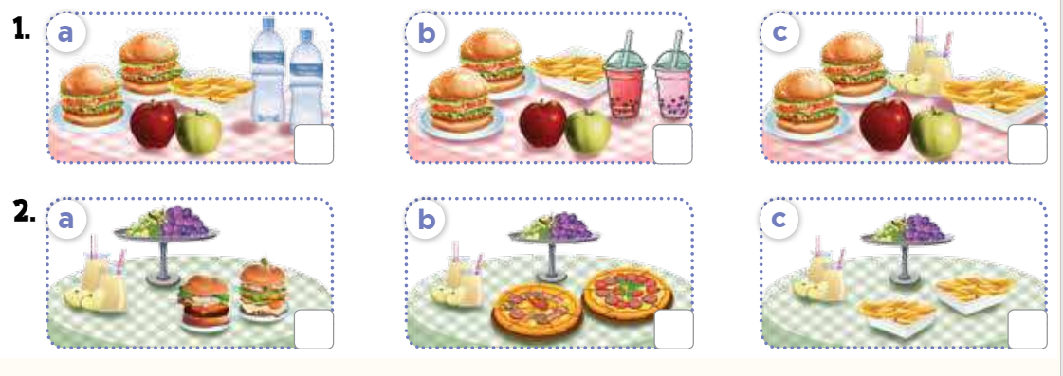

4. Listen and tick
Notes:
MADE BY FACEBOOK :TRAN THI THANH TAM

Slide 3
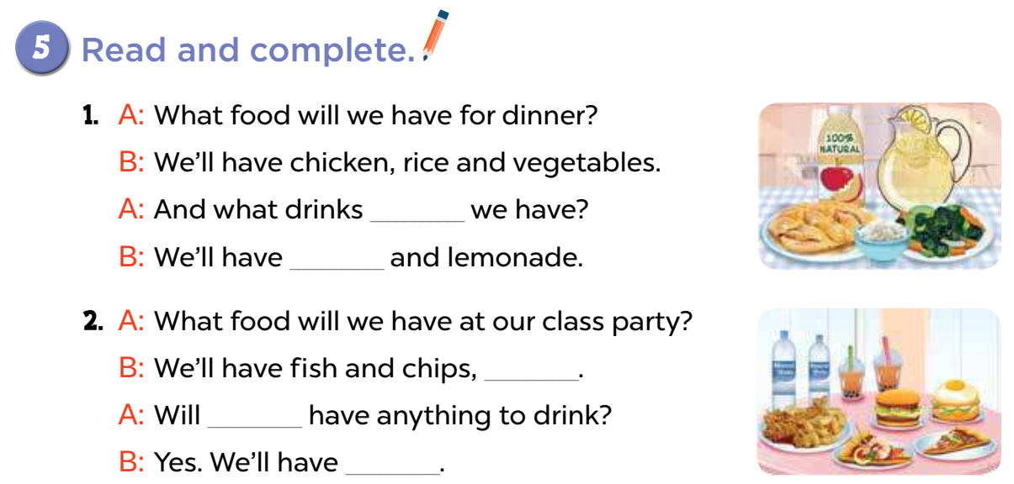
will
apple juice
___________________ and lemonade.
burgers and pizzas
____________________.
we
mineral water and milk tea
_______________________________.
Notes:
MADE BY FACEBOOK :TRAN THI THANH TAM

Slide 4
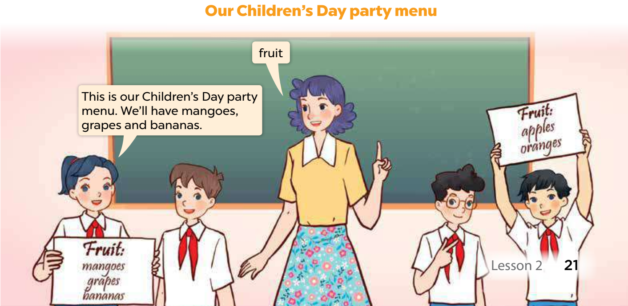
6. Let’s play
Notes:
MADE BY FACEBOOK :TRAN THI THANH TAM

