Slide 1
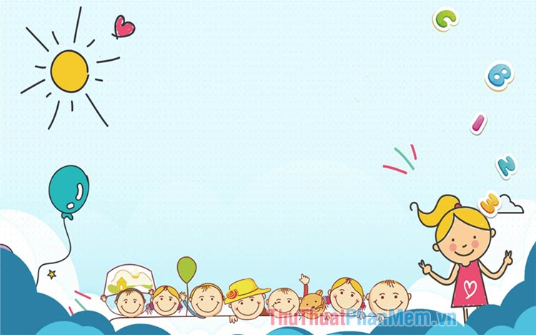
UNIT 13:OUR SPECIAL DAYS
LESSON 3 ( 4, 5, 6)

Slide 2
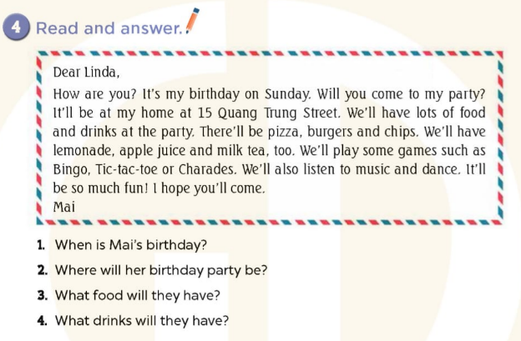
-> Her birthday is on Sunday.
->It’ll be at her home at 15 Quang Trung Street.
->They will have pizza, burgers and chips.
->They will have lemonade, apple juice and milk tea.
Notes:
MADE BY FACEBOOK :TRAN THI THANH TAM

Slide 3
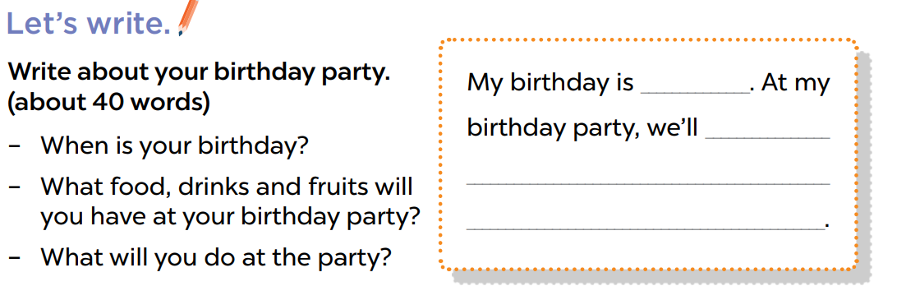
5. Let’s write
Notes:
MADE BY FACEBOOK :TRAN THI THANH TAM

Slide 4
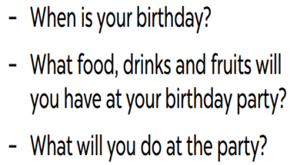

My birthday is in July.
I will have cakes, chicken, milk tea and apple juice…
I will sing and dance.
in July
have cakes
chicken, milk tea and apple juice…
We will sing and dance.

Slide 5
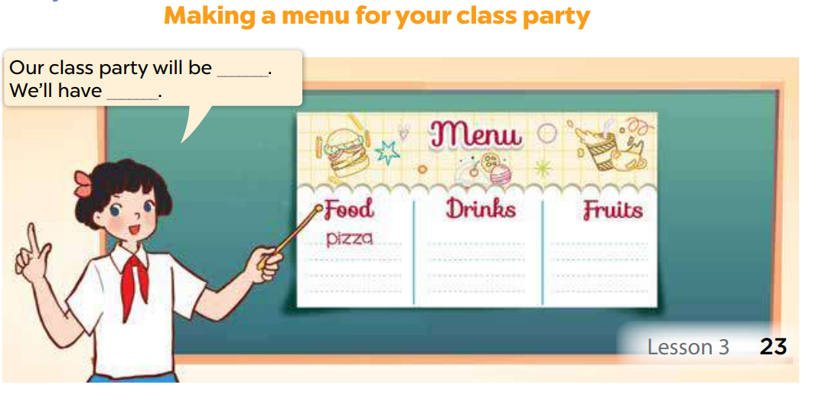
6. Project
Notes:
MADE BY FACEBOOK :TRAN THI THANH TAM

