Slide 1

UNIT 14:STAYING HEALTHY
LESSON 2 ( 1, 2, 3)
Notes:
MADE BY FACEBOOK :TRAN THI THANH TAM

Slide 2
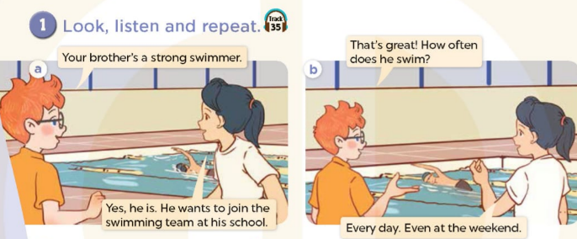

Notes:
MADE BY FACEBOOK :TRAN THI THANH TAM

Slide 3
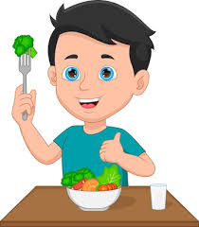
eat vegetables/ iːt ˈvedʒtəbls/ăn rau
Notes:
MADE BY FACEBOOK :TRAN THI THANH TAM

Slide 4
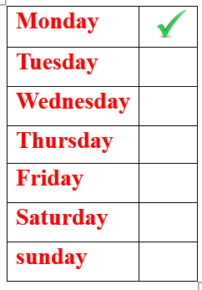
once a week/wʌns ə wiːk/
một lần một tuần
Notes:
MADE BY FACEBOOK :TRAN THI THANH TAM

Slide 5
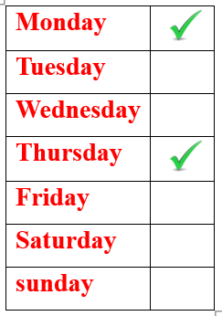
twice a week/twaɪs ə wiːk/
:hai lần một tuần
Notes:
MADE BY FACEBOOK :TRAN THI THANH TAM

Slide 6
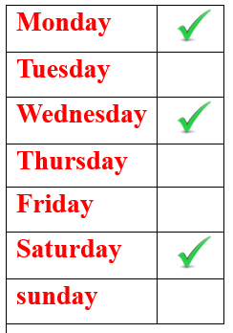
three times a week/ θriː taɪmz ə wiːk/
:ba lần một tuần
Notes:
MADE BY FACEBOOK :TRAN THI THANH TAM

Slide 7
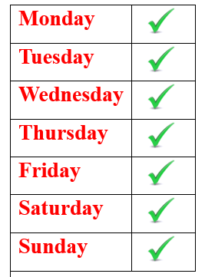
every day/ˈevri deɪ/ mỗi ngày
Notes:
MADE BY FACEBOOK :TRAN THI THANH TAM

Slide 8
VOCABULARY
Eat vegetables: ăn rau
Once a week: 1 lần 1 tuần
Twice a week: 2 lần 1 tuần
Three times a week: 3 lần 1 tuần
Every day: mỗi ngày

Slide 9

EVERY DAY
?
Notes:
MADE BY FACEBOOK :TRAN THI THANH TAM

Slide 10
?
EAT VEGETABLES
Notes:
MADE BY FACEBOOK :TRAN THI THANH TAM

Slide 11
?
ONCE A WEEK
Notes:
MADE BY FACEBOOK :TRAN THI THANH TAM

Slide 12
?
TWICE A WEEK
Notes:
MADE BY FACEBOOK :TRAN THI THANH TAM

Slide 13
?
THREE TIMES A WEEK
Notes:
MADE BY FACEBOOK :TRAN THI THANH TAM

Slide 14
Hỏi xem ai đó có thường hay làm gì không
How often does she do yoga?
( Cô ấy có thường tập yo ga không? )
Once a week.
(Một lần một tuần.)
Notes:
MADE BY FACEBOOK :TRAN THI THANH TAM

Slide 15
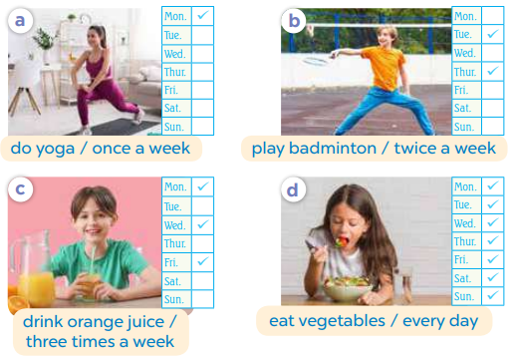
2.Listen, point and say
do yoga
How often does she.................. ?
Once a week
......…..................
Notes:
MADE BY FACEBOOK :TRAN THI THANH TAM

Slide 16

play badminton
How often does he........................... ?
Twice a week
......…..................
Notes:
MADE BY FACEBOOK :TRAN THI THANH TAM

