Slide 1
UNIT 14: STAYING HEALTHY
LESSON 2 ( 4, 5, 6)
Notes:
MADE BY FACEBOOK :TRAN THI THANH TAM

Slide 2

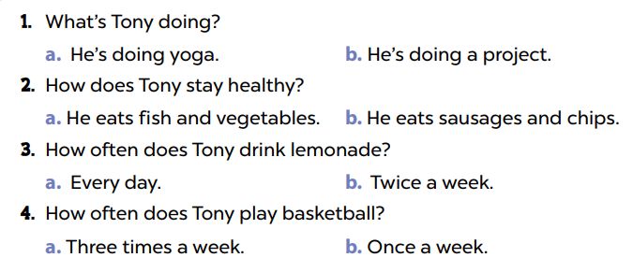

4. Listen and circle
Notes:
MADE BY FACEBOOK :TRAN THI THANH TAM

Slide 3
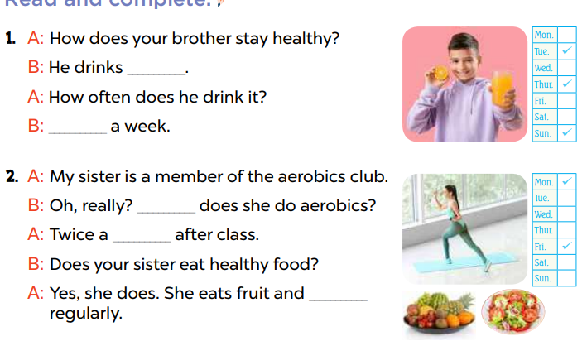
5. Read and complete
orange juice
three times
How often
week
vegetables
Notes:
MADE BY FACEBOOK :TRAN THI THANH TAM

Slide 4
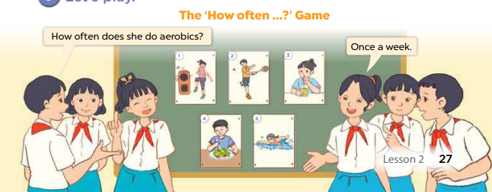
6. Let’s play
Notes:
MADE BY FACEBOOK :TRAN THI THANH TAM

