Slide 1

UNIT 16 :SEASONS AND
THE WEATHER
LESSON 3 (1, 2, 3)
Notes:
MADE BY FACEBOOK :TRAN THI THANH TAM

Slide 2


1.Listen and repeat
It’s cloudy in autumn.
I wear jeans in winter.
Notes:
MADE BY FACEBOOK :TRAN THI THANH TAM

Slide 3
2. Listen and repeat. Pay attention to the intonation.
1. It’s humid in spring.
2. Dresses are perfect for today.
3. I wear trousers in summer.
4. Jackets are good for winter.
Notes:
MADE BY FACEBOOK :TRAN THI THANH TAM

Slide 4
LET’S PLAY
Choose the best answer

Slide 5
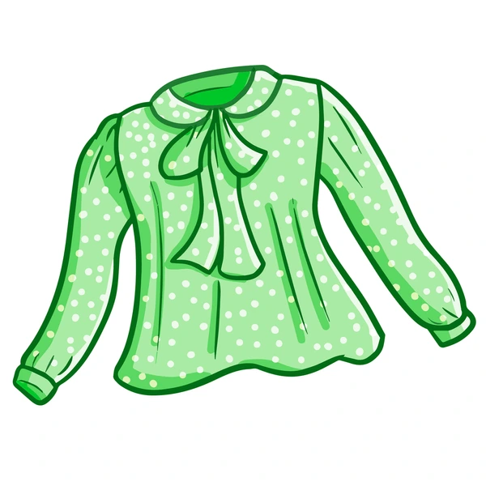
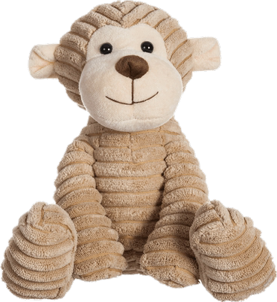
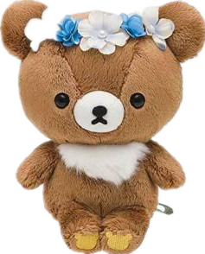

blouse
I wear a…………….
skirt
T-shirt
blouse

Slide 6
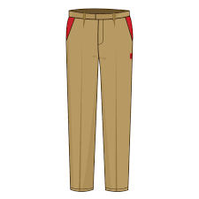
trousers
I wear …………….
trousers
jeans
shorts

Slide 7
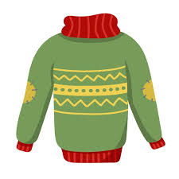
jumper
I wear a…………….
shirt
jumper
blouse

Slide 8
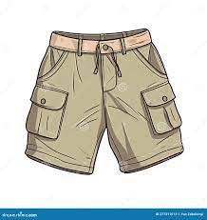
shorts
I wear …………….
skirt
shorts
trousers

