Slide 1

UNIT 14: STAYING HEALTHY
LESSON 1 ( 1, 2, 3)
Notes:
MADE BY FACEBOOK :TRAN THI THANH TAM

Slide 2
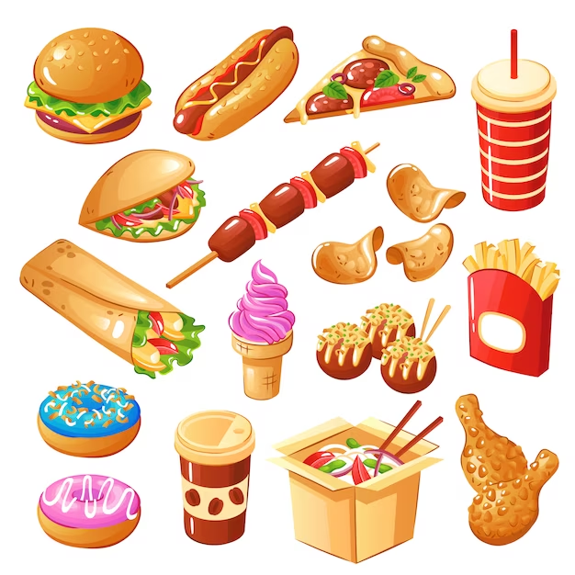
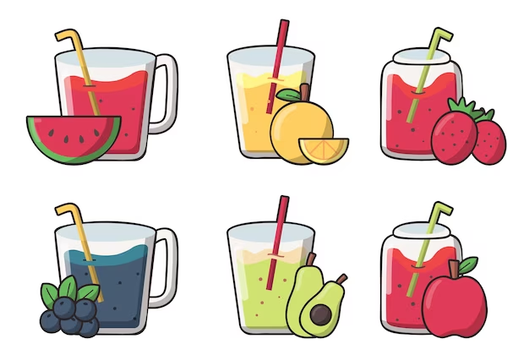
Which food is healthy and unhealthy? Let’s match
A
B
1. healthy
2. unhealthy
Notes:
MADE BY FACEBOOK :TRAN THI THANH TAM

Slide 3

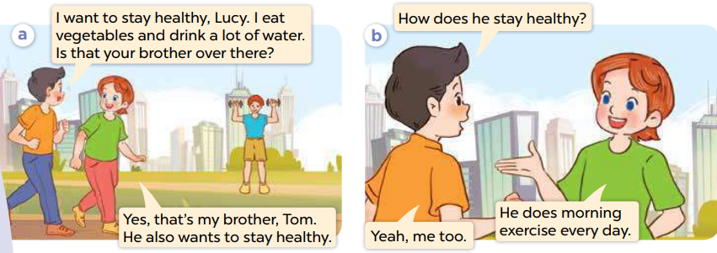
1.Look, listen and repeat
Notes:
MADE BY FACEBOOK :TRAN THI THANH TAM

Slide 4
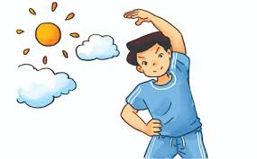
do morning exercise/duː ˈmɔːnɪŋ ˈeksəsaɪz/ : tập thể dục buổi sáng
Notes:
MADE BY FACEBOOK :TRAN THI THANH TAM

Slide 5
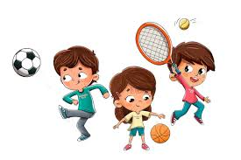
play sports/ˌpleɪ ˈspɔːts/: chơi thể thao
Notes:
MADE BY FACEBOOK :TRAN THI THANH TAM

Slide 6
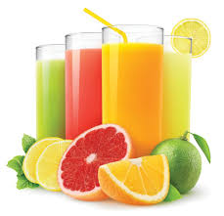
drink fresh juice/ drɪŋk freʃ dʒuːs/: uống nước ép trái cây tươi
Notes:
MADE BY FACEBOOK :TRAN THI THANH TAM

Slide 7
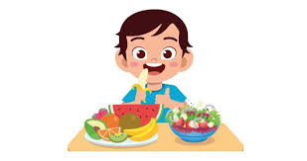
eat healthy food/ iːt ˈhelθi fuːd/
: ăn thức ăn có lợi cho sức khỏe
Notes:
MADE BY FACEBOOK :TRAN THI THANH TAM

Slide 8
VOCABULARY
Do morning exercise:tập thể dục buổi sáng
Play sports: chơi thể thao
Drink fresh juice: uống nước trái cây tươi
Eat healthy food: ăn thức ăn lành mạnh

Slide 9
1.Play sports
A
2.Drink fresh juice
B
3.Eat healthy food
C
4. Do morning exercise
D
Notes:
MADE BY FACEBOOK :TRAN THI THANH TAM

Slide 10
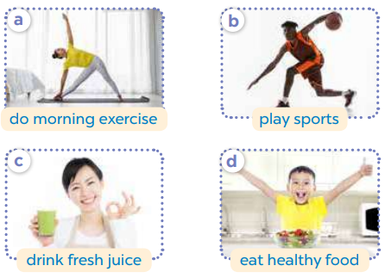
2.Listen, point and say
she
How does ......... stay healthy?
does morning exerccise
He....................…..................
Notes:
MADE BY FACEBOOK :TRAN THI THANH TAM

