Slide 1

UNIT 14:STAYING HEALTHY
LESSON 1 (4, 5, 6)
Notes:
MADE BY FACEBOOK :TRAN THI THANH TAM

Slide 2

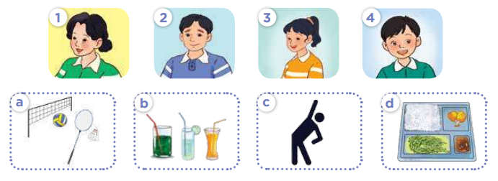
4. Listen and match
Notes:
MADE BY FACEBOOK :TRAN THI THANH TAM

Slide 3
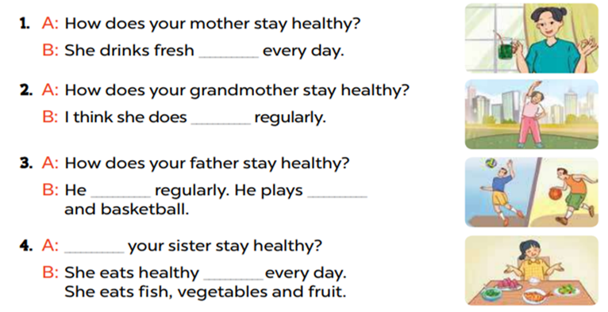
5. Read and complete
juice
morning exercise
plays sports
volleyball
How does
food
Notes:
MADE BY FACEBOOK :TRAN THI THANH TAM

Slide 4
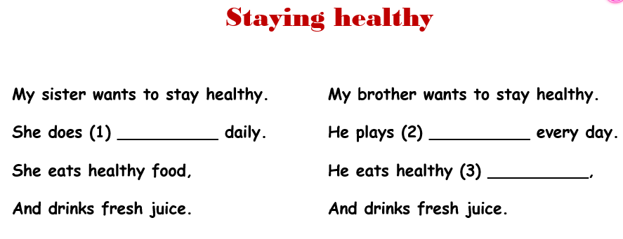
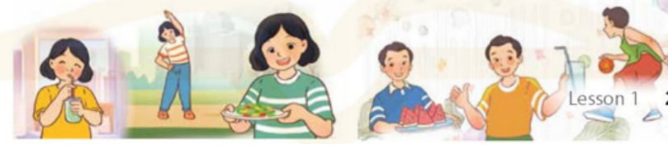
6. Listen, complete and sing
morning exercise
sports
fruits
Notes:
MADE BY FACEBOOK :TRAN THI THANH TAM

Slide 5


Thank you very much
Good bye! See you again!
Notes:
MADE BY FACEBOOK :TRAN THI THANH TAM

