Slide 1

UNIT 14:STAYING HEALTHY
LESSON 3 (1, 2, 3)
Notes:
MADE BY FACEBOOK :TRAN THI THANH TAM

Slide 2

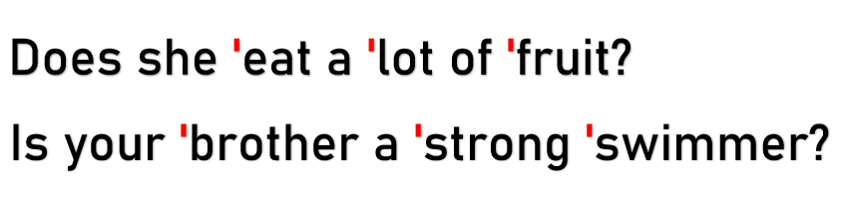
1.Listen and repeat
Notes:
MADE BY FACEBOOK :TRAN THI THANH TAM

Slide 3
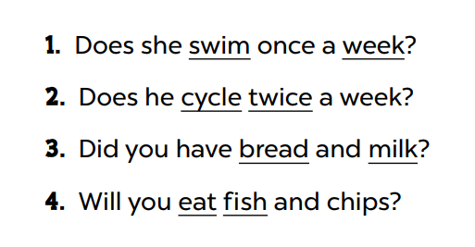
2. Listen and underline one more stressed word. Then repeat
Notes:
MADE BY FACEBOOK :TRAN THI THANH TAM

Slide 4
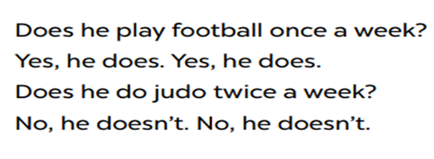
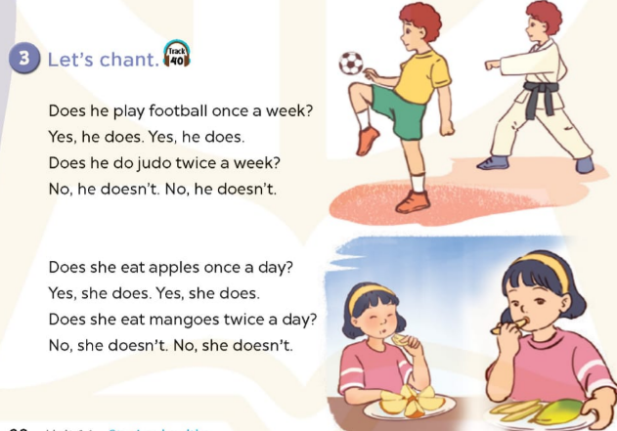
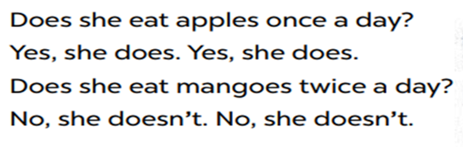
3. Let’s chant
Notes:
MADE BY FACEBOOK :TRAN THI THANH TAM

