Slide 1


UNIT 14: STAYING HEALTHY
LESSON 3 ( 4, 5, 6)

Slide 2
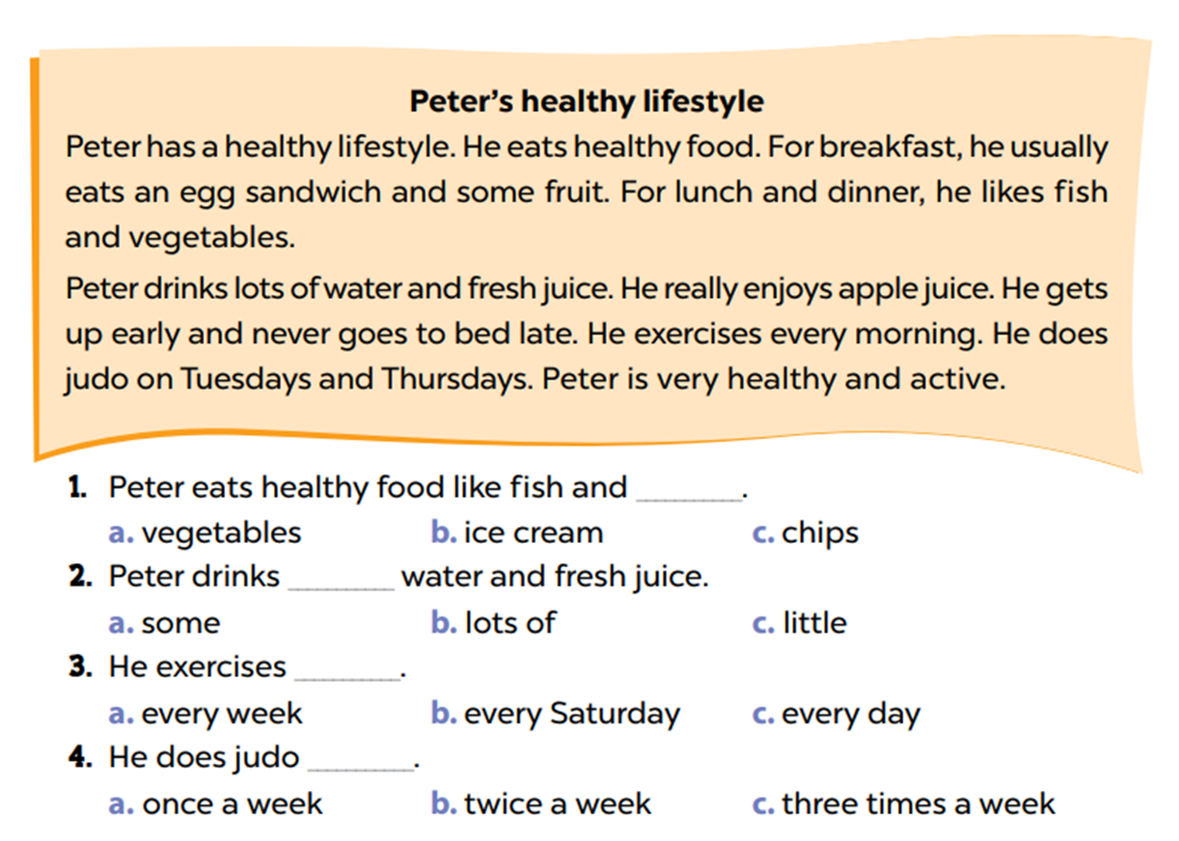
4. Read and circle
Notes:
MADE BY FACEBOOK :TRAN THI THANH TAM

Slide 3
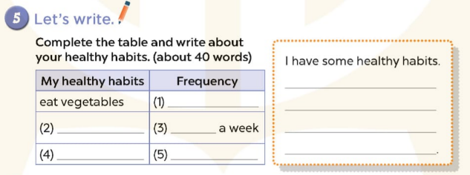
every day
do yoga
twice
drink fresh juice
Three times a week
Notes:
MADE BY FACEBOOK :TRAN THI THANH TAM

Slide 4



Write about your healthy habits (about 40 words)
I have some healthy habits. I eat vegetables every day. I do yoga twice a week. I drink fresh juice three times a week. How about you. How do you stay healthy?
Notes:
Step 4: Get pupils to swap their books with a partner and check their answers before checking as a class.

Slide 5
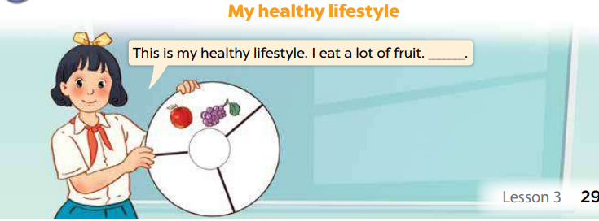
6. Project
Notes:
MADE BY FACEBOOK :TRAN THI THANH TAM

